Slide 1

10 Arrow Function
Peter H. Chen

Slide 2
10 Arrow Function
https://www.youtube.com/watch?v=4N-L3Mmzu0Y&list=PLC3y8-rFHvwhI0V5mE9Vu6Nm-nap8EcjV&index=10
Arrow Function
Arrow Function provides a short and concise syntax for functions.
Arrow function also simplified the behavior of the ‘this’ keyword in JavaScript.

Slide 3
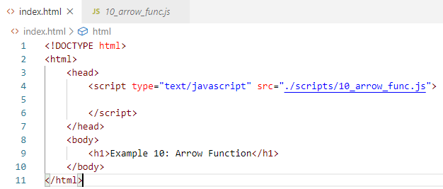
10 Arrow Function
https://www.youtube.com/watch?v=4N-L3Mmzu0Y&list=PLC3y8-rFHvwhI0V5mE9Vu6Nm-nap8EcjV&index=10
Arrow Function
Create index.html:

Slide 4
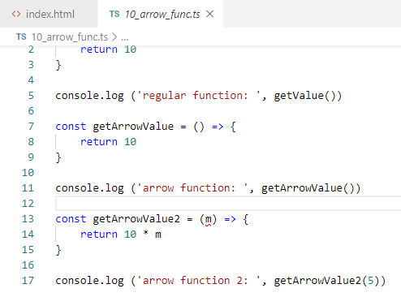
10 Arrow Function
https://www.youtube.com/watch?v=4N-L3Mmzu0Y&list=PLC3y8-rFHvwhI0V5mE9Vu6Nm-nap8EcjV&index=10
Arrow Function
Create 10_arrow_func.ts:
Control+shit+B: translate TS into JS.

Slide 5
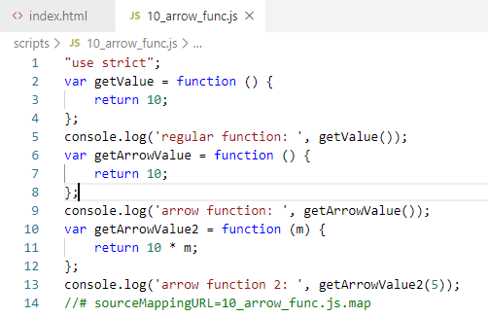
10 Arrow Function
https://www.youtube.com/watch?v=4N-L3Mmzu0Y&list=PLC3y8-rFHvwhI0V5mE9Vu6Nm-nap8EcjV&index=10
Arrow Function
Translate 10_arrow_func.js

Slide 6
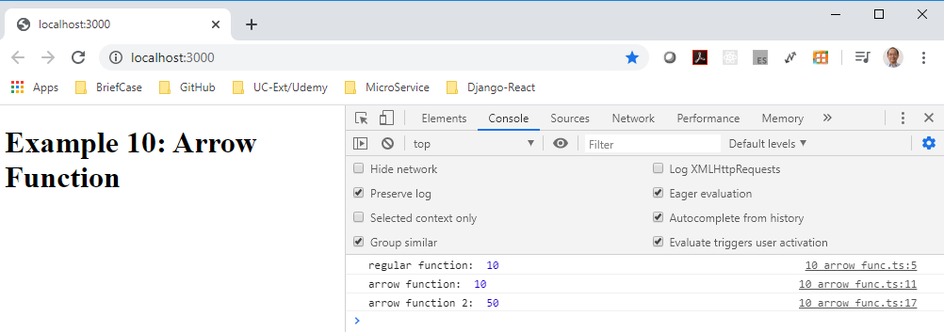
10 Arrow Function
https://www.youtube.com/watch?v=4N-L3Mmzu0Y&list=PLC3y8-rFHvwhI0V5mE9Vu6Nm-nap8EcjV&index=10
Arrow Function
> lite-server

Slide 7
End of Chapter

