Slide 1

5 var Scope
Peter H. Chen

Slide 2
5 var Scope
https://www.youtube.com/watch?v=izlLVx_dTH0&list=PLC3y8-rFHvwhI0V5mE9Vu6Nm-nap8EcjV&index=5
Var Scope:
What is the problem of ES5? Why do we need new features of ES6?

Slide 3
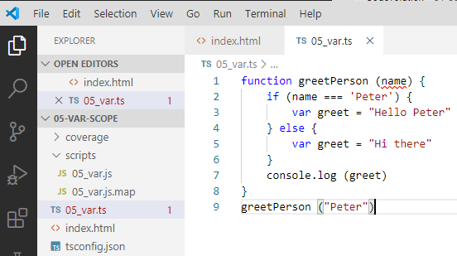
5 var Scope
https://www.youtube.com/watch?v=izlLVx_dTH0&list=PLC3y8-rFHvwhI0V5mE9Vu6Nm-nap8EcjV&index=5
Var Scope:
Create a file “05_var.ts” for TypeScript.

Slide 4
5 var Scope
https://www.youtube.com/watch?v=izlLVx_dTH0&list=PLC3y8-rFHvwhI0V5mE9Vu6Nm-nap8EcjV&index=5
Var Scope:
> CONTROL+SHIFT+B
> select Build: tsconfig.json

Slide 5
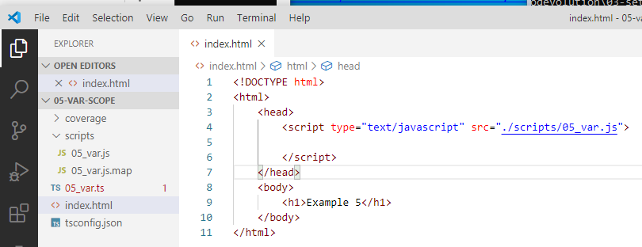
5 var Scope
https://www.youtube.com/watch?v=izlLVx_dTH0&list=PLC3y8-rFHvwhI0V5mE9Vu6Nm-nap8EcjV&index=5
Var Scope:
Create “index.html” and call transpile JavaScript “./Scripts/05_var.js”

Slide 6
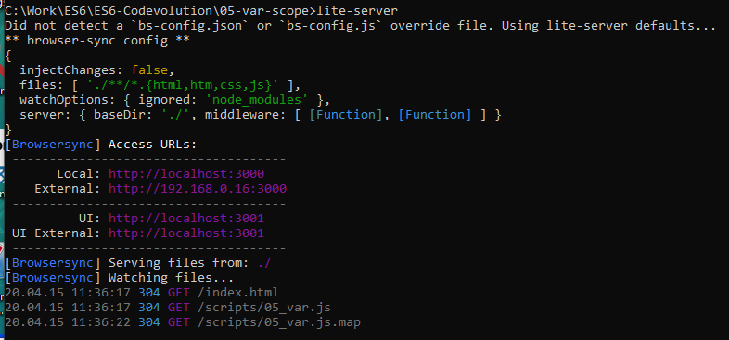
5 var Scope
https://www.youtube.com/watch?v=izlLVx_dTH0&list=PLC3y8-rFHvwhI0V5mE9Vu6Nm-nap8EcjV&index=5
Var Scope:
> lite-server

Slide 7
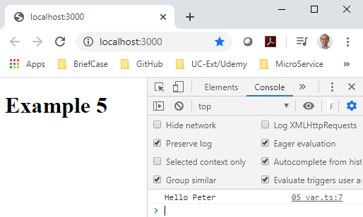
5 var Scope
https://www.youtube.com/watch?v=izlLVx_dTH0&list=PLC3y8-rFHvwhI0V5mE9Vu6Nm-nap8EcjV&index=5
Var Scope:
> lite-server

Slide 8
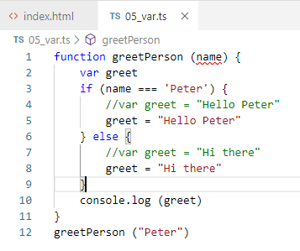
5 var Scope
https://www.youtube.com/watch?v=izlLVx_dTH0&list=PLC3y8-rFHvwhI0V5mE9Vu6Nm-nap8EcjV&index=5
Var Scope:
It is working fine.
For JavaScript, declared “var greet” twice is called hoisting (variable elevation) and fine.
For other languages, we need just declare once as follow.

Slide 9
5 var Scope
https://www.youtube.com/watch?v=izlLVx_dTH0&list=PLC3y8-rFHvwhI0V5mE9Vu6Nm-nap8EcjV&index=5
Var Scope:
Var is functional scope.
https://www.geeksforgeeks.org/difference-between-var-and-let-in-javascript/
RS6 uses let for block scope and var for functional scope.

Slide 10
End of Chapter

