Slide 1

13 Rest Operator
Peter H. Chen

Slide 2
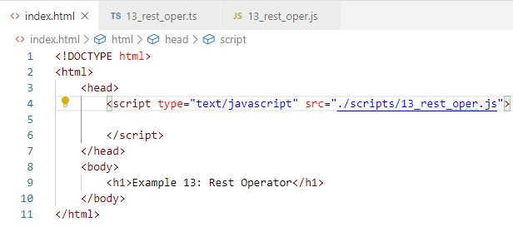
13 Rest Operator
https://www.youtube.com/watch?v=TK0xDoQ4UKA&list=PLC3y8-rFHvwhI0V5mE9Vu6Nm-nap8EcjV&index=13
Rest Operator (…)
Create index.html

Slide 3
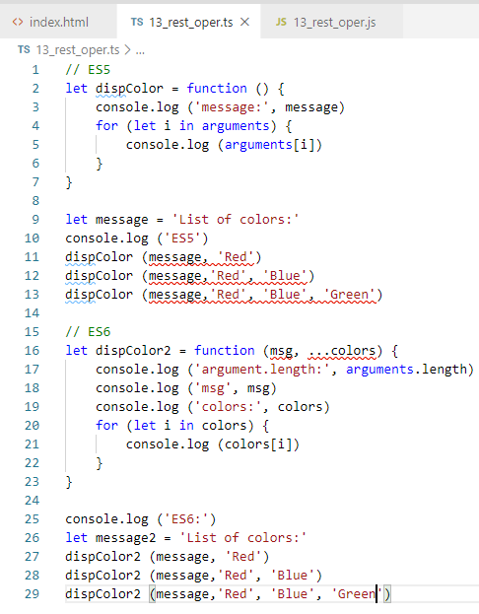
13 Rest Operator
https://www.youtube.com/watch?v=TK0xDoQ4UKA&list=PLC3y8-rFHvwhI0V5mE9Vu6Nm-nap8EcjV&index=13
Rest Operator (…)
Rest Operator (…) extract the separated elements into a array.

Slide 4
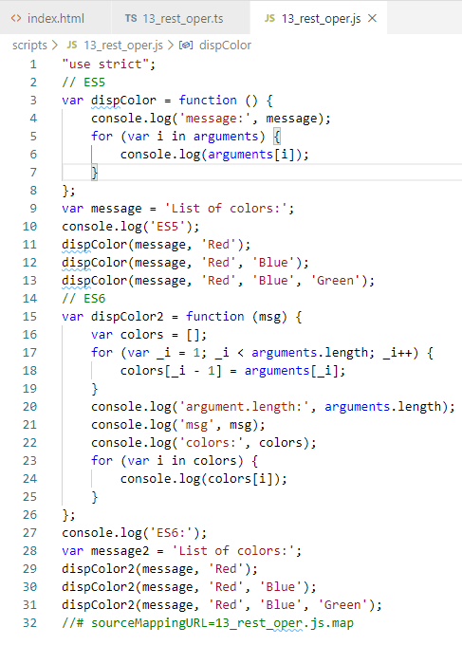
13 Rest Operator
https://www.youtube.com/watch?v=TK0xDoQ4UKA&list=PLC3y8-rFHvwhI0V5mE9Vu6Nm-nap8EcjV&index=13
Rest Operator (…)
CONTROL+SHIFT+B
Transpile JavaScript:
The passed in item remain no changes.
The rest operator is translates array into arguments.

Slide 5
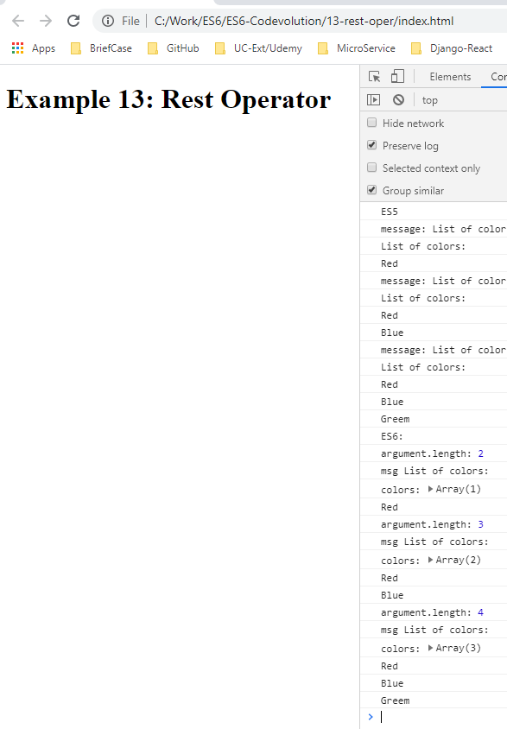
11 this Keyword
https://www.youtube.com/watch?v=TK0xDoQ4UKA&list=PLC3y8-rFHvwhI0V5mE9Vu6Nm-nap8EcjV&index=13
This keyword
> lite-server

Slide 6
End of Chapter

