Slide 1

14 Spread Operator
Peter H. Chen

Slide 2
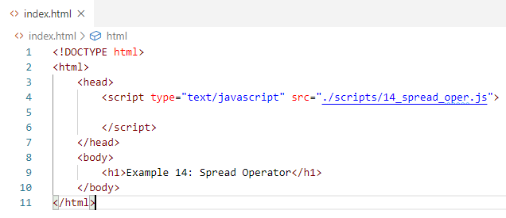
14 Spread Operator
https://www.youtube.com/watch?v=Fc6DPYx9aQU&list=PLC3y8-rFHvwhI0V5mE9Vu6Nm-nap8EcjV&index=14
Spread Operator:
Spread operator split the array into individual element. It is opposite of Rest Operator in the passing parameter which is assembly the element into the array.

Slide 3
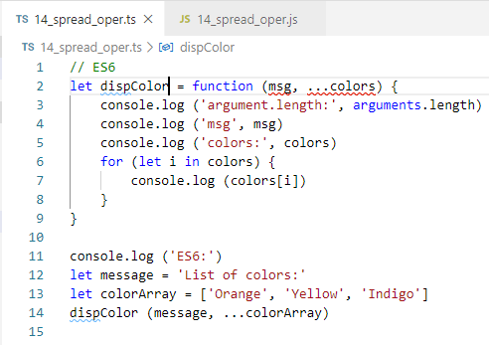
14 Spread Operator
https://www.youtube.com/watch?v=TK0xDoQ4UKA&list=PLC3y8-rFHvwhI0V5mE9Vu6Nm-nap8EcjV&index=13
Spread Operator (…)
Rest Operator (…) assemble the passing elements into array.
Spread Operator (…) extract the array into separated elements.

Slide 4
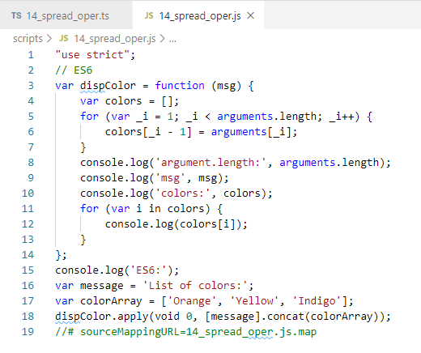
14 Spread Operator
https://www.youtube.com/watch?v=TK0xDoQ4UKA&list=PLC3y8-rFHvwhI0V5mE9Vu6Nm-nap8EcjV&index=13
Rest Operator (…)
CONTROL+SHIFT+B
Transpile JavaScript:

Slide 5
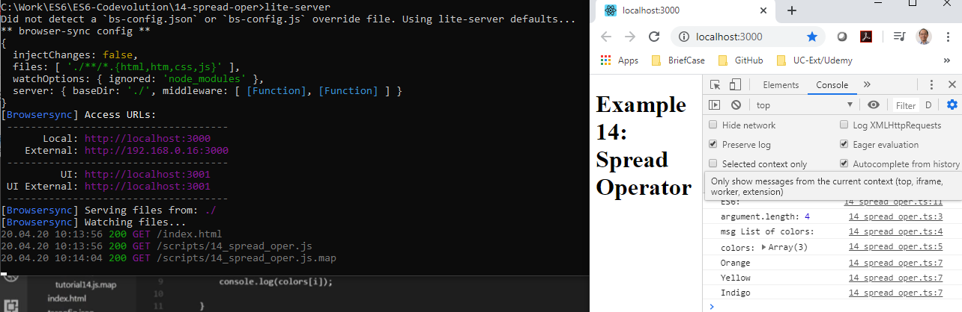
11 this Keyword
https://www.youtube.com/watch?v=TK0xDoQ4UKA&list=PLC3y8-rFHvwhI0V5mE9Vu6Nm-nap8EcjV&index=13
This keyword
> lite-server

Slide 6
End of Chapter

