Slide 1

15 Object Literal
Peter H. Chen

Slide 2
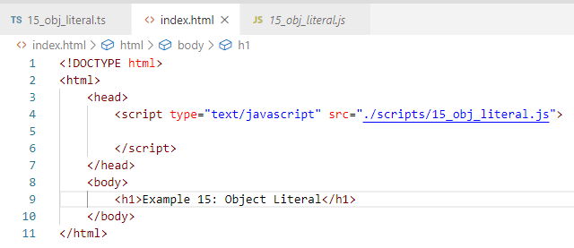
15 Object Literal
https://www.youtube.com/watch?v=fgoNcYHxfdM&list=PLC3y8-rFHvwhI0V5mE9Vu6Nm-nap8EcjV&index=15
Object Libteral
Create index.html

Slide 3
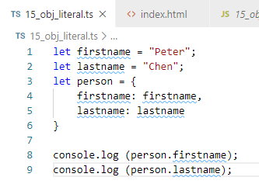
15 Object Literal
https://www.youtube.com/watch?v=fgoNcYHxfdM&list=PLC3y8-rFHvwhI0V5mE9Vu6Nm-nap8EcjV&index=15
Object Literal:
The “person = { … }” is called the object literal

Slide 4
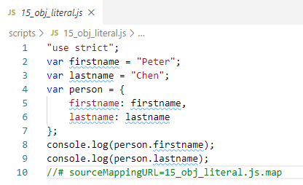
15 Object Literal
https://www.youtube.com/watch?v=fgoNcYHxfdM&list=PLC3y8-rFHvwhI0V5mE9Vu6Nm-nap8EcjV&index=15
Rest Operator (…)
CONTROL+SHIFT+B
Transpile JavaScript:

Slide 5
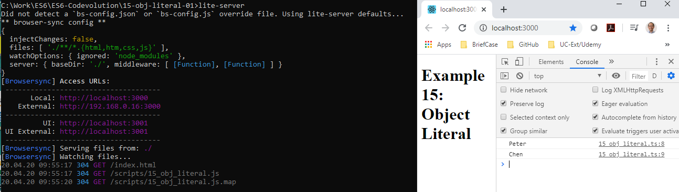
11 this Keyword
https://www.youtube.com/watch?v=fgoNcYHxfdM&list=PLC3y8-rFHvwhI0V5mE9Vu6Nm-nap8EcjV&index=15
This keyword
> lite-server

Slide 6
End of Chapter

