Slide 1

11 this Keyword
Peter H. Chen

Slide 2
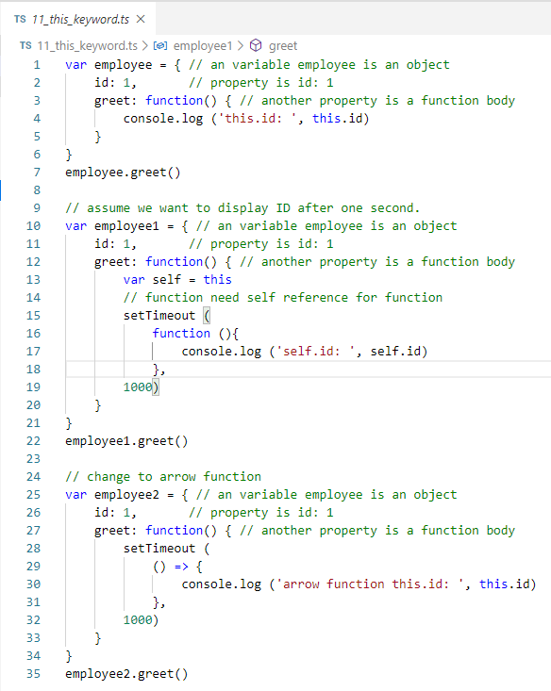
11 this Keyword
calendar.google.com/calendar/r?tab=rc
This keyword
Create 11_this_keyword.ts:
var employee = {
id: 1
function() { this.id }
}
‘this’ keyword is inside the object employee.
function and ‘this’ keyword are in the same scope. function can access ‘this.id’

Slide 3
11 this Keyword
calendar.google.com/calendar/r?tab=rc
This keyword
var emp1 = {
id: 1
function () {
self = this
setTimeout (function () {
self.id }
, 1000})
}
}
setTime() create another level of function.
function cannot access ‘this’ any more.
Inside function(), we create another reference ‘self’

Slide 4
11 this Keyword
calendar.google.com/calendar/r?tab=rc
This keyword
var emp2 = {
id: 1
function () {
setTimeout (() => {
this.id }
, 1000})
}
}
When we look at the JavaScript, the transpile create _this = this for us to reference.
We can directly use ‘this.id’

Slide 5
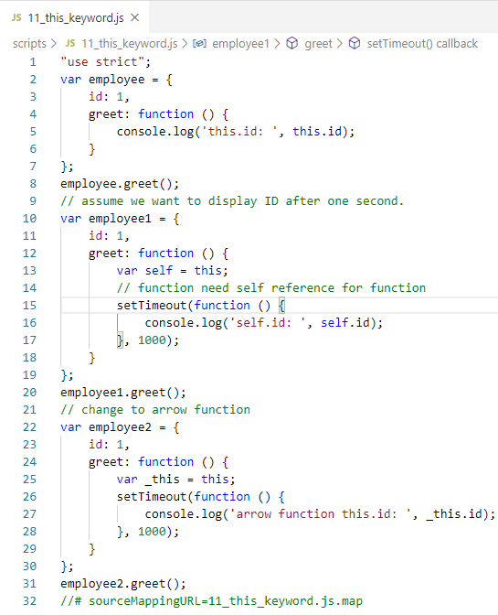
11 this Keyword
calendar.google.com/calendar/r?tab=rc
This keyword:
> CONTROL+SHIFT+B:
Transpile result:
function () {
var _this = this;
setTimeout (function () {
console.log (_this.id)
}, 1000);
}

Slide 6
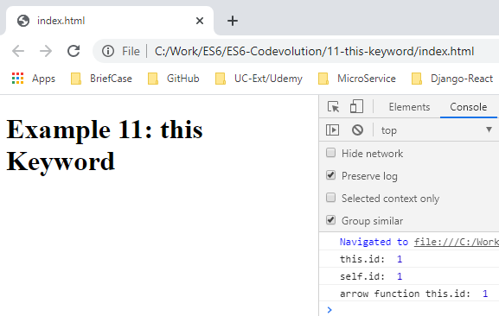
11 this Keyword
calendar.google.com/calendar/r?tab=rc
This keyword
> lite-server

Slide 7
11 this Keyword
calendar.google.com/calendar/r?tab=rc
This keyword
Using the arrow function has two benefit:
Make the code shorter
Access ‘this’ keyword without extra reference. The Traspile create _this = this for you to refere _this.

Slide 8
End of Chapter

