Slide 1

12 IntelliJ
Peter H. Chen

Slide 2
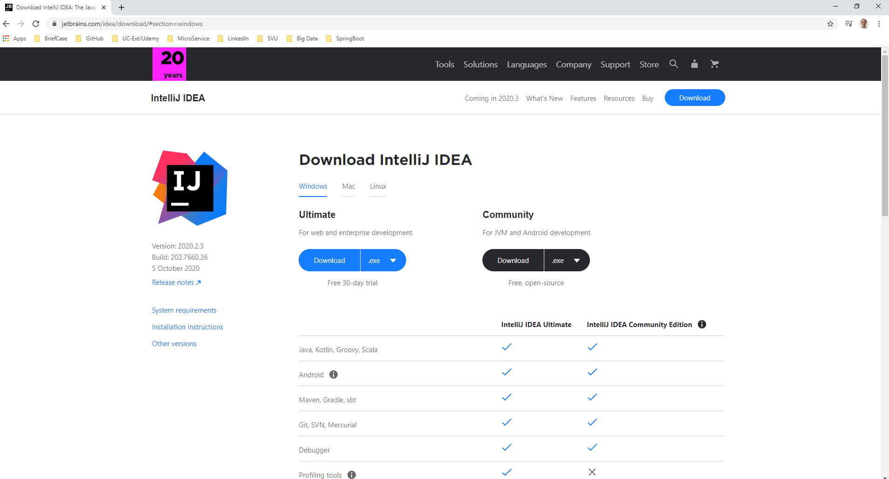
12 IntelliJ
https://www.youtube.com/watch?v=27I1M5RLplE
Download the IntelliJ Community version.
IntelliJ community version is free but have restriction to start with the Spring Boot, i.e., Spring Initializr to generate the JAR file for you. That is the only restriction.

Slide 3
12.1 Spring Boot

Slide 4
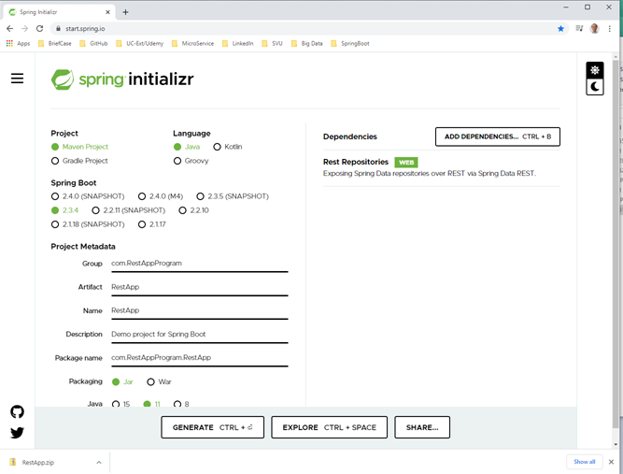
12.1 Spring Boot
https://www.youtube.com/watch?v=27I1M5RLplE
Go to https://start.spring.io/
Select Dependency “Spring Web”.

Slide 5
12.2 Start IntelliJ and Open Project

Slide 6
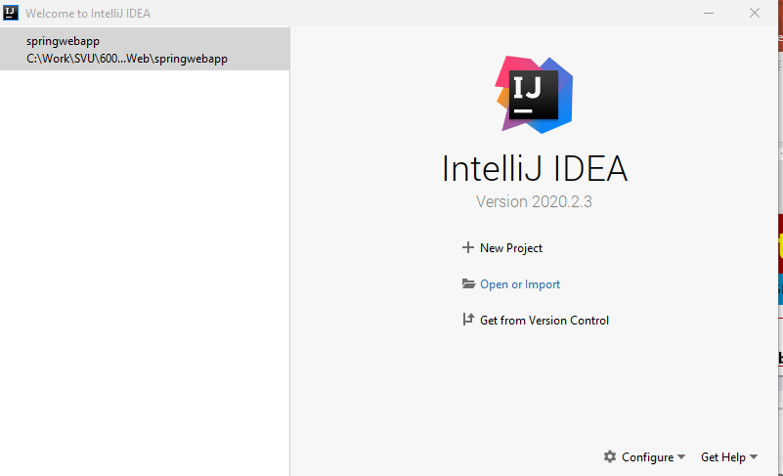
12.2 Start IntelliJ
https://www.youtube.com/watch?v=27I1M5RLplE
Start IntelliJ.
Close the existing project if your already open the project.
Import the project

Slide 7
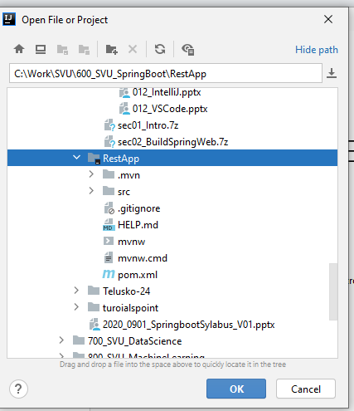
12.2 Start IntelliJ
https://www.youtube.com/watch?v=27I1M5RLplE
import Project “RestApp” (with .mvn, src folders as below). Click “OK”

Slide 8
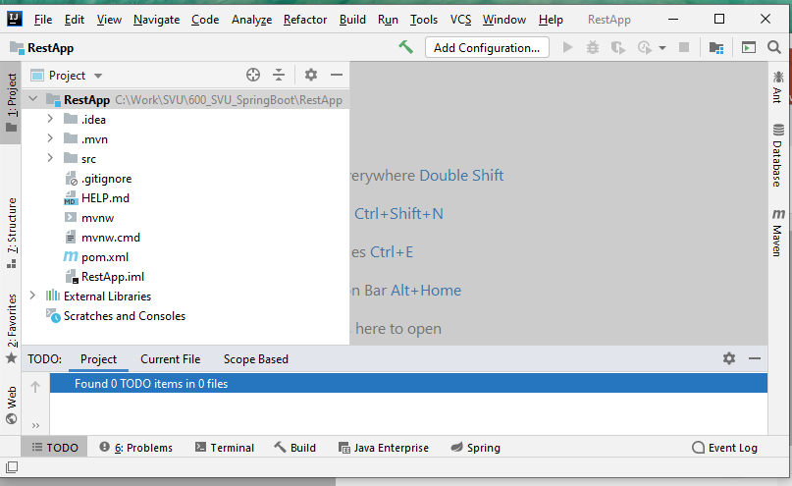
12.2 Start IntelliJ
https://www.youtube.com/watch?v=27I1M5RLplE
The RestApp Empty Project: There are RestApp Project folder (.isea, .mvn, src) and External Libraries folder.

Slide 9
12.3 Setup JDK

Slide 10
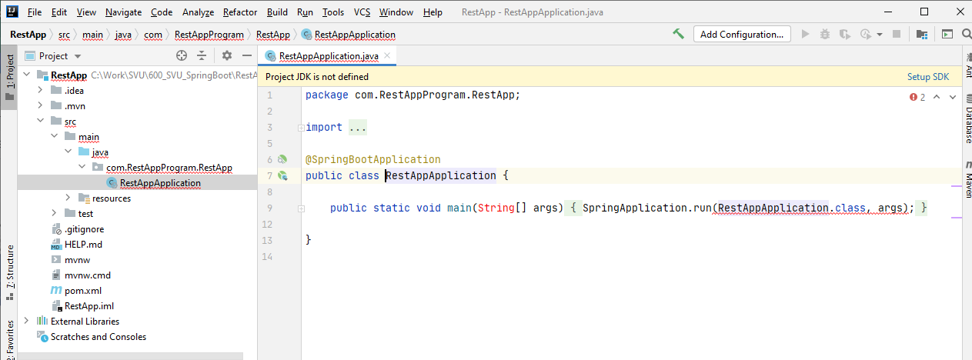
12.3 Setup JDK
https://www.youtube.com/watch?v=27I1M5RLplE
Expand the Main/java folder.
There is a package folder with Java application file.
There is a wire annotation “@SpringBootApplication”.
The annotation is the boiler place contains codes inject from external dependency and compile into the java application.
Note: Below there is error message shows “Project JDK is not defined”. Click it and select “C:\Program Files\Java\jdk-11.0.8”

Slide 11
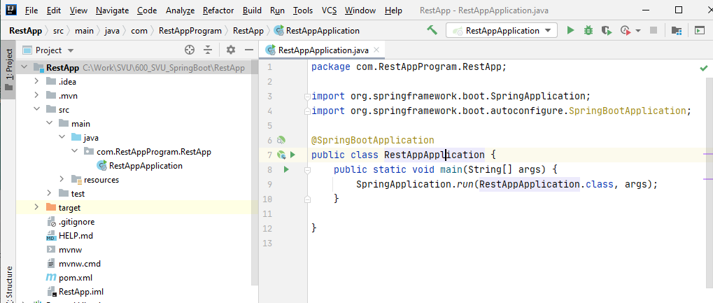
12.3 Setup JDK
https://www.youtube.com/watch?v=27I1M5RLplE
Expand the Main/java folder.
Separate the main () into separate lines for easier reading.

Slide 12
12.4 Run RestApp on Port 8080

Slide 13
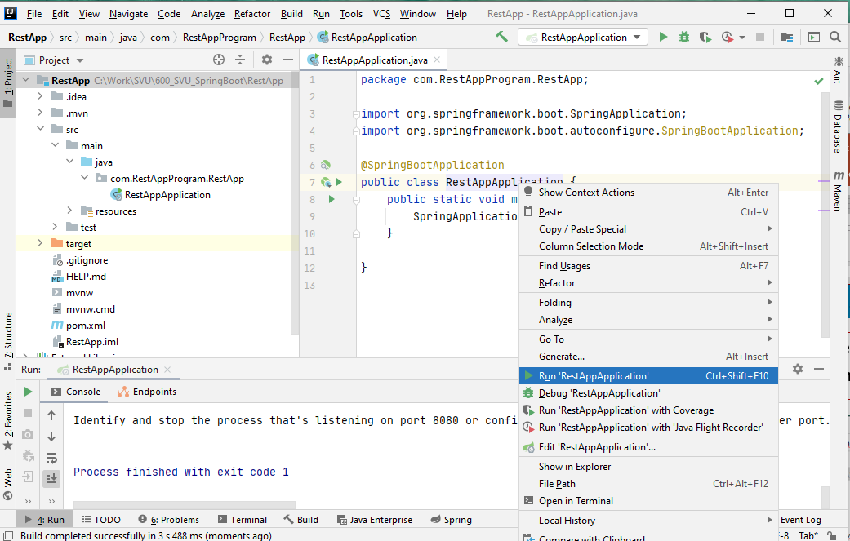
12.4 Run RestApp on Port 8080
https://www.youtube.com/watch?v=27I1M5RLplE
Expand the Main/java folder.
RMB: Select “Run”

Slide 14
12.5 Configure Port 8081

Slide 15
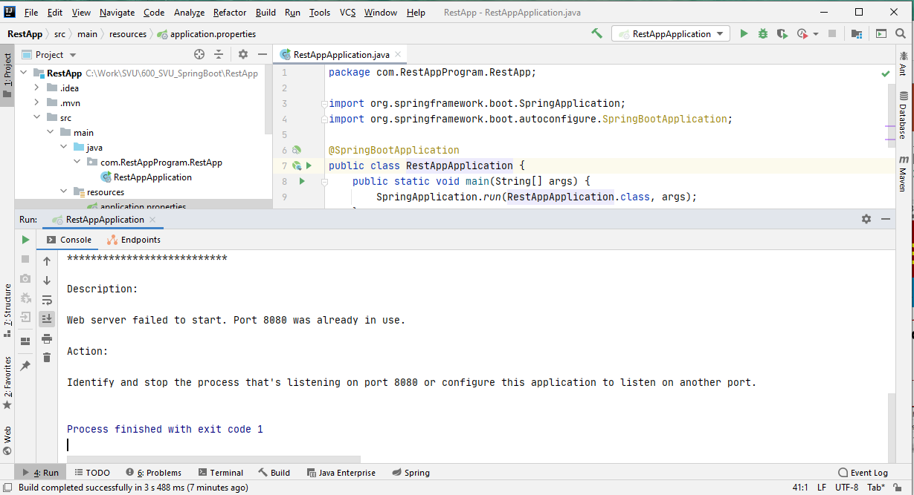
12.5 Configure Port 8081
https://www.youtube.com/watch?v=27I1M5RLplE
Port 8080 is being used.
We need to use other port, such as, 8091.

Slide 16
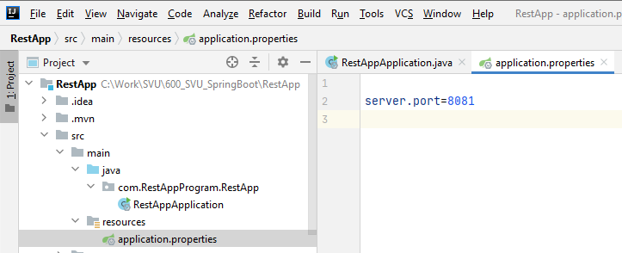
12.5 Configure Port 8081
https://www.youtube.com/watch?v=27I1M5RLplE
Port 8080 is being used.
We need to use other port, such as, 8081.

Slide 17
12.6 Run RestApp on Port 8081

Slide 18
12.6 Run RestApp on Port 8081
https://www.youtube.com/watch?v=27I1M5RLplE
Rerun again with port 8081:

Slide 19
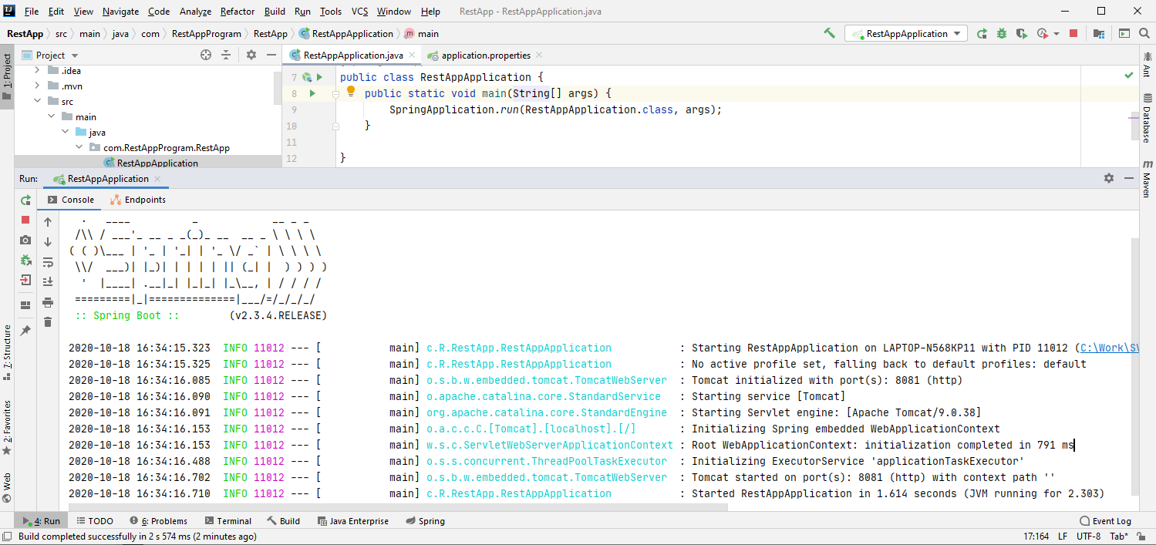
12.6 Run RestApp on Port 8081
https://www.youtube.com/watch?v=27I1M5RLplE
Spring boot is running fine with REST Services.

Slide 20
12.7 Create HelloWorld Class

Slide 21
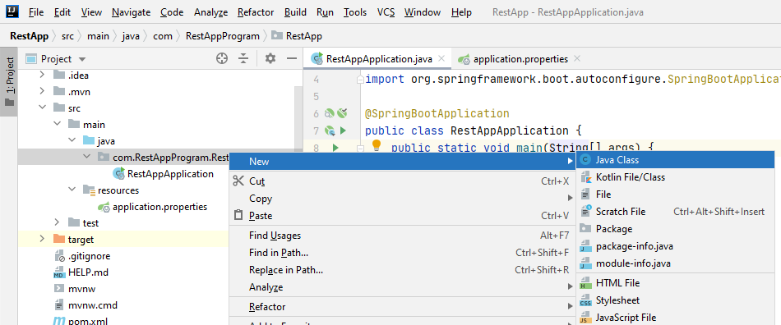
12.7 Create HelloWorld Class
https://www.youtube.com/watch?v=27I1M5RLplE
Click Package “com.RestAppProgram.RestApp”:
RMB: Create New Java Class “HelloWorld”.

Slide 22
12.8 Add Rest Controller Annotation

Slide 23
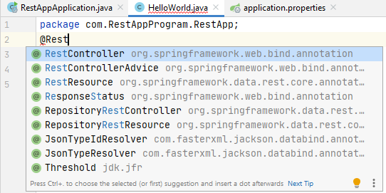
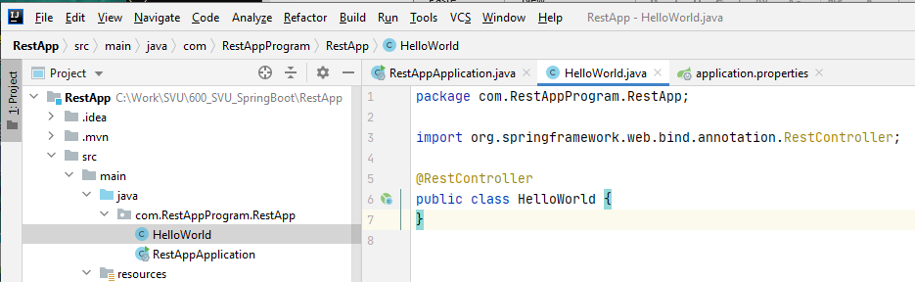
12.8 Add Rest Controller Annotation
https://www.youtube.com/watch?v=27I1M5RLplE
Add “@RestController” before “public class HelloWorld”.
The associated dependency is imported.

Slide 24
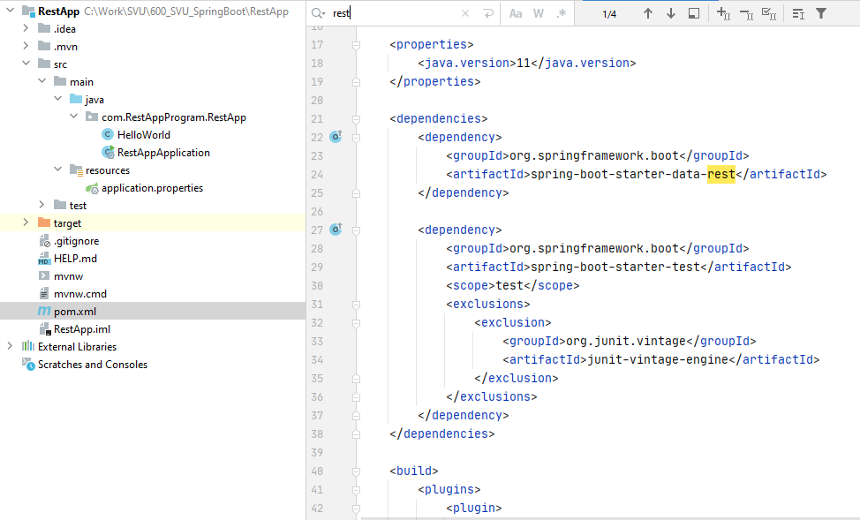
12.8 Add Rest Controller Annotation
https://www.youtube.com/watch?v=27I1M5RLplE
If we look at the pom.xml file, we can see the specified dependencies.

Slide 25
12.9 Add Request Mapping Annotation

Slide 26
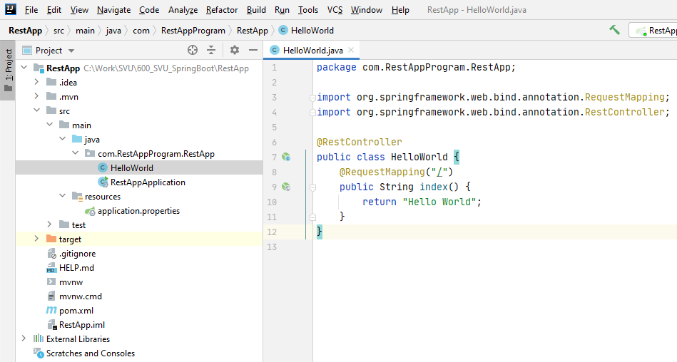
12.9 Add Request Mapping Annotation
https://www.youtube.com/watch?v=27I1M5RLplE
In HelloWorld class, add
> @RequestMapping(“/”)
> public String index() {
> return “Hello World”;
>}

Slide 27
12.10 Rerun RestApp with Rest API

Slide 28
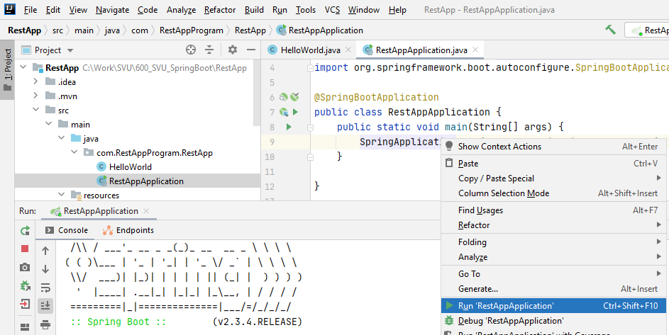
12.10 Rerun RestApp with Rest API
https://www.youtube.com/watch?v=27I1M5RLplE
Rerun Application

Slide 29
12.11 Verify

Slide 30
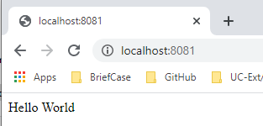
12.11 Verify
https://www.youtube.com/watch?v=27I1M5RLplE
Open Chrome:
> localhost:8081

Slide 31
12.12 Restart/Rerun RestApp

Slide 32
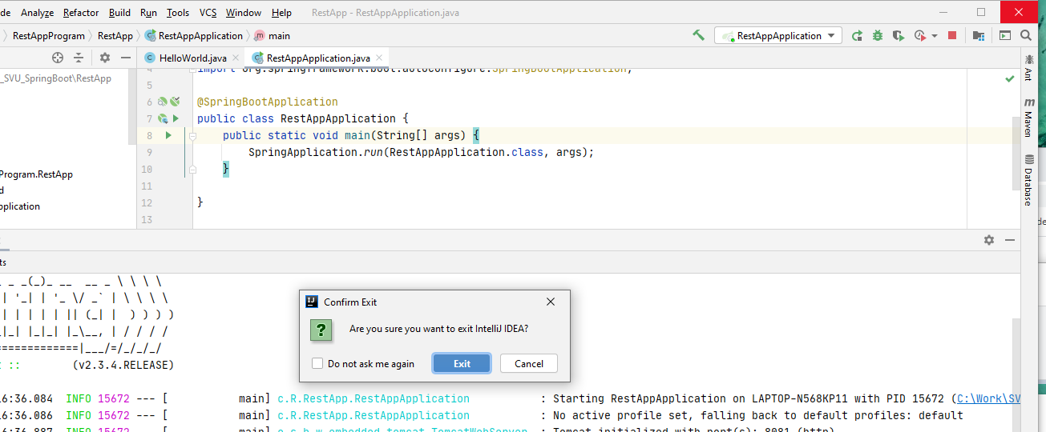
12.12 Restart/Rerun RestApp
https://www.youtube.com/watch?v=27I1M5RLplE
Close IntelliJ
Click “Exit”

Slide 33
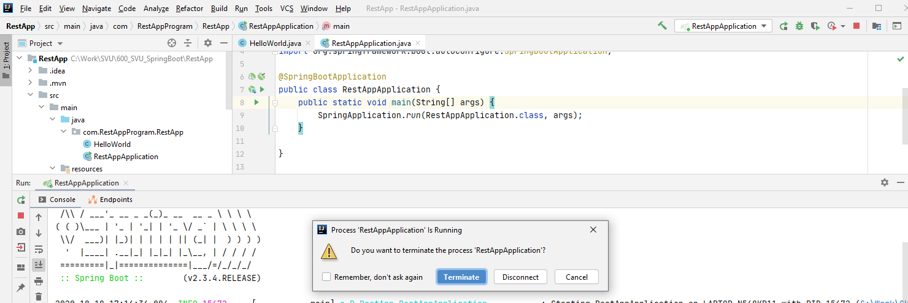
12.12 Restart/Rerun RestApp
https://www.youtube.com/watch?v=27I1M5RLplE
Click “Terminate”

Slide 34
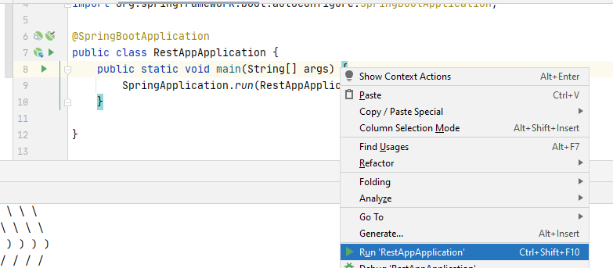
12.12 Restart/Rerun RestApp
https://www.youtube.com/watch?v=27I1M5RLplE
Start IntelliJ again.
Rerun RestApp Application.

Slide 35
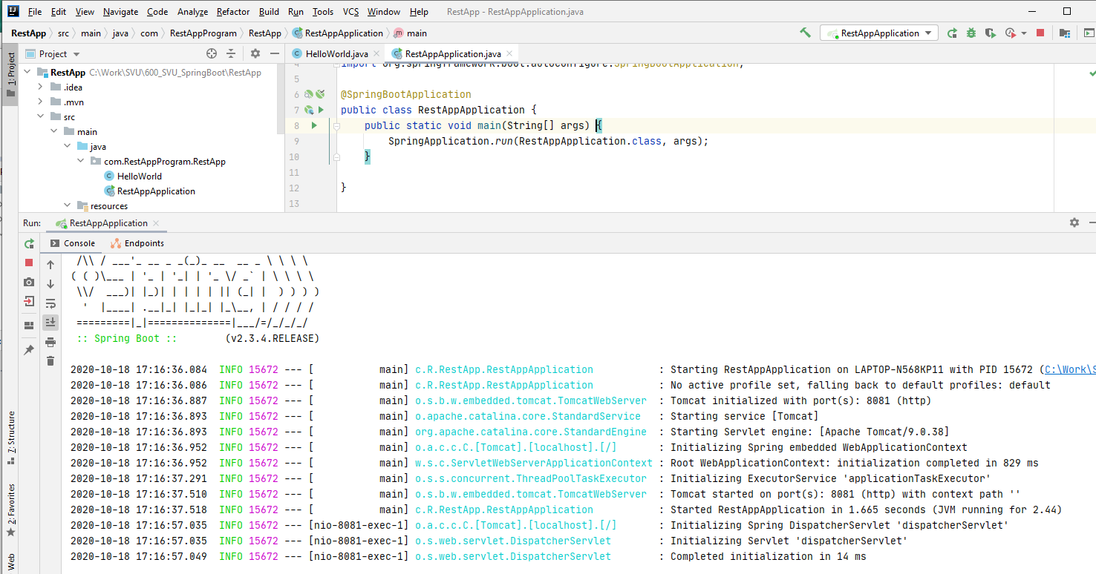
12.12 Restart/Rerun RestApp
https://www.youtube.com/watch?v=27I1M5RLplE
Make sure no error message.

Slide 36
12.12 Restart/Rerun RestApp
https://www.youtube.com/watch?v=27I1M5RLplE
Open Chrome:
> localhost:8081

Slide 37
End of Chapter

