Slide 1
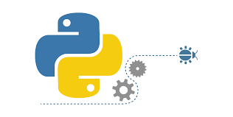
Docker, Python, GUI Programming
Peter H. Chen

Slide 2
00 Python Data Science
https://github.com/peterhchen/300_SVU_DataScience
Course Description
This course is an introductory course on fundamentals of Python programming and data structures. It covers the following:
Part 1: Docker
Sec 1: VirtualBox/Ubuntu Setup, Basics, Architecture, Advantage, Setup
Sec 2: Docker Command
Sec 3: Docker Image and Container
Sec 4: Docker Jenkins and Dockerfile
Sec 5: Dockerized API and Composer
Sec 6: Docker Volume and Python API
Sec 7: Docker Swarm
Sec 8: Docker Container Communication
Sec 9: Docker Network
Sec 10: Kubernetes
Sec 11: Prometheus

Slide 3
00 Python Data Science
https://github.com/peterhchen/300_SVU_DataScience
Course Description
Part 2: GUI
Sec 12: Hello, Grid, Entry, Calculator
Sec 13: Icon, Image View, Status Bar
Sec 14: Frame, Button, Radio, Text Box, Window, Open File Dialog
Sec 15: Matplotlib plot and Seaborn

Slide 4
End of Chapter

