Slide 1

0 VirtualBox and Ubuntu
Peter H. Chen

Slide 2
0 VirtualBox and Ubuntu
https://www.youtube.com/watch?v=x5MhydijWmc
VirtualBox and Ubuntu
We will install VirtualBox and Ubuntu in this discussion.

Slide 3
0.1 Download/Install VirtualBox

Slide 4
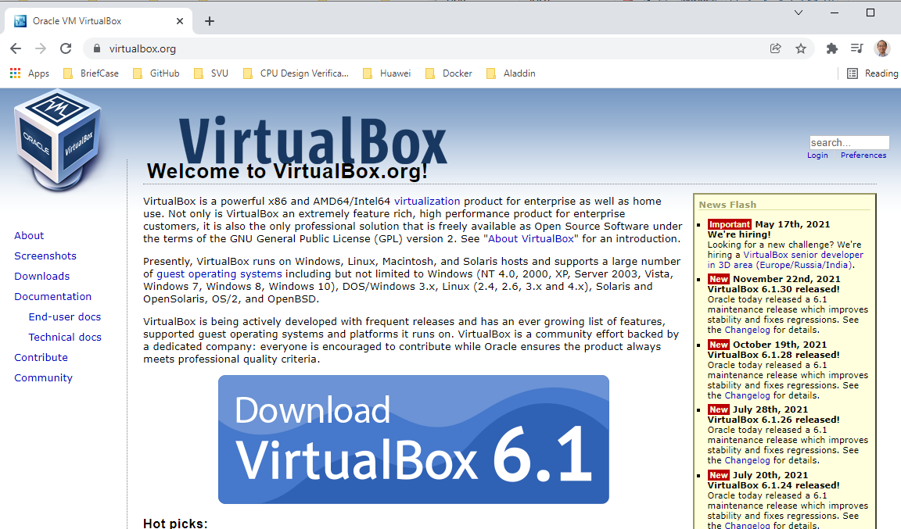
0.1 Download/Install VirtualBox
https://www.youtube.com/watch?v=x5MhydijWmc
Download Virtual Box
VirtualBox is a tool which will enable you to run different Operating systems.
We will use Linux Ubuntu for Docker/Kubernetrs discussion.
Go to https://www.virtualbox.org/
Download the VirtualBox.

Slide 5

0.1 Download/Install VirtualBox
https://www.youtube.com/watch?v=x5MhydijWmc
Download/Install VirtualBox
After VirtualBox is installed, you should get “OracleVM VirtualBox” on your desktop.

Slide 6
0.2 Download Ubuntu

Slide 7
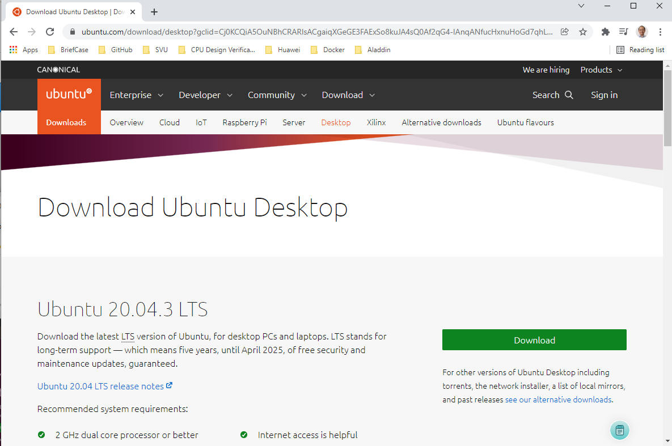
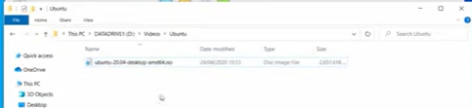
0.2 Download Ubuntu
https://www.youtube.com/watch?v=x5MhydijWmc
Download Ubuntu
Download Ubuntu iso image file.
It will takes 10 minutes to download.
Once we download, we have Ubuntu image as below.

Slide 8
0.3 New Ubuntu

Slide 9
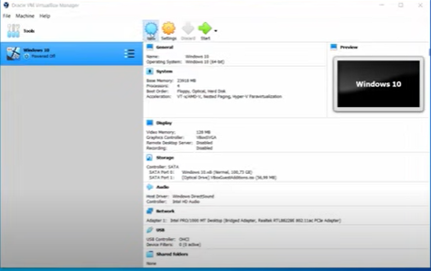
0.3 New Ubuntu
https://www.youtube.com/watch?v=x5MhydijWmc
Download/Install VirtualBox
Double click “VirtualBox”, we will have the VirtualBox main window.
Click “New” button on VirtualBox main Window.

Slide 10
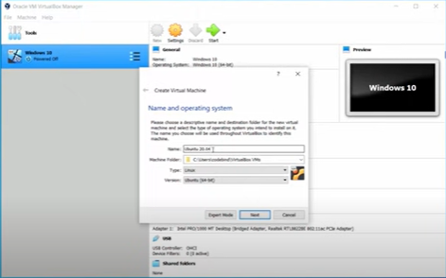
0.3 New Ubuntu
https://www.youtube.com/watch?v=x5MhydijWmc
Download/Install VirtualBox
Give the name “Ubuntu_20.04”. On my machine, I use name “Docker_Linux”
Keep other options unchanged.

Slide 11
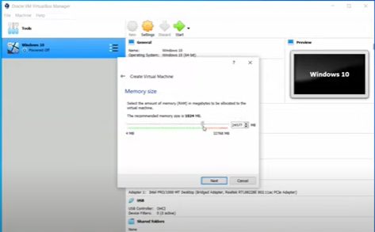
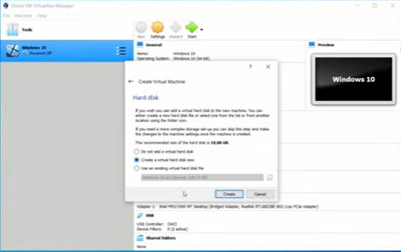
0.3 New Ubuntu
https://www.youtube.com/watch?v=x5MhydijWmc
New Ubuntu
Set memory size the green max.
Leave other as defaults.

Slide 12
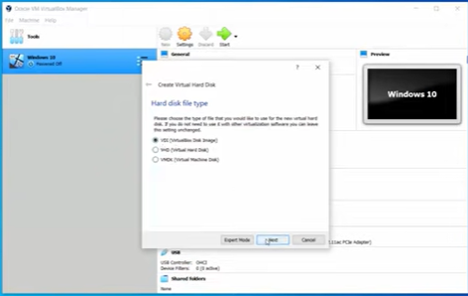
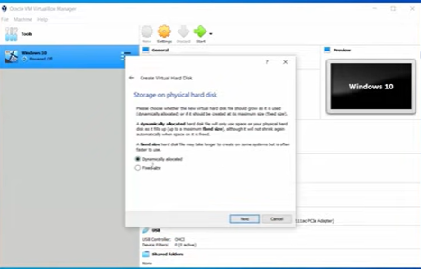
0.3 New Ubuntu
https://www.youtube.com/watch?v=x5MhydijWmc
New Ubuntu
Leave Disk Type and Dynamic Allocate as defaults.

Slide 13
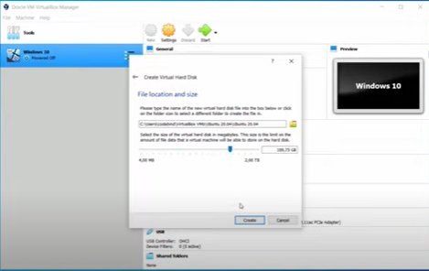
0.3 New Ubuntu
https://www.youtube.com/watch?v=x5MhydijWmc
New Ubuntu
Move disk size around 100GB.

Slide 14
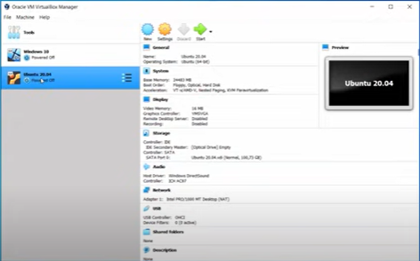
0.3 New Ubuntu
https://www.youtube.com/watch?v=x5MhydijWmc
New Ubuntu
You will see new machine logo changed after setup.

Slide 15
0.4 Setup Ubuntu

Slide 16
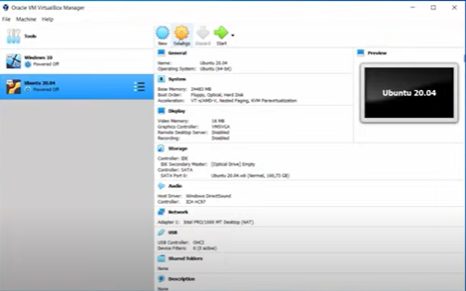
0.4 Setup Ubuntu
https://www.youtube.com/watch?v=x5MhydijWmc
Setup Ubuntu
Do not click “Start” yet.
1. Select “Ubunutu_20.04” machine and
2. Click “Setup” button.
2
1

Slide 17
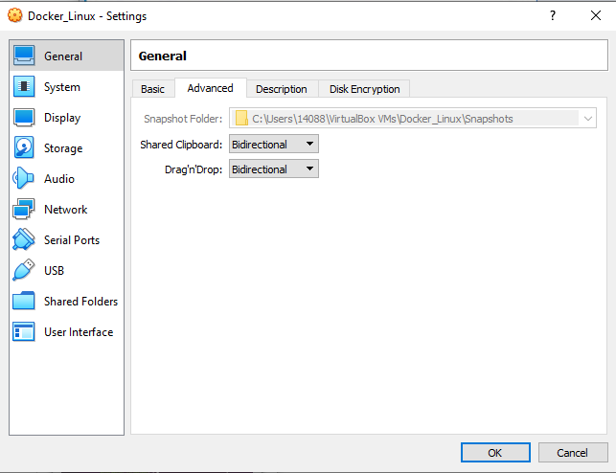
0.4 Setup Ubuntu
https://www.youtube.com/watch?v=x5MhydijWmc
Setup Ubuntu
Select “General” and Click “Advanced” Tab.
Changed Shared Clipboard and Drag’n’Drap into “Bidrectional”.
This gives Ubuntu and Windows can have the share folders.

Slide 18
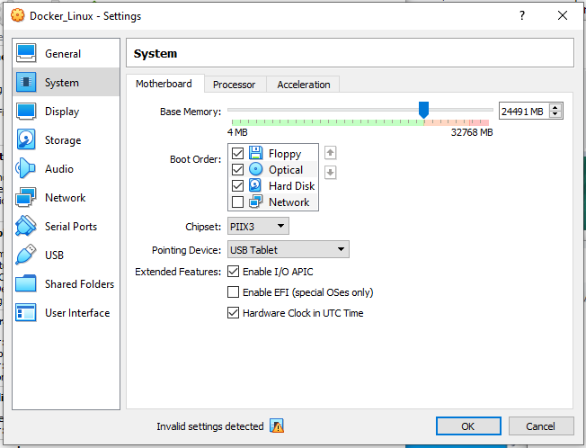
0.4 Setup Ubuntu
https://www.youtube.com/watch?v=x5MhydijWmc
Setup Ubuntu
Select “System” and “Motherboard” Tab.
Move the “Base Memory” to green max.

Slide 19
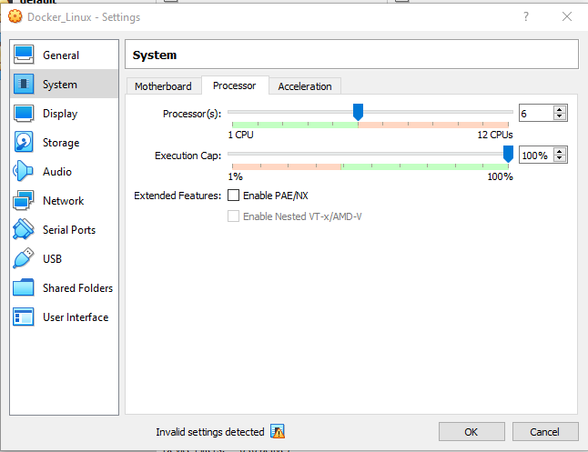
0.4 Setup Ubuntu
https://www.youtube.com/watch?v=x5MhydijWmc
Setup Ubuntu
Select “System” and “Process” Tab.
Move the “Processor(s)” to green max which is “6” in my case.

Slide 20
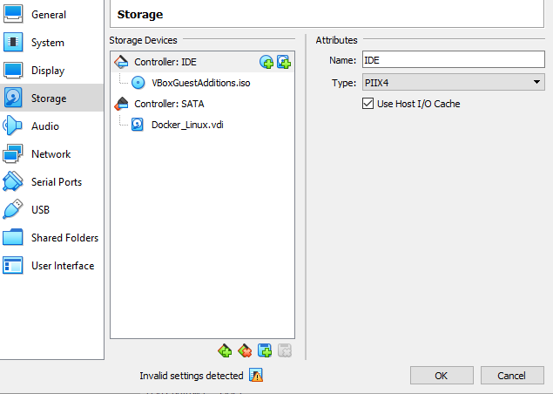
0.4 Setup Ubuntu
https://www.youtube.com/watch?v=x5MhydijWmc
Setup Ubuntu
Select “Storage”.
You can add the “Ubunxx.iso” or additional “VBoxGuessAditions.iso” which can be downloaded from VirtualBox web site for guess addition.

Slide 21
0.5 Install Ubuntu

Slide 22
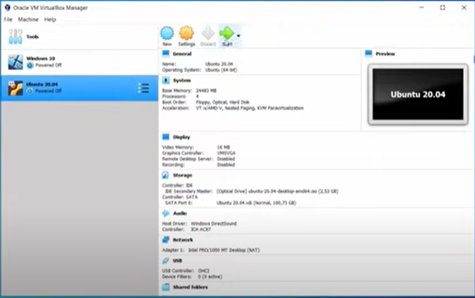
0.5 Install Ubuntu
https://www.youtube.com/watch?v=x5MhydijWmc
Install Ubuntu
Select “Ubuntu_20.04” and
Click “Start” to install Ubuntu.

Slide 23
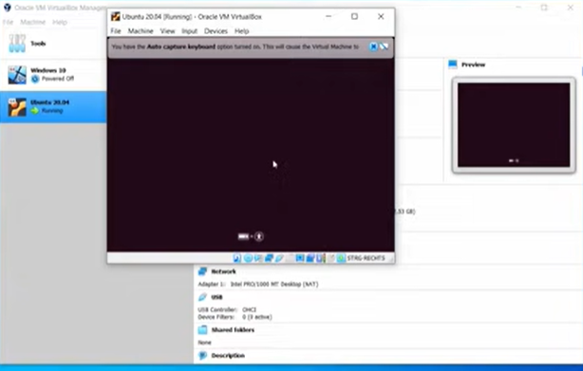
0.5 Install Ubuntu
https://www.youtube.com/watch?v=x5MhydijWmc
Install Ubuntu
You can see Ubuntu is start to install.

Slide 24
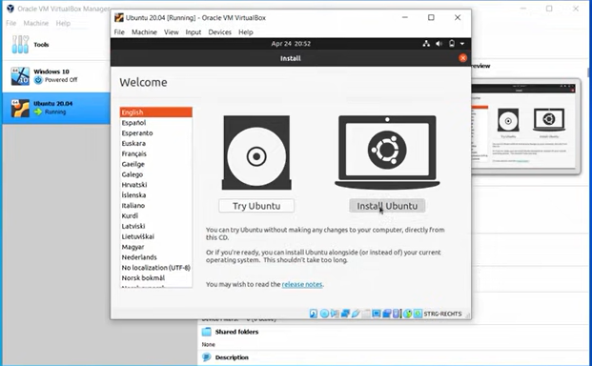
0.5 Install Ubuntu
https://www.youtube.com/watch?v=x5MhydijWmc
Install Ubuntu
Select “Install Ubuntu” to install.

Slide 25
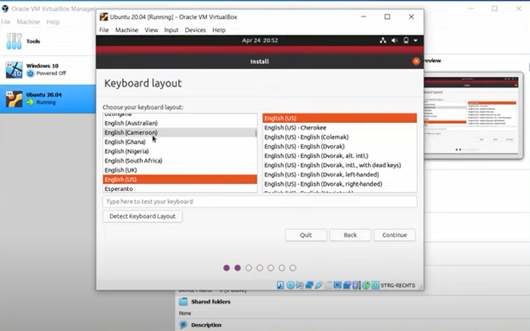
0.5 Install Ubuntu
https://www.youtube.com/watch?v=x5MhydijWmc
Install Ubuntu
Keep default selection and click “Next”…

Slide 26
0.6 Start New Linux Terminal

Slide 27
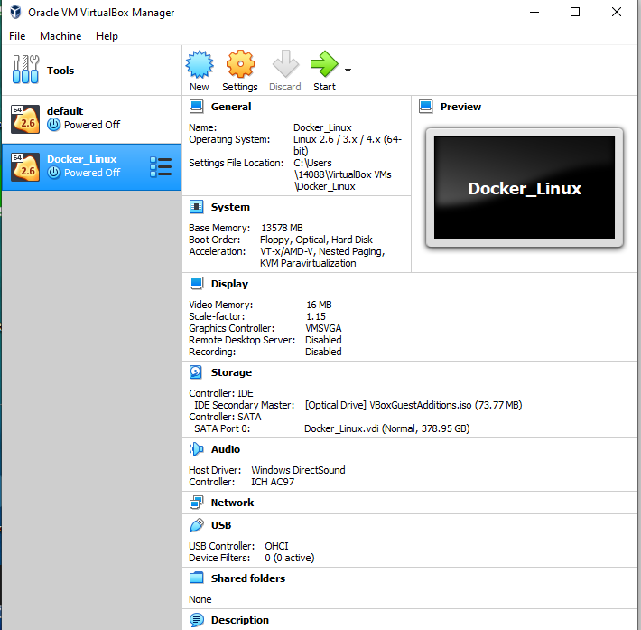
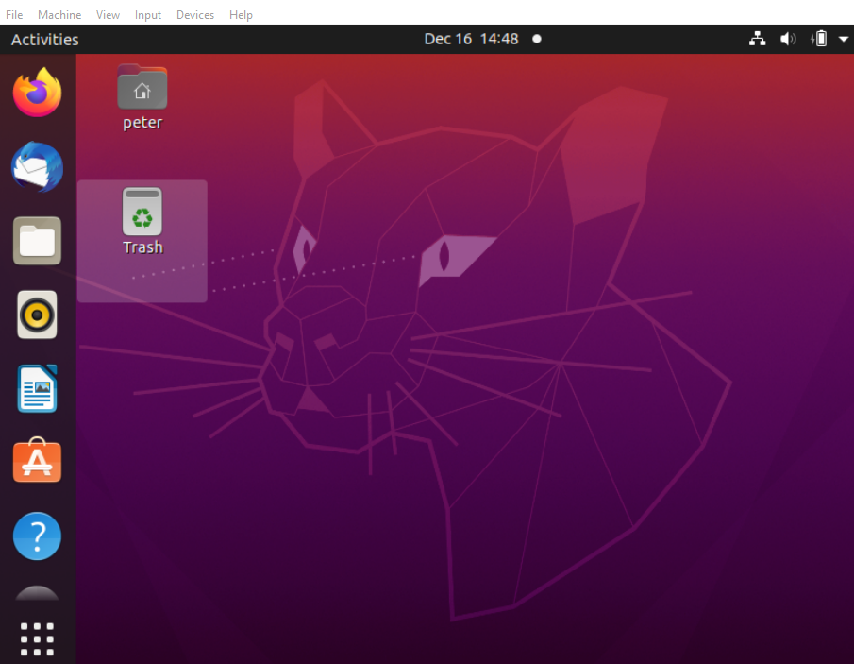
0.6 Start New Linux Terminal
https://www.youtube.com/watch?v=x5MhydijWmc
Start New Linux Terminal
Select the Docker_Linux and click “start”
Type the user name and password to log into Ubuntu as below.

Slide 28
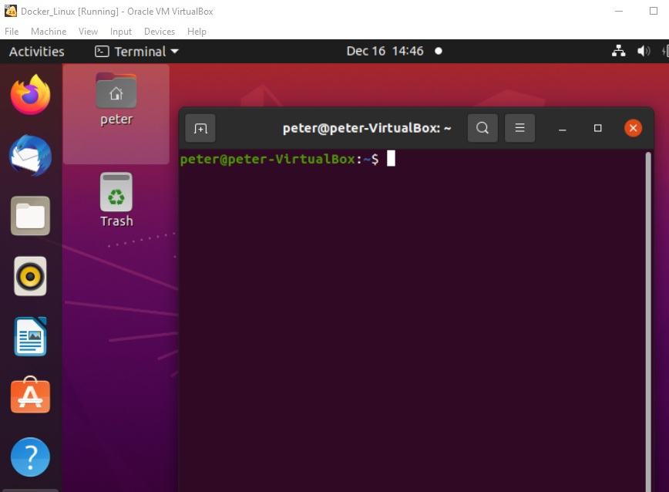
0.5 Start New Linux Terminal
https://www.youtube.com/watch?v=x5MhydijWmc
Start New Linux Terminal
On the Ubuntu OS, “Control-Alt-t” to start a new Linux Terminal

Slide 29
End

