Slide 1
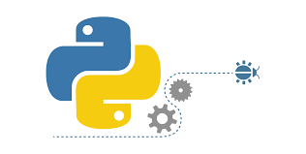
Docker, Python, GUI Programming
Peter H. Chen

Slide 2
00 Python Data Science
https://github.com/peterhchen/300_SVU_DataScience
Course Description
This course is an introductory course on fundamentals of Python programming and data structures. It covers the following:
Part 1: Docker
Sec 1: VirtualBox/Ubuntu Setup, Basics, Architecture, Advantage, Setup
Sec 2: Command, Image, Container
Sec 3: Jenkins, Dockerfile, Composer
Sec 4: Docker Volume, Swarm
Sec 5: Dockerize Python API (Part1, Part 2)
Sec 6: Kubernetes

Slide 3
00 Python Data Science
https://github.com/peterhchen/300_SVU_DataScience
Course Description
Part 2: Python Programming
Sec 7: Setup, Basic, Tuple, List
Sec 8: Data Structure
Sec 9: File IO
Sec 10: OOP
Part 3: GUI
Sec 11: Hello, Grid, Entry, Calculator
Sec 12: Icon, Image View, Status Bar
Sec 13: Frame, Button, Radio, Text Box, Window, Open File Dialog
Sec 14: Matplotlib plot
Sec 15: Seaborn: Scatter Plot, Heatmap, histogram

Slide 4
End of Chapter

