Slide 1
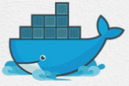
1 Docker Basics
Peter H. Chen

Slide 2
1 Docker Basics
https://www.youtube.com/watch?v=wi-MGFhrad0&list=PLhW3qG5bs-L99pQsZ74f-LC-tOEsBp2rK&index=1
Docker Basics:
1. Why need Docker?
2. What is Docker?
3. Software Container Platform
4. Matrix from Hell
5. Shipping Industry Problem
6. Deploy and Run App by Container
7. Pack Application into Container

Slide 3
1.1 Why Need Docker?

Slide 4
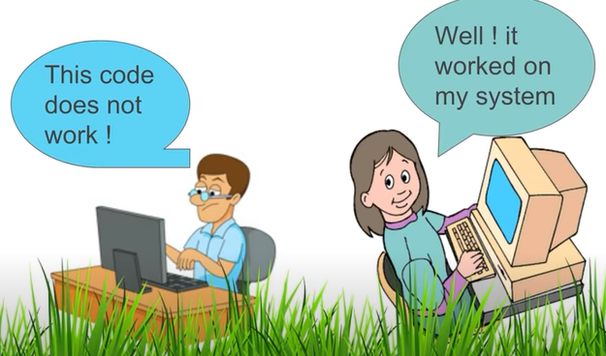
1.1 Why Need Docker?
https://www.youtube.com/watch?v=wi-MGFhrad0&list=PLhW3qG5bs-L99pQsZ74f-LC-tOEsBp2rK&index=1
Why need Docker?
Some software work in one platform and does not work on another platform.

Slide 5
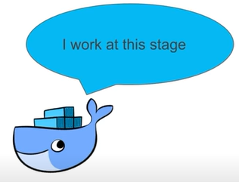
1.1 Why Need Docker?
https://www.youtube.com/watch?v=wi-MGFhrad0&list=PLhW3qG5bs-L99pQsZ74f-LC-tOEsBp2rK&index=1
Why need Docker?
The stages of software development: Design, Development, Deployment, Testing/Release.
Docker comes into the picture at the Deployment Stage.
Docker makes the process of application deployment very easy, very efficient, and resolves a lot issues related to deploying applications.
Design
Development
Deployment
Testing/Release

Slide 6
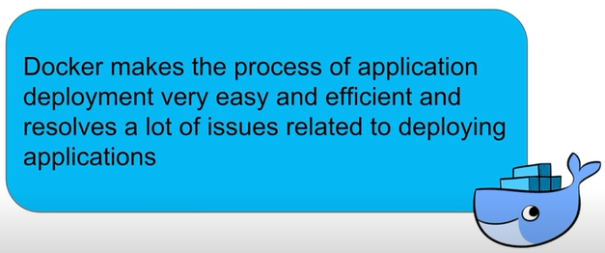
1.1 Why Need Docker?
https://www.youtube.com/watch?v=wi-MGFhrad0&list=PLhW3qG5bs-L99pQsZ74f-LC-tOEsBp2rK&index=1
Why need Docker?

Slide 7
1.2 What is Docker?

Slide 8
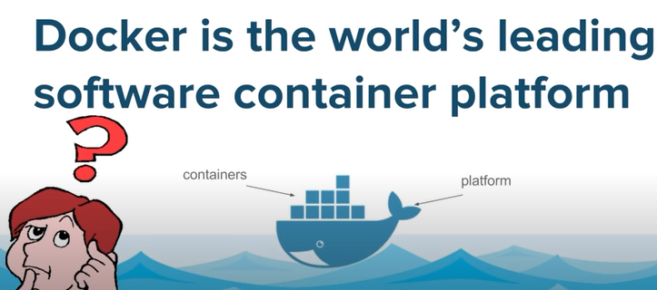
1.2 What is Docker?
https://www.youtube.com/watch?v=wi-MGFhrad0&list=PLhW3qG5bs-L99pQsZ74f-LC-tOEsBp2rK&index=1
What is Docker?
Docker is world’s leading software container platform.
What is this mean?

Slide 9
1.3 Software Container Platform

Slide 10
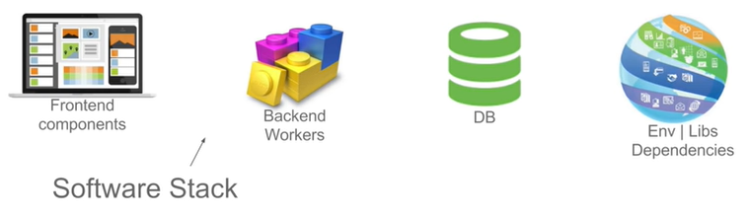
1.3 Software Container Platform
https://www.youtube.com/watch?v=wi-MGFhrad0&list=PLhW3qG5bs-L99pQsZ74f-LC-tOEsBp2rK&index=1
What is the “Software Container Platform” mean?
When we develop the software application, it is not a single piece of code, however, it is an entire software stack.
Typical software application will consist of a group of front-end components, backend components, databases servers, libraries, and other environment dependent components.

Slide 11
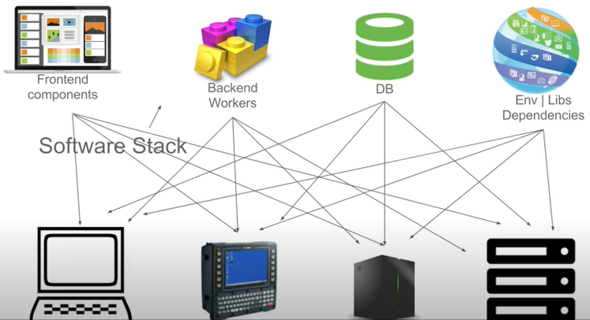
1.3 Software Container Platform
https://www.youtube.com/watch?v=wi-MGFhrad0&list=PLhW3qG5bs-L99pQsZ74f-LC-tOEsBp2rK&index=1
What is the “Software Container Platform” mean? (2)
We have to make sure all these components work on different and wide range of platforms.
If we look at the picture, it becomes very complex.
To ensure that each of us of the component works on every possible platform.

Slide 12
1.4 Matrix From Hell

Slide 13
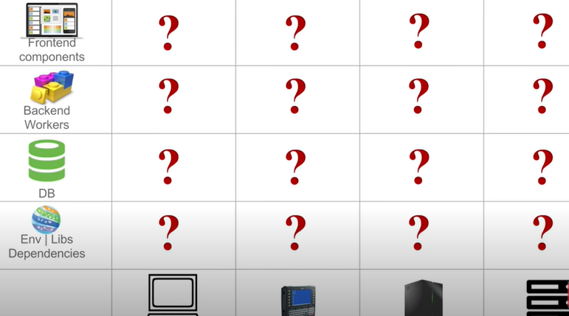
1.4 Matrix From Hell
https://www.youtube.com/watch?v=wi-MGFhrad0&list=PLhW3qG5bs-L99pQsZ74f-LC-tOEsBp2rK&index=1
What is the Matrix from the Hell?
If we make a matrix out of above diagram, it will be look like the following.
We have to make sure that all the components the application are compatible with all the possible hardware in the organization:

Slide 14
1.5 Shipping Industry Problem

Slide 15
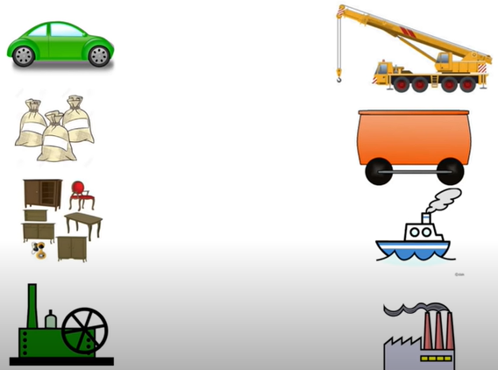
1.5 Shipping Industry Problem
https://www.youtube.com/watch?v=wi-MGFhrad0&list=PLhW3qG5bs-L99pQsZ74f-LC-tOEsBp2rK&index=1
Shipping industry Problem:
When we move the furniture from one place to another place, we have the same problem.
We have fioriture on the left and shipping equipment on the right.

Slide 16
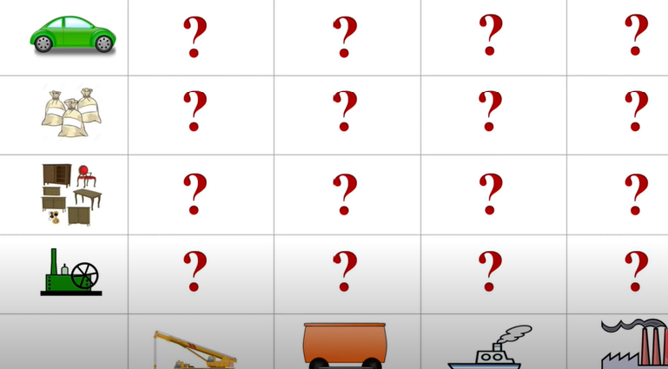
1.5 Shipping Industry Problem
https://www.youtube.com/watch?v=wi-MGFhrad0&list=PLhW3qG5bs-L99pQsZ74f-LC-tOEsBp2rK&index=1
Shipping industry matrix:

Slide 17
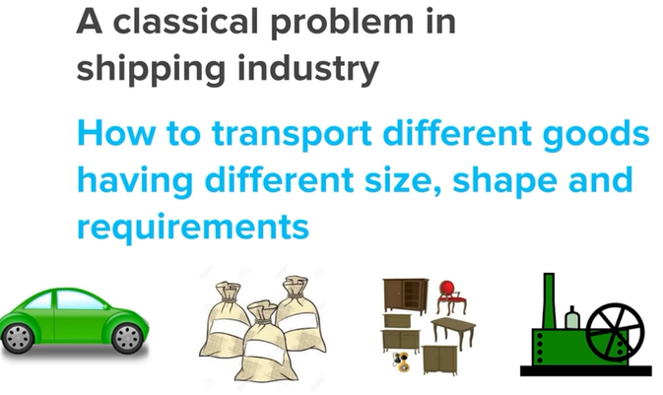
1.5 Shipping Industry Problem
https://www.youtube.com/watch?v=wi-MGFhrad0&list=PLhW3qG5bs-L99pQsZ74f-LC-tOEsBp2rK&index=1
How to solve the Matrix from Hell problem?
How to transport different goods having different size, shape, and requirements.

Slide 18
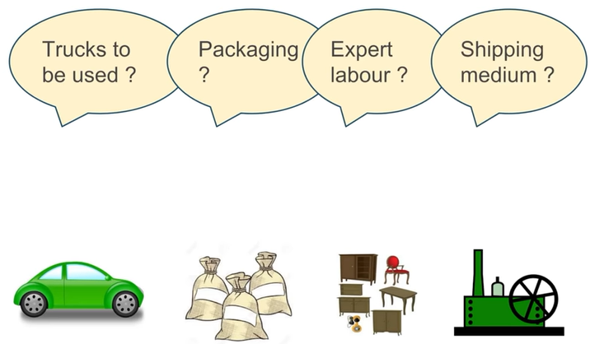
1.5 Shipping Industry Problem
https://www.youtube.com/watch?v=wi-MGFhrad0&list=PLhW3qG5bs-L99pQsZ74f-LC-tOEsBp2rK&index=1
How to solve the Matrix from Hell problem?
What trucks to be used? What kind of packaging? What expert labor? What shipping medium?

Slide 19
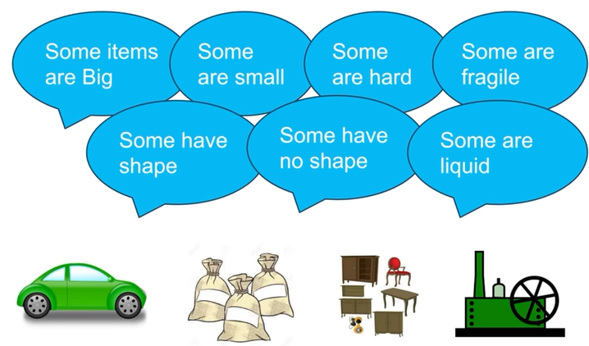
1.5 Shipping Industry Problem
https://www.youtube.com/watch?v=wi-MGFhrad0&list=PLhW3qG5bs-L99pQsZ74f-LC-tOEsBp2rK&index=1
How to solve the Matrix from Hell problem?
We have some items are big, some are small, some are hard, some are fragile, and etc.

Slide 20
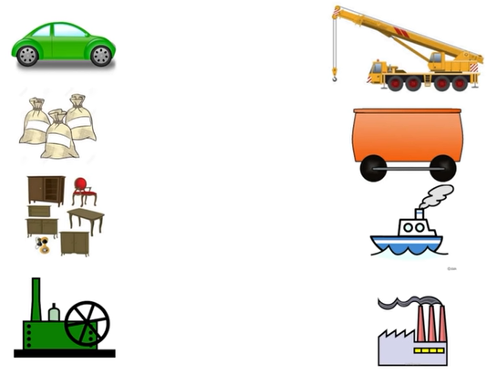
1.5 Shipping Industry Problem
https://www.youtube.com/watch?v=wi-MGFhrad0&list=PLhW3qG5bs-L99pQsZ74f-LC-tOEsBp2rK&index=1
How to solve the Matrix from Hell problem?
You can think of all the possibilities to ship the items.

Slide 21
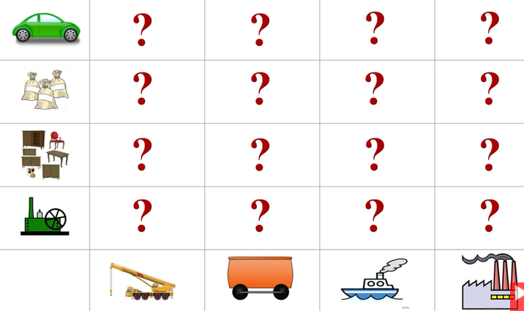
1.5 Shipping Industry Problem
https://www.youtube.com/watch?v=wi-MGFhrad0&list=PLhW3qG5bs-L99pQsZ74f-LC-tOEsBp2rK&index=1
How to solve the Matrix from Hell problem?
This is again become very complex.

Slide 22
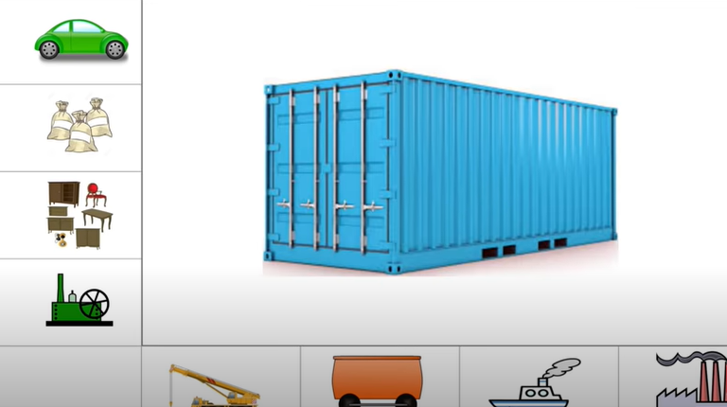
1.5 Shipping Industry Problem
https://www.youtube.com/watch?v=wi-MGFhrad0&list=PLhW3qG5bs-L99pQsZ74f-LC-tOEsBp2rK&index=1
How to solve the Matrix from Hell problem?
We solve the Matrix from the Hell by using the Container.
Container are standard boxes where the goods can be packaged in a standard way.
For example, if you are the furniture manufacture, you need to packaging your furniture into the standard way into the container. You are not worry about the ship through the air, water, who will ship, and etc.

Slide 23
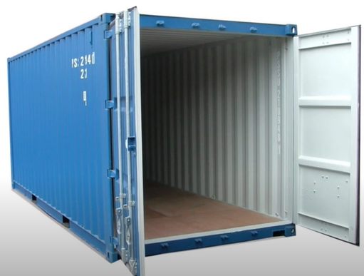
1.5 Shipping Industry Problem
https://www.youtube.com/watch?v=wi-MGFhrad0&list=PLhW3qG5bs-L99pQsZ74f-LC-tOEsBp2rK&index=1
The container make the shipping very easy and efficient.

Slide 24
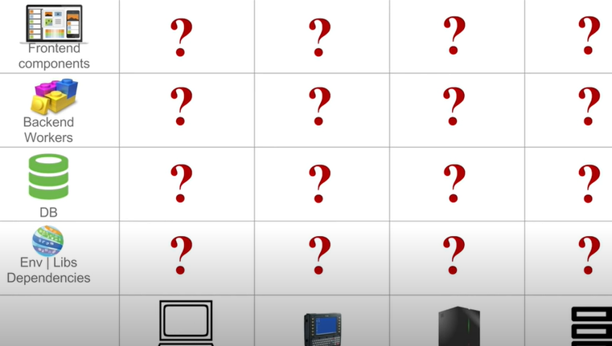
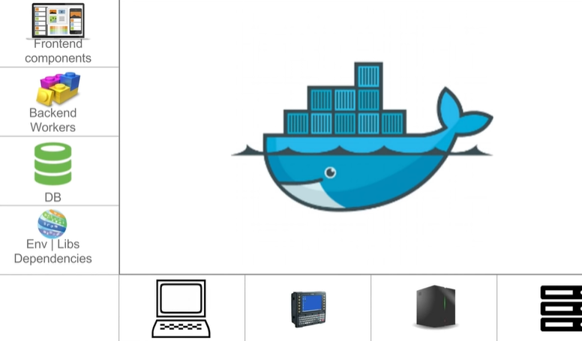
1.5 Shipping Industry Problem
https://www.youtube.com/watch?v=wi-MGFhrad0&list=PLhW3qG5bs-L99pQsZ74f-LC-tOEsBp2rK&index=1
Look the Matrix from the Hell again.
We use the standard way of container with Docker to solve it.

Slide 25
1.6 Deploy and Run App by Container

Slide 26
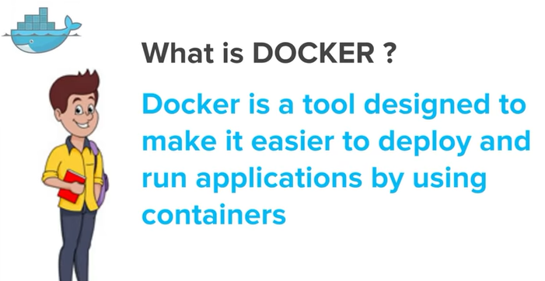
1.6 Deploy and Run App by Container
https://www.youtube.com/watch?v=wi-MGFhrad0&list=PLhW3qG5bs-L99pQsZ74f-LC-tOEsBp2rK&index=1
What is docker?
Docker is a tool designed to make it easier to deploy and run applications by using containers.

Slide 27
1.6 Pack App into Container

Slide 28
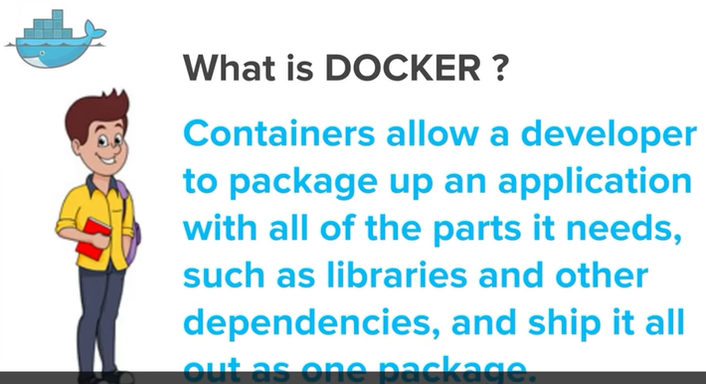
1.6 Pack App into Container
https://www.youtube.com/watch?v=wi-MGFhrad0&list=PLhW3qG5bs-L99pQsZ74f-LC-tOEsBp2rK&index=1
What is docker?
…and containers allow a developer to package their application and all of its dependencies into a box and then ship the entire package.

Slide 29
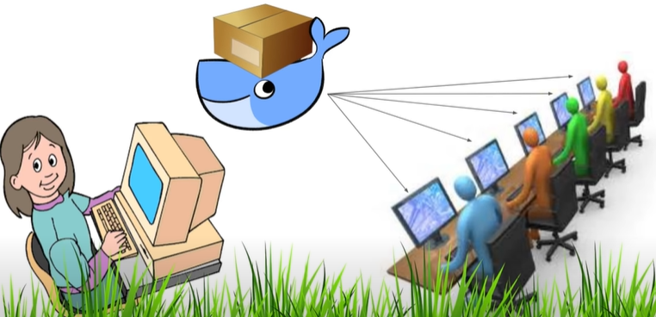

1.6 Pack App into Container
https://www.youtube.com/watch?v=wi-MGFhrad0&list=PLhW3qG5bs-L99pQsZ74f-LC-tOEsBp2rK&index=1
What is Docker?
A developer packages all the software and components into a container and ship to the box called the container and docker will take care of shipping this container to all the platform in a standard way.
Docker container is the standard way to solve Matrix from the Hell.

Slide 30
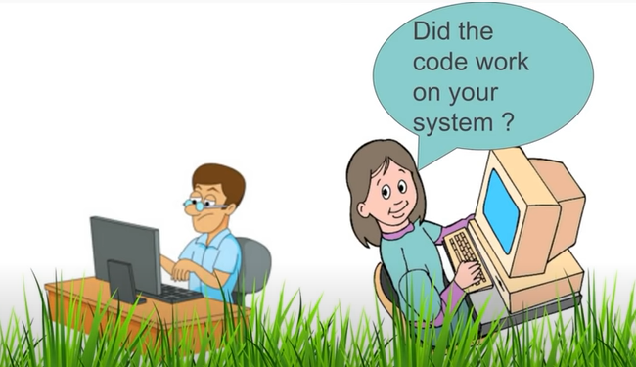
1.6 Pack App into Container
https://www.youtube.com/watch?v=wi-MGFhrad0&list=PLhW3qG5bs-L99pQsZ74f-LC-tOEsBp2rK&index=1
What is Docker?
…also we can see now there is a clear separation of concerns.

Slide 31

1.6 Pack App into Container
https://www.youtube.com/watch?v=wi-MGFhrad0&list=PLhW3qG5bs-L99pQsZ74f-LC-tOEsBp2rK&index=1
What is Docker?
…A developer will now really focus on creating the code and software and will package the software along withal its dependencies into a container and will not worry about this will be deployed on what all platform it has deployed on what all platforms it has to be deployed, and so on.

Slide 32
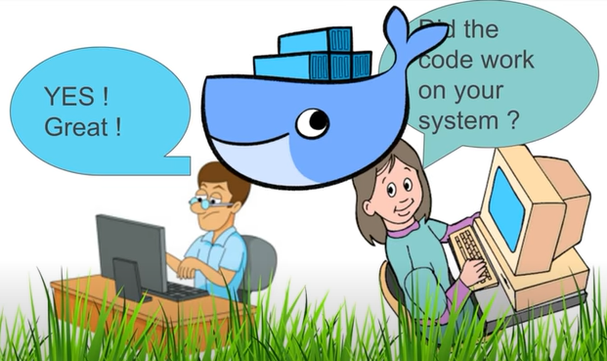
1.6 Pack App into Container
https://www.youtube.com/watch?v=wi-MGFhrad0&list=PLhW3qG5bs-L99pQsZ74f-LC-tOEsBp2rK&index=1
What is Docker?
…and docker makes this process of deploying software very easy , very efficient, and very good.

Slide 33
End of Chapter

