Slide 1
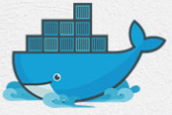
2 Docker Architecture
Peter H. Chen

Slide 2
2 Docker Architecture
https://www.youtube.com/watch?v=0e-KiGJIiDc&list=PLhW3qG5bs-L99pQsZ74f-LC-tOEsBp2rK&index=2
Docker Architecture
1. General Workflow of Docker
2. Docker Hub
3. Container Platform
4. Virtualization vs. Containerization
5. Client-Server Architecture

Slide 3
2.1 General Workflow of Docker

Slide 4
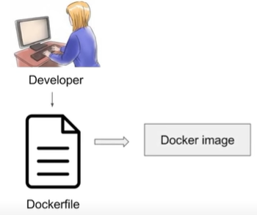
2.1 General Workflow of Docker
https://www.youtube.com/watch?v=0e-KiGJIiDc&list=PLhW3qG5bs-L99pQsZ74f-LC-tOEsBp2rK&index=2
General Workflow of Docker
Dockerfile: describes steps to create a Docker image. Dockerfile is like a recipe with all ingredients and steps in making the dish.

Slide 5
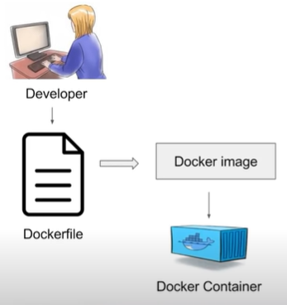
2.1 General Workflow of Docker
https://www.youtube.com/watch?v=0e-KiGJIiDc&list=PLhW3qG5bs-L99pQsZ74f-LC-tOEsBp2rK&index=2
General Workflow of Docker
In the Docker image, we have all the application requirements and dependencies.
When we run the Docker image, we got the Docker container.
Container are runtime instances of a docker image.
Container have the application with all its dependencies.

Slide 6
2.2 Docker Hub

Slide 7
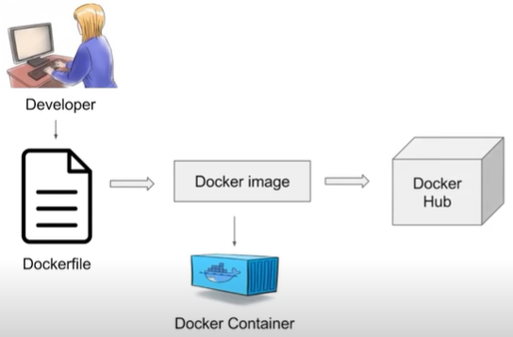
2.2 Docker Hub
https://www.youtube.com/watch?v=0e-KiGJIiDc&list=PLhW3qG5bs-L99pQsZ74f-LC-tOEsBp2rK&index=2
What is Docker Hub (Registry)?
The created Docker images can also be stored in an online cloud repository called Docker Hub or Registry.

Slide 8
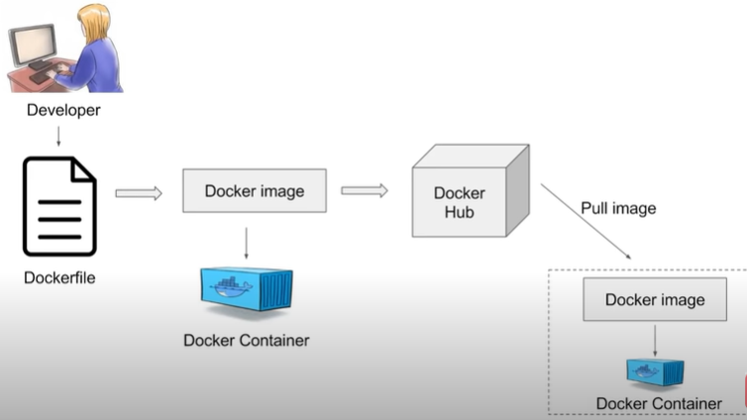
2.2 Docker Hub
https://www.youtube.com/watch?v=0e-KiGJIiDc&list=PLhW3qG5bs-L99pQsZ74f-LC-tOEsBp2rK&index=2
What is Docker Hub (Registry)?
Docker Hub web site: https://hub.decker.com
In the Docker Hub, you can find a lot of publicly available images. You can store your own Docker image as well.
You can have your own repository or version control system.
These images can be pulled to create container in any environment.

Slide 9
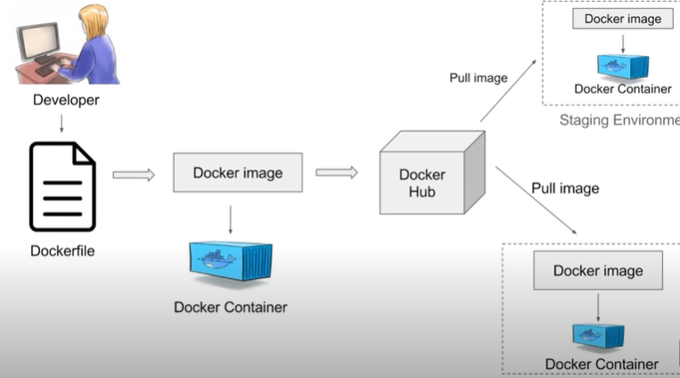
2.2 Docker Hub
https://www.youtube.com/watch?v=0e-KiGJIiDc&list=PLhW3qG5bs-L99pQsZ74f-LC-tOEsBp2rK&index=2
What is Docker Hub (Registry)?
You can create a docker container in a test environment or on any staging environment.
Staging Environment
Test Environment

Slide 10
2.3 Container Platform

Slide 11
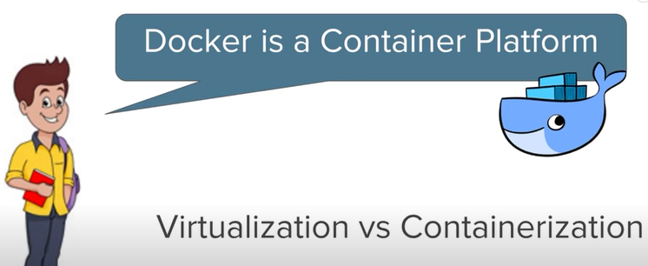
2.3 Container Platform
https://www.youtube.com/watch?v=0e-KiGJIiDc&list=PLhW3qG5bs-L99pQsZ74f-LC-tOEsBp2rK&index=2
Docker is container Platform

Slide 12
2.4 Virtualization vs Containerization

Slide 13
2.3 Virtualization vs Containerization
https://www.youtube.com/watch?v=0e-KiGJIiDc&list=PLhW3qG5bs-L99pQsZ74f-LC-tOEsBp2rK&index=2
What is the difference between the Virtualization vs. Containerization?
Docker is a Container Platform.
What is the benefit of using container platforms like Docker?
The Guest OS consumes a lot of memory and disk spaces.
The container is very fast.
App 1
App 2
App 3
Lib/bin
Lib/bin
Lib/bin
Virtual
Machines
App 1
App 2
App 3
Guest OS
Guest OS
Guest OS
Containers
Lib/
bin
Lib/
bin
Lib/
bin
Hypervisor
Docker Engine
Host OS
Host OS
Hardware, Infrastructure, cloud
Hardware, Infrastructure, cloud
Virtualization
Containerization

Slide 14
2.5 Client-Server Architecture

Slide 15
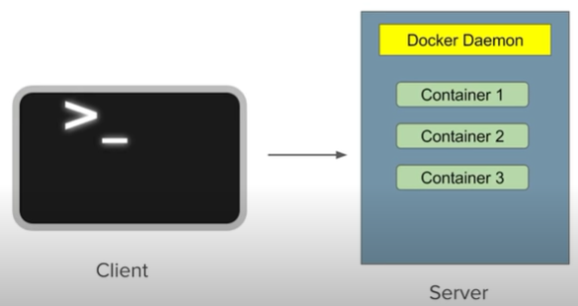
2.5 Client-Server Architecture
https://www.youtube.com/watch?v=0e-KiGJIiDc&list=PLhW3qG5bs-L99pQsZ74f-LC-tOEsBp2rK&index=2
Docker has a Client-Server Architecture
In Docker, the command-line interface is the client and we have the Docker server (or Docker Daemon). The Docker server have all the Containers.
The Docker server receives commands from the Docker client in the form of commands (or REST API request)

Slide 16
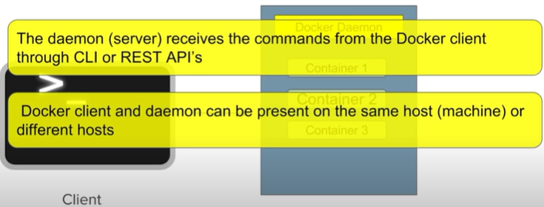
2.5 Client-Server Architecture
https://www.youtube.com/watch?v=0e-KiGJIiDc&list=PLhW3qG5bs-L99pQsZ74f-LC-tOEsBp2rK&index=2
Docker has a Client-Server Architecture
The Client and server together forms the docker engine.
The Docker Daemon (or server) receives the commands from the Docker client through REST API (or command-line interface).
The Docker Client (or Docker Daemon) can be present on the same platform or can be on different machines.
Server

Slide 17
End of Chapter

