Slide 1
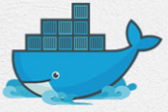
3 Docker Advantage
Peter H. Chen

Slide 2
3 Docker Advantage
https://www.youtube.com/watch?v=YCrRy7pBzdc&list=PLhW3qG5bs-L99pQsZ74f-LC-tOEsBp2rK&index=3
Docker Advantage
1. Build App Only Once
2. Test Application Inside the Container
3. Portability
4. Version Control
5. Container Isolation
6. Productivity

Slide 3
3.1 Build App Only Once

Slide 4
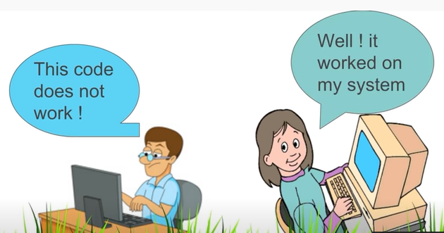
3.1 Build App Only Once
https://www.youtube.com/watch?v=YCrRy7pBzdc&list=PLhW3qG5bs-L99pQsZ74f-LC-tOEsBp2rK&index=3
Build App Only Once
Very basic use of Docker is it resolves the problem pf accord (agree) working on one system and not working on some other systems.

Slide 5
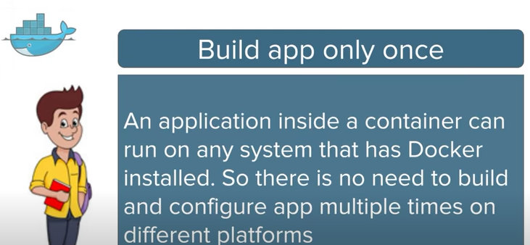
3.1 Build App Only Once
https://www.youtube.com/watch?v=YCrRy7pBzdc&list=PLhW3qG5bs-L99pQsZ74f-LC-tOEsBp2rK&index=3
Build App Only Once
An Application inside a container can run on any system that has Docker installed.
There is no need to build and configure app multiple times on different platforms.

Slide 6
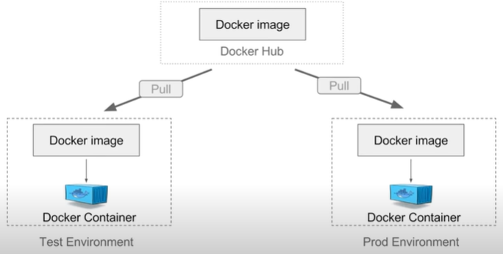
3.1 Build App Only Once
https://www.youtube.com/watch?v=YCrRy7pBzdc&list=PLhW3qG5bs-L99pQsZ74f-LC-tOEsBp2rK&index=3
Build App Only Once
We can create a Docker image and put on a Docker Hub or any repository.
Then, we can pull this image on any environment and run the image to create a Docker container.
Our application will run inside this container.
We can do the same with any environment.

Slide 7
3.2 Test Application Inside Container

Slide 8
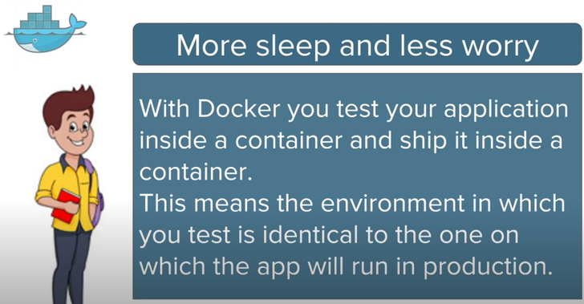
3.2 Test Application Inside Container
https://www.youtube.com/watch?v=YCrRy7pBzdc&list=PLhW3qG5bs-L99pQsZ74f-LC-tOEsBp2rK&index=3
Test Application Inside Container
With Docker, we test the our application inside a container and ship it inside a container.
The environment we test is identical the app will run in production.
These two environments are running the same Docker container.

Slide 9
3.3 Portability

Slide 10
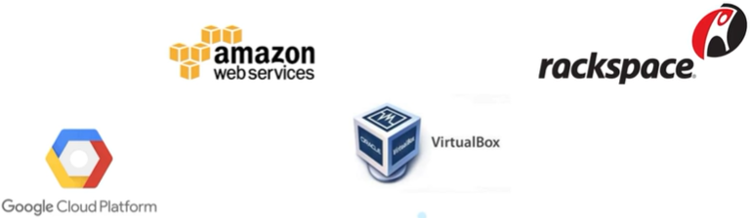
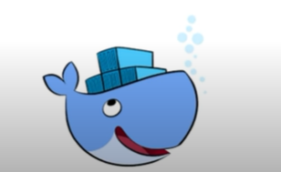
3.3 Portability
https://www.youtube.com/watch?v=YCrRy7pBzdc&list=PLhW3qG5bs-L99pQsZ74f-LC-tOEsBp2rK&index=3
Portability
The portability is a create feature with Docker.
If we create a container with AWS EC2, we can pull this container to a Virtual Box and run

Slide 11
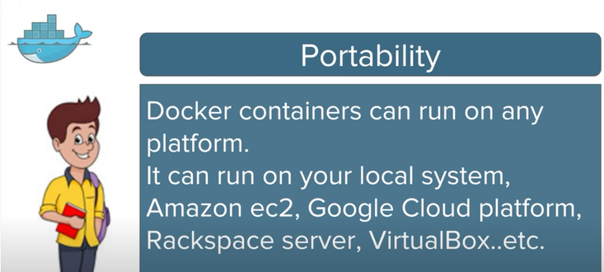
3.3 Portability
https://www.youtube.com/watch?v=YCrRy7pBzdc&list=PLhW3qG5bs-L99pQsZ74f-LC-tOEsBp2rK&index=3
Portability
Docker containers can run on any platform.
It can run our local system, AWS EC2, Google Cloud Platform, Rackspace Server, VirtualBox, and etc.
A container running on AWS can easily be ported to VirtualBox.

Slide 12
3.4 Version Control

Slide 13
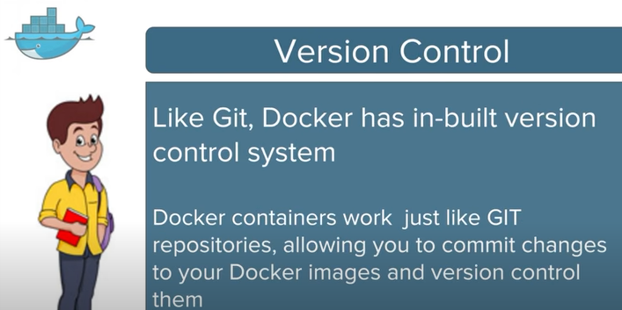
3.4 Version Control
https://www.youtube.com/watch?v=YCrRy7pBzdc&list=PLhW3qG5bs-L99pQsZ74f-LC-tOEsBp2rK&index=3
Version Control
Git: Docker has built-in version control system (same as s Git).
Git Repository: Docker containers is similar to Git repositories. We can commit changes to Docker images and version control them.

Slide 14
3.5 Container Isolation

Slide 15
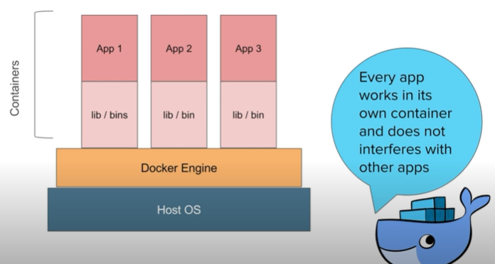
3.5 Container Isolation
https://www.youtube.com/watch?v=YCrRy7pBzdc&list=PLhW3qG5bs-L99pQsZ74f-LC-tOEsBp2rK&index=3
Container Isolation
A great feature of Docker is every application work inside its own container
…and that is not interfere with any other application working inside other containers
…or on the host operating system.

Slide 16
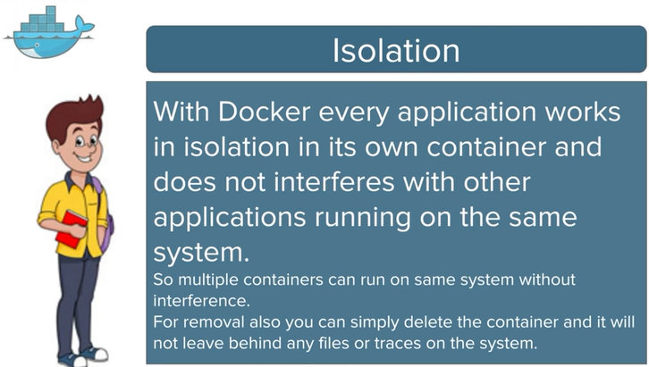
3.5 Container Isolation
https://www.youtube.com/watch?v=YCrRy7pBzdc&list=PLhW3qG5bs-L99pQsZ74f-LC-tOEsBp2rK&index=3
Container Isolation
With Docker, every application works in isolation in its own container and does not interferes with other applications running on the same system.
Multiple containers can run on the same system without interference.
We can delete the container without affect other containers in the system.

Slide 17
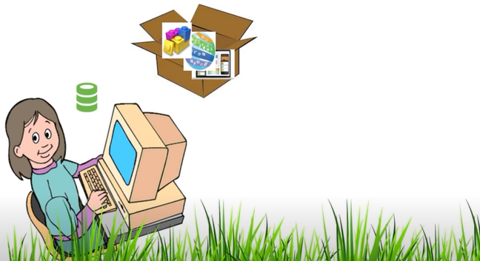
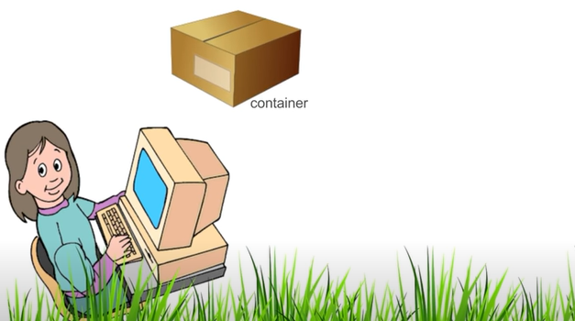
3.5 Container Isolation
https://www.youtube.com/watch?v=YCrRy7pBzdc&list=PLhW3qG5bs-L99pQsZ74f-LC-tOEsBp2rK&index=3
Container Isolation
With Docker, a developer can package all the software and its dependencies in the container.

Slide 18
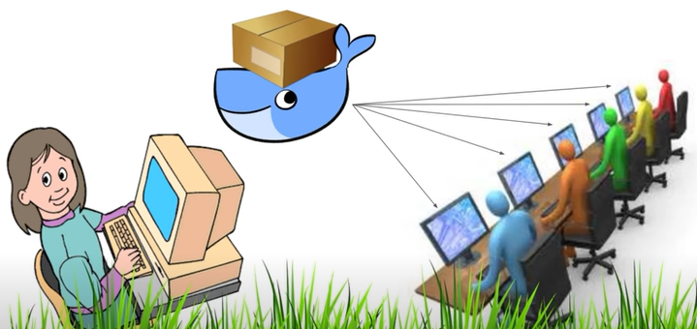
3.5 Container Isolation
https://www.youtube.com/watch?v=YCrRy7pBzdc&list=PLhW3qG5bs-L99pQsZ74f-LC-tOEsBp2rK&index=3
Container Isolation
…and Docker will make sure that all this is deployed on every possible platform,

Slide 19
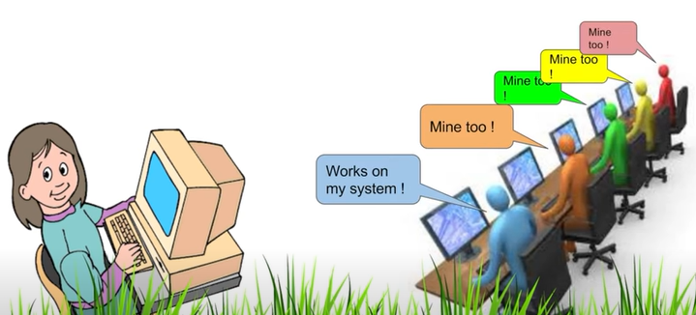
3.5 Container Isolation
https://www.youtube.com/watch?v=YCrRy7pBzdc&list=PLhW3qG5bs-L99pQsZ74f-LC-tOEsBp2rK&index=3
Container Isolation
…and everything works fine on every system.

Slide 20
3.6 Productivity

Slide 21
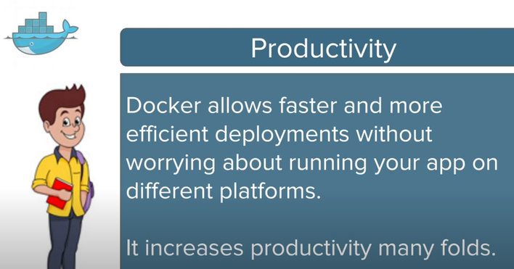
3.6 Productivity
https://www.youtube.com/watch?v=YCrRy7pBzdc&list=PLhW3qG5bs-L99pQsZ74f-LC-tOEsBp2rK&index=3
Productivity
Docker allows faster and more efficient deployments without worrying about running your app on different platforms.
It increases productivity many folds.

Slide 22
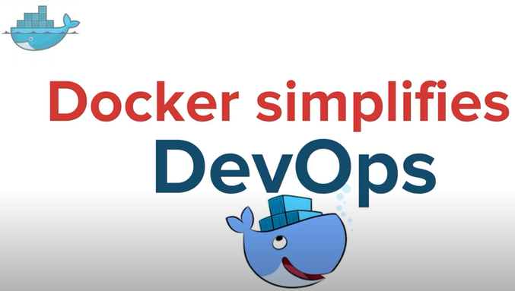
3.6 Productivity
https://www.youtube.com/watch?v=YCrRy7pBzdc&list=PLhW3qG5bs-L99pQsZ74f-LC-tOEsBp2rK&index=3
Productivity
With all these features, Docker makes DevOps very easy, very efficient, and faster.

Slide 23
End of Chapter

