Slide 1

4 Docker Lab
Peter H. Chen

Slide 2
4 Docker Lab
https://labs.play-with-docker.com/
Go to Docker Lab. This is the web site for practing Docker commands.
1. Go to Docker Lab: https://labs.play-with-docker.com/
2. Log in Docker Lab
3. Start Docker Lab
4. Create Docker Instance
5. Docker Tool
6. Docker Setting
7. Docker Version

Slide 3
4.1 Go To Docker Lab

Slide 4
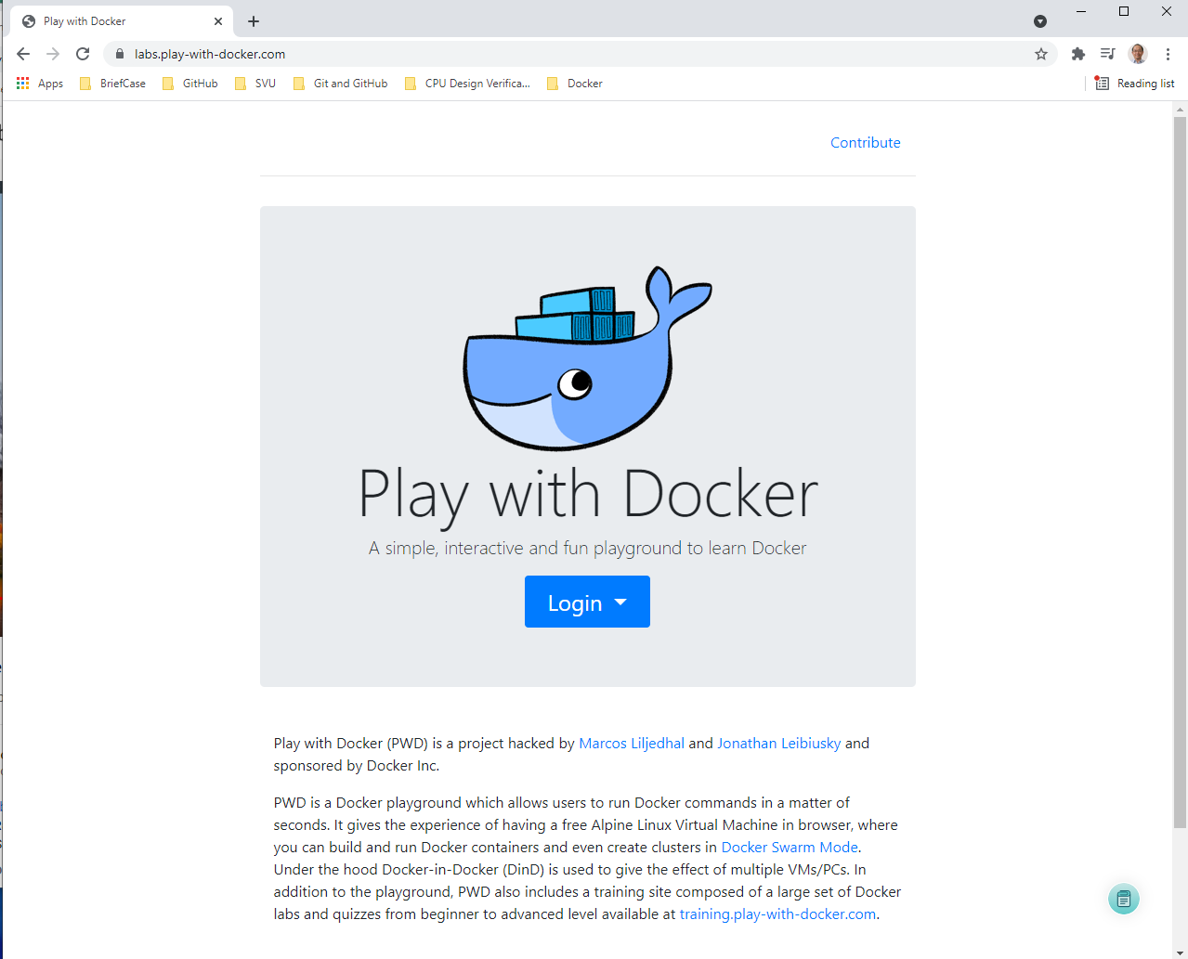
4.1 Go To Docker Lab
https://labs.play-with-docker.com/
Go to Docker Lab: https://labs.play-with-docker.com/
We can practice Docker and get familiar with Docker by Docker lab.

Slide 5
4.2 Login Docker Lab

Slide 6
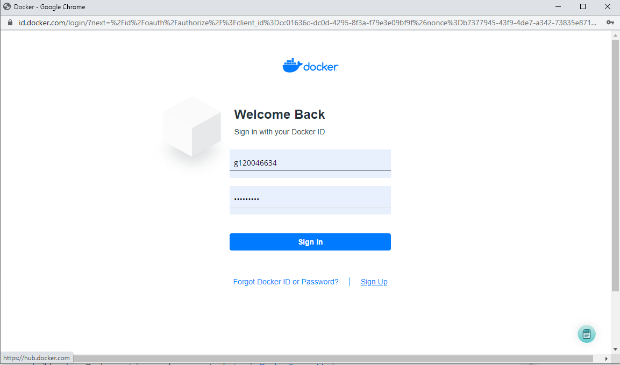
4.2 Login Docker Lab
https://labs.play-with-docker.com/
Login Docker Lab
I signup with id “g120046634” and password “Pcxxxx=xx”

Slide 7
4.3 Start Docker Lab

Slide 8
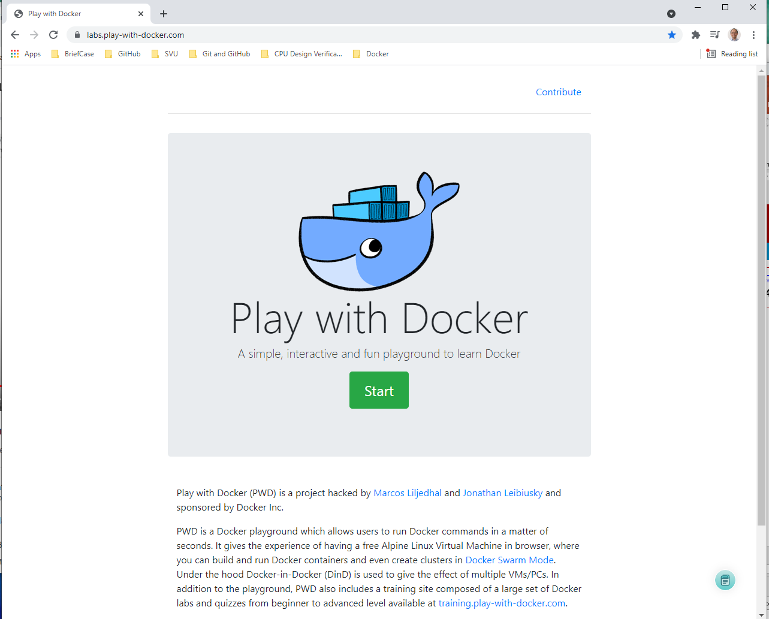
4.3 Start Docker Lab
https://labs.play-with-docker.com/
Start Docker Lab
Click “Start” button.

Slide 9
4.4 Create Docker Instance

Slide 10
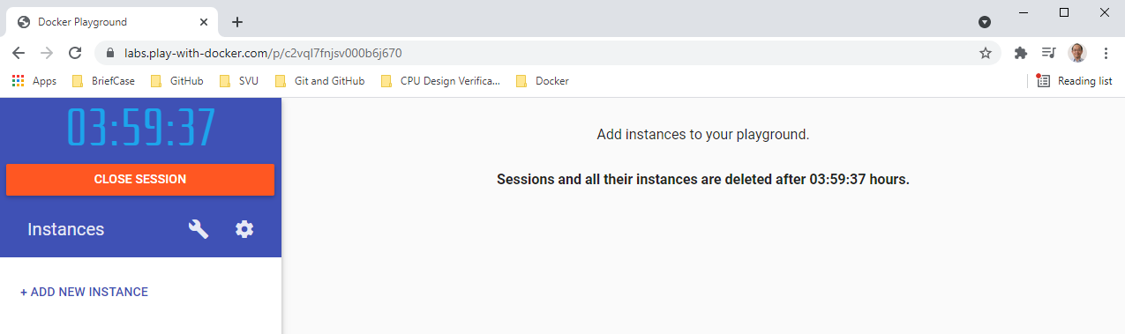
4.4 Create Docker Instance
https://labs.play-with-docker.com/
Create Docker Instance
This is the new play ground, click “Add New Instance”

Slide 11
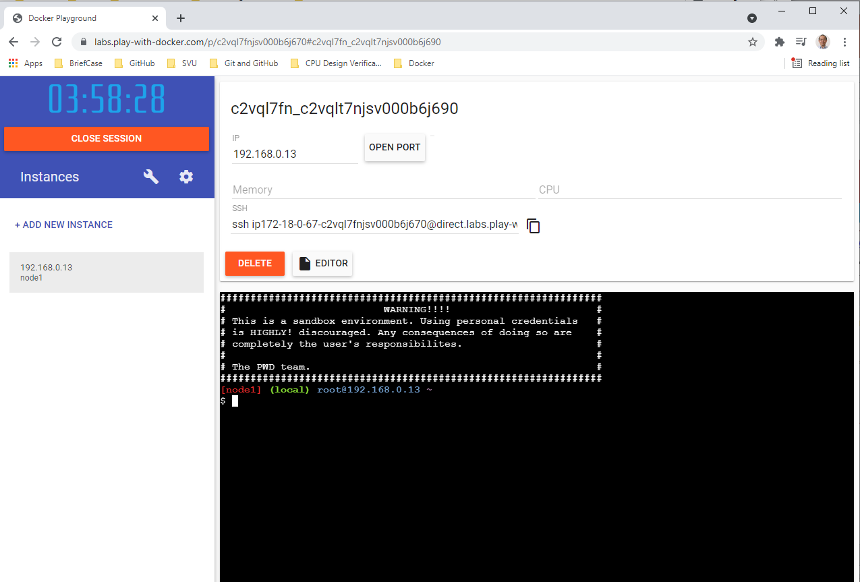
4 Docker Lab
https://labs.play-with-docker.com/
Create Docker Instance
This is the new play ground, click “Add New Instance”

Slide 12
4.5 Docker Tool

Slide 13
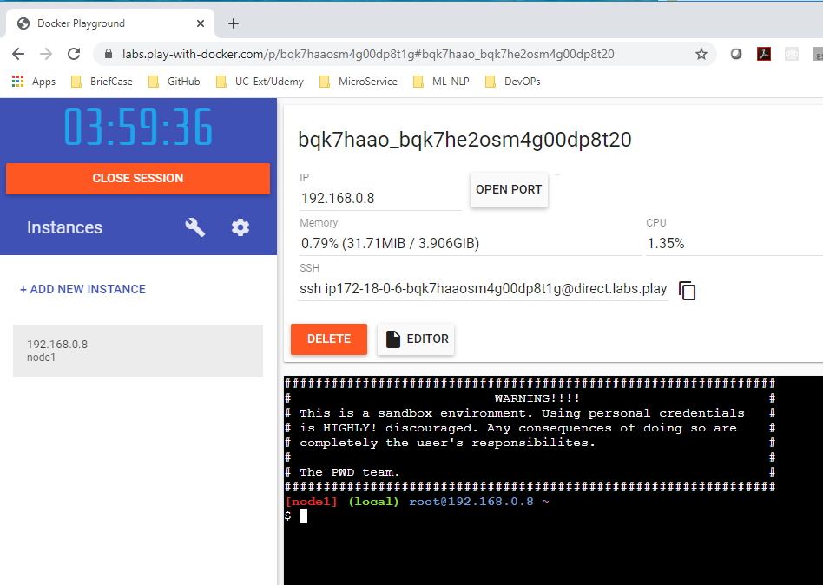
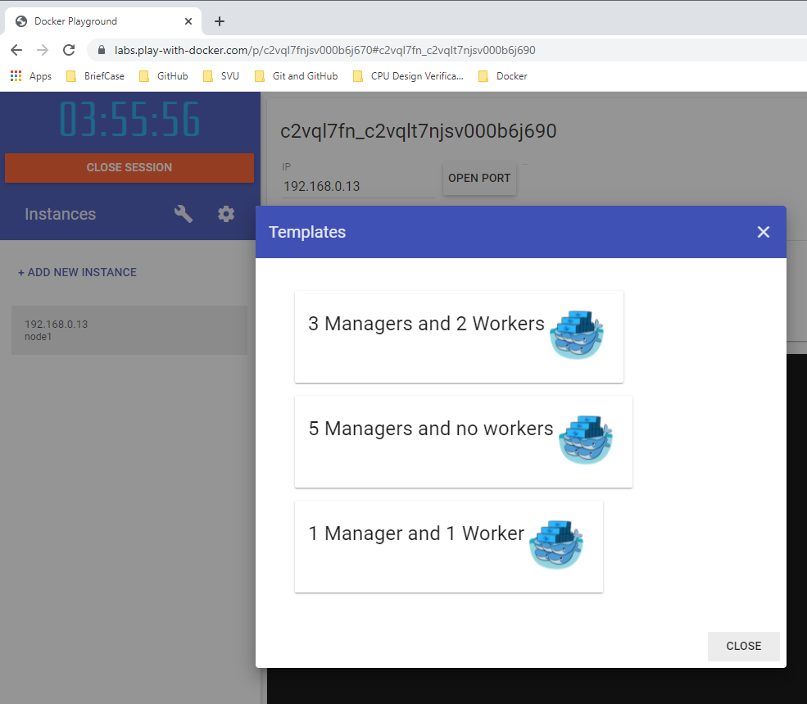
4.5 Docker Tool
https://labs.play-with-docker.com/
Docker Tool
You can click the tool bar. You can select “3 Manager and 2 workers”, “5 Managers and no workers” or “ 1 manager and 1 worker.”

Slide 14
4.6 Docker Setting

Slide 15
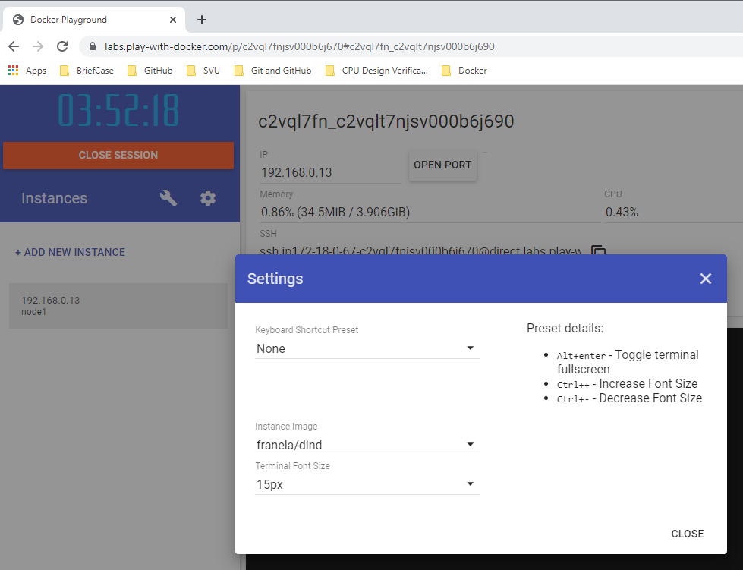
4.6 Docker Setting
https://labs.play-with-docker.com/
Docker Setting
You can click “Setting” to see all the settings and options.

Slide 16
4.7 Docker Version

Slide 17
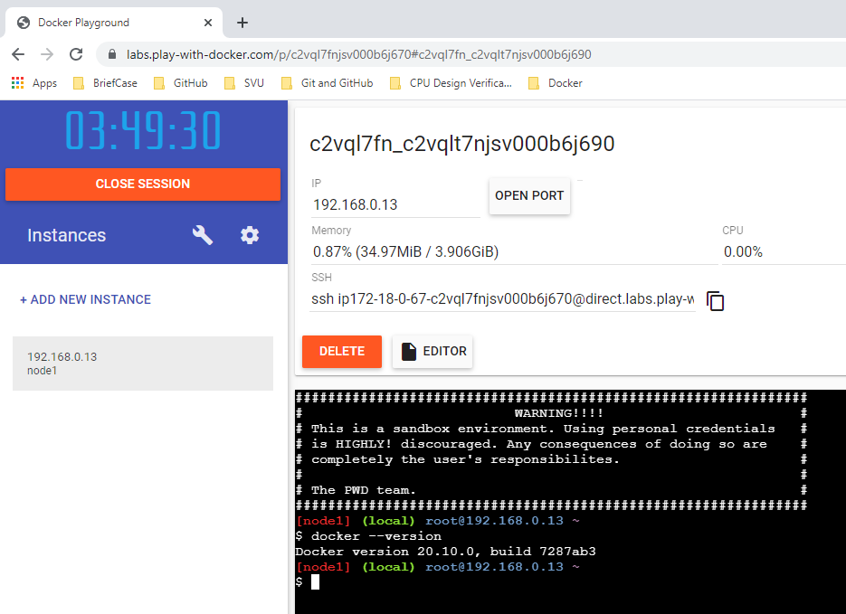
4.7 Docker Version
https://labs.play-with-docker.com/
Go to Docker Lab: https://labs.play-with-docker.com/
> docker --versions
>> docker version 20.10.0

Slide 18
4.7 Docker Version
https://labs.play-with-docker.com/
Go to Docker Lab: https://labs.play-with-docker.com/
We can try all the Docker commands by using Docker Lab.

Slide 19
End of Chapter

