Slide 1
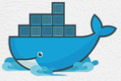
5 Docker Linux
Peter H. Chen

Slide 2
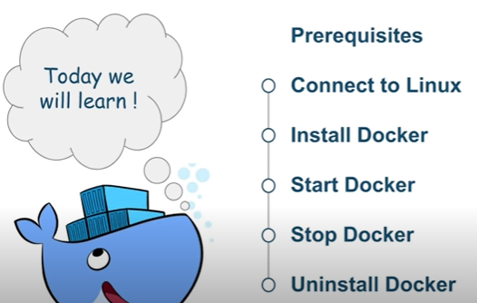
5 Docker Linux
https://www.youtube.com/watch?v=KCckWweNSrM&list=PLhW3qG5bs-L99pQsZ74f-LC-tOEsBp2rK&index=5
Docker Linux
1. Connect to Linux
2. Install Docker
3. Start Docker
4. Stop Docker
5. Uninstall Docker

Slide 3
5.1 Connect to Linux

Slide 4

5.1 Connect to Linux
https://www.youtube.com/watch?v=KCckWweNSrM&list=PLhW3qG5bs-L99pQsZ74f-LC-tOEsBp2rK&index=5
Install Virtual Box and Ubuntu
Go to virtualbox.org
Download and install VirtualBox
Go to Ubuntu.com
Download Guest OS Ubuntu.
Double click “Oracle VM VirtualBox” and select the “Ubuntu” to install.

Slide 5
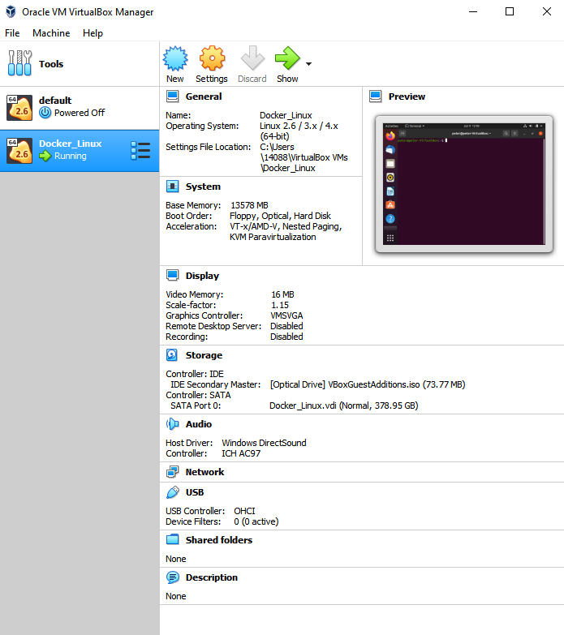
5.1 Connect to Linux
https://www.youtube.com/watch?v=KCckWweNSrM&list=PLhW3qG5bs-L99pQsZ74f-LC-tOEsBp2rK&index=5
Install Virtual Box and Ubuntu
Go to virtualbox.org
Download and install VirtualBox
The Ubuntu name “Docker_Linux”
Select “Docker_Linux” and click “start” to run Ubuntu Linux.

Slide 6
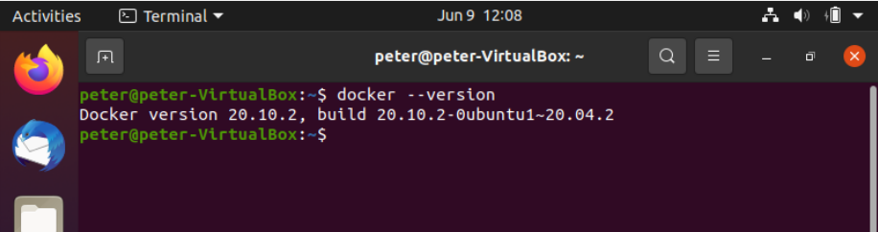
5.1 Connect to Linux
https://www.youtube.com/watch?v=KCckWweNSrM&list=PLhW3qG5bs-L99pQsZ74f-LC-tOEsBp2rK&index=5
Install Docker on Ubuntu Linux
Type “docker --version“
Ubuntu will prompt the docker installation command for you.
Install the docker as below:
> sudo apt-get docker
> docker --version

Slide 7
5.1 Connect to Linux
https://www.youtube.com/watch?v=KCckWweNSrM&list=PLhW3qG5bs-L99pQsZ74f-LC-tOEsBp2rK&index=5
Docker Version, docker-compose, and docker-machine
Check Linux Version
> uname -r

Slide 8
5.2 Install Docker

Slide 9
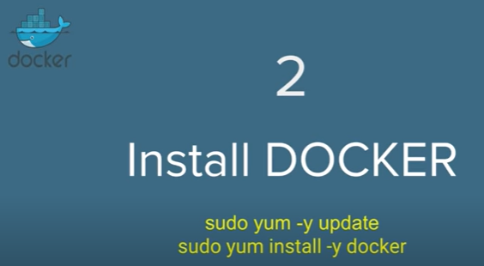
5.2 Install Docker
https://www.youtube.com/watch?v=KCckWweNSrM&list=PLhW3qG5bs-L99pQsZ74f-LC-tOEsBp2rK&index=5
Install Docker
> sudo yum -y update # or
> sudo apt-get -y update
> sudo yum install -y docker # or
> sudo apt-get install -y docker
Note: Ubuntu use “apt-get” instead of “yum”

Slide 10
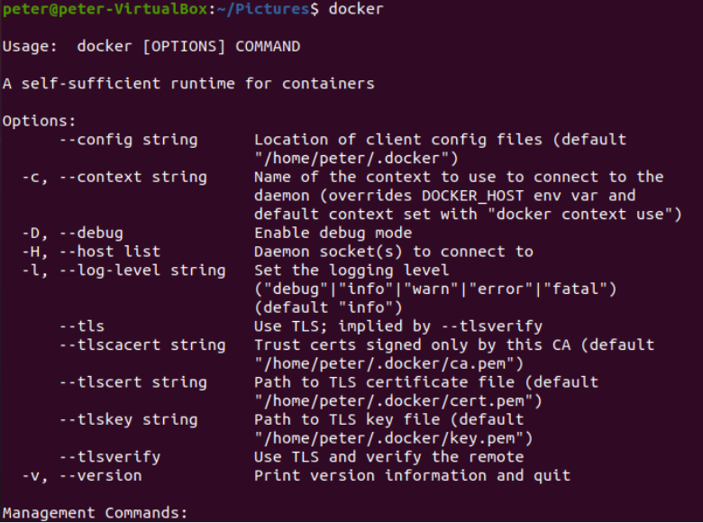
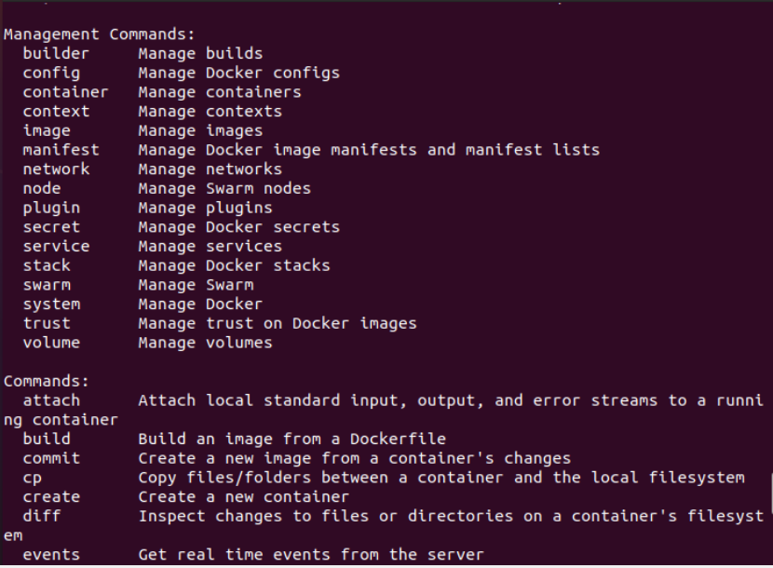
5.2 Install Docker
https://www.youtube.com/watch?v=KCckWweNSrM&list=PLhW3qG5bs-L99pQsZ74f-LC-tOEsBp2rK&index=5
Docker Options and Commands
> docker # or
> docker [options] COMMAND
List all the docker options and commands.

Slide 11
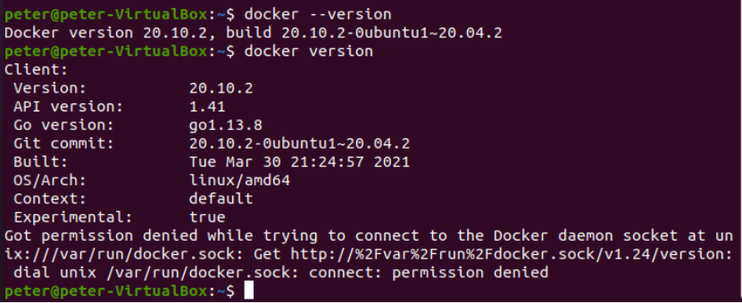
5.2 Install Docker
https://www.youtube.com/watch?v=KCckWweNSrM&list=PLhW3qG5bs-L99pQsZ74f-LC-tOEsBp2rK&index=5
Docker Version, docker-compose, and docker-machine
> docker --version
Or
> docker version
Note:
> sudo apt install docker

Slide 12
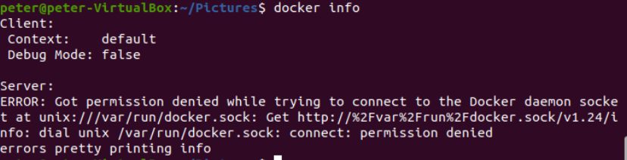
5.2 Install Docker
https://www.youtube.com/watch?v=KCckWweNSrM&list=PLhW3qG5bs-L99pQsZ74f-LC-tOEsBp2rK&index=5
Docker Version, docker-compose, and docker-machine
> docker info
Our docker is not yet running, so therefore, we are getting this message.
…so our next step is to start the docker.

Slide 13
5.3 Start Docker

Slide 14
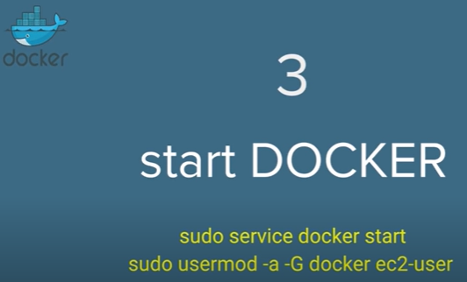
5.3 Start Docker
https://www.youtube.com/watch?v=KCckWweNSrM&list=PLhW3qG5bs-L99pQsZ74f-LC-tOEsBp2rK&index=5
Start Docker
We start the docker service now.

Slide 15
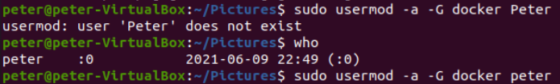
5.3 Start Docker
https://www.youtube.com/watch?v=KCckWweNSrM&list=PLhW3qG5bs-L99pQsZ74f-LC-tOEsBp2rK&index=5
Start Docker
> sudo service docker start
> sudo usermod -a -G docker peter
Note:
https://net2.com/usermod-command-usage-in-ubuntu-debian-a-beginners-guide/
-a: appends the user to the group
-G: add a new list of groups.
This command add “peter” to the group of “docker”.

Slide 16

5.3 Start Docker
https://www.youtube.com/watch?v=KCckWweNSrM&list=PLhW3qG5bs-L99pQsZ74f-LC-tOEsBp2rK&index=5
Start Docker
> sudo docker images

Slide 17
5.3 Start Docker
https://www.youtube.com/watch?v=KCckWweNSrM&list=PLhW3qG5bs-L99pQsZ74f-LC-tOEsBp2rK&index=5
Start Docker
> sudo docker ps

Slide 18
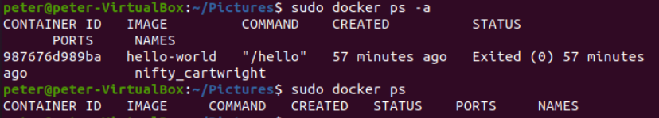
5.3 Start Docker
https://www.youtube.com/watch?v=KCckWweNSrM&list=PLhW3qG5bs-L99pQsZ74f-LC-tOEsBp2rK&index=5
Start Docker
> sudo docker ps -a
Note:
> sudo docker ps -a: list all the containers including running and not running.
> sudo docker ps: list the running container.

Slide 19
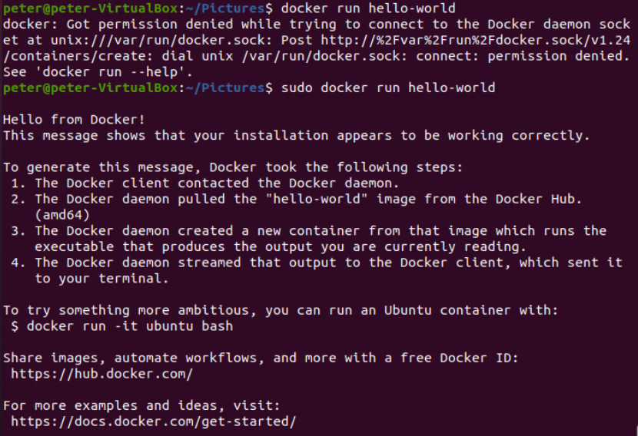
5.3 Start Docker
https://www.youtube.com/watch?v=KCckWweNSrM&list=PLhW3qG5bs-L99pQsZ74f-LC-tOEsBp2rK&index=5
Start Docker
> sudo docker run hello-world
If local image does not existed, the docker will find the online docker repository and then it will start the container.

Slide 20

5.3 Start Docker
https://www.youtube.com/watch?v=KCckWweNSrM&list=PLhW3qG5bs-L99pQsZ74f-LC-tOEsBp2rK&index=5
Start Docker
> sudo docker images
Now we can check the docker images again.
We got the “hello-world” Repository image, Tag, Image ID, Create time, and image Size.

Slide 21
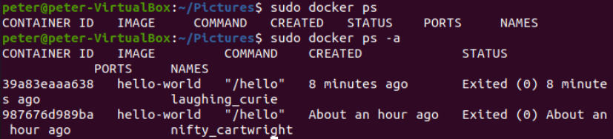
5.3 Start Docker
https://www.youtube.com/watch?v=KCckWweNSrM&list=PLhW3qG5bs-L99pQsZ74f-LC-tOEsBp2rK&index=5
Start Docker
> sudo docker ps
> sudo docker ps -a
The “docker ps –a” command list out the containers so we can see the local images are created 8 minutes ago and an hour ago, respectively.

Slide 22
5.4 Stop Docker

Slide 23

5.4 Stop Docker
https://www.youtube.com/watch?v=KCckWweNSrM&list=PLhW3qG5bs-L99pQsZ74f-LC-tOEsBp2rK&index=5
Stop Docker
> sudo service docker stop
We stop the docker service.

Slide 24
5.5 Uninstall Docker

Slide 25
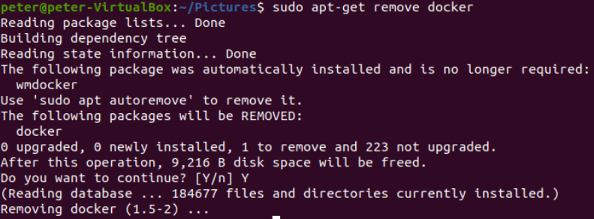
5.5 Uninstall Docker
https://www.youtube.com/watch?v=KCckWweNSrM&list=PLhW3qG5bs-L99pQsZ74f-LC-tOEsBp2rK&index=5
Uninstall Docker
> sudo yum remove docker # or
> sudo apt-get remove docker
The docker is remove from Linux completely.

Slide 26
5.5 Uninstall Docker
https://www.youtube.com/watch?v=KCckWweNSrM&list=PLhW3qG5bs-L99pQsZ74f-LC-tOEsBp2rK&index=5
Uninstall Docker
After docker is remove from Linux completely.
> docker
We will not have any docker in our Linux System

Slide 27
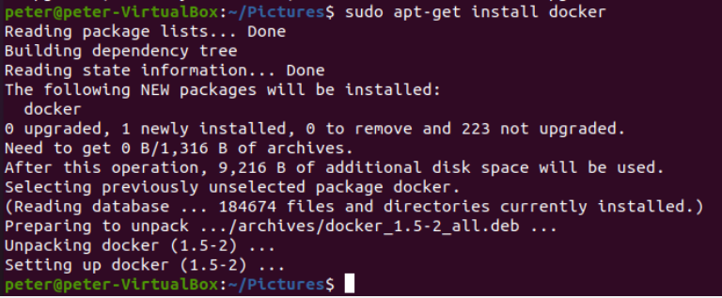
5.5 Uninstall Docker
https://www.youtube.com/watch?v=KCckWweNSrM&list=PLhW3qG5bs-L99pQsZ74f-LC-tOEsBp2rK&index=5
Uninstall Docker
We can re-install the docker into Linux System.
> sudo apt-get install docker

Slide 28
5.6 Summary

Slide 29
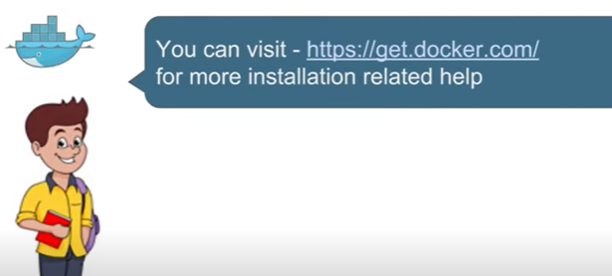
5.6 Summary
https://www.youtube.com/watch?v=KCckWweNSrM&list=PLhW3qG5bs-L99pQsZ74f-LC-tOEsBp2rK&index=5
Summary
We can get more information from “get.docker.com”.

Slide 30
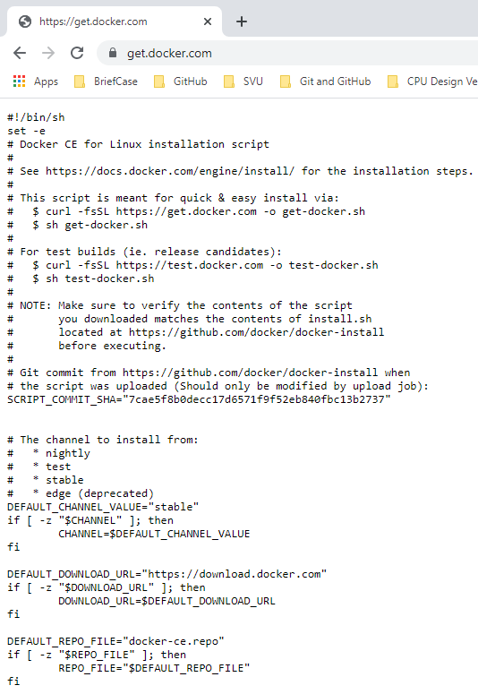
5.6 Summary
https://www.youtube.com/watch?v=KCckWweNSrM&list=PLhW3qG5bs-L99pQsZ74f-LC-tOEsBp2rK&index=5
Summary
We can see there are some commands and useful commands when you work on docker.

Slide 31
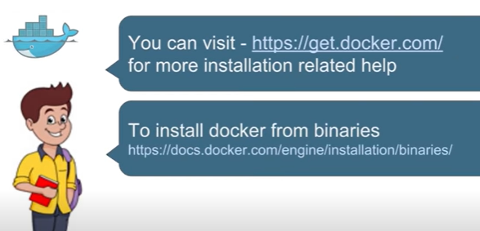
5.6 Summary
https://www.youtube.com/watch?v=KCckWweNSrM&list=PLhW3qG5bs-L99pQsZ74f-LC-tOEsBp2rK&index=5
Summary
To install docker from binaries.

Slide 32
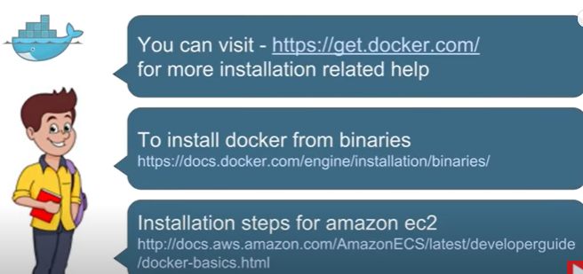
5.6 Summary
https://www.youtube.com/watch?v=KCckWweNSrM&list=PLhW3qG5bs-L99pQsZ74f-LC-tOEsBp2rK&index=5
Summary
Install steps for Amazon ec2.

Slide 33
End of Chapter

