Slide 1

1 Home
Peter H. Chen

Slide 2
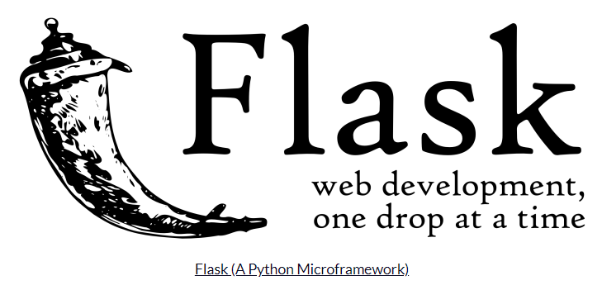

1 Introduction
https://www.tutorialspoint.com/flask/flask_overview.htm
What is Flask?
In English, Flask means the gunpowder container which is used to store the gunpowder.
The flask logo below shows exactly the gunpowder container.
Flask is a web application framework written in Python.
Armin Ronacher, who leads an international group of Python enthusiasts named Pocco, develops it.
Flask is based on Werkzeug WSGI toolkit and Jinja2 template engine. Both are Pocco projects.

Slide 3
End of Chapter

