Slide 1

3 Environment
Peter H. Chen

Slide 2
3 Environment
https://www.tutorialspoint.com/flask/flask_environment.htm
Prerequisite
Python 2.6 or higher is usually required for installation of Flask. Although Flask and its dependencies work well with Python 3 (Python 3.3 onwards), many Flask extensions do not support it properly. Hence, it is recommended that Flask should be installed on Python 2.7.
Install virtualenv for development environment
virtualenv is a virtual Python environment builder. It helps a user to create multiple Python environments side-by-side. Thereby, it can avoid compatibility issues between the different versions of the libraries.
The following command installs virtualenv
> pip install virtualenv
This command needs administrator privileges. Add sudo before pip on Linux/Mac OS. If you are on Windows, log in as Administrator.
On Ubuntu virtualenv may be installed using its package manager.
> sudo apt-get install virtualenv

Slide 3
3 Environment
https://www.tutorialspoint.com/flask/flask_environment.htm
Once installed, new virtual environment is created in a folder.
> mkdir newproj
> cd newproj
> vitrualenv venv

Slide 4
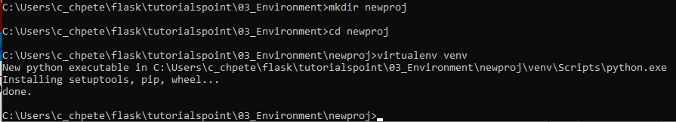
3 Environment
https://www.tutorialspoint.com/flask/flask_environment.htm
To activate corresponding environment, on Linux/OS X, use the following
> venv/bin/activate
On Windows, following can be used
> venv\Scripts\Activate

Slide 5
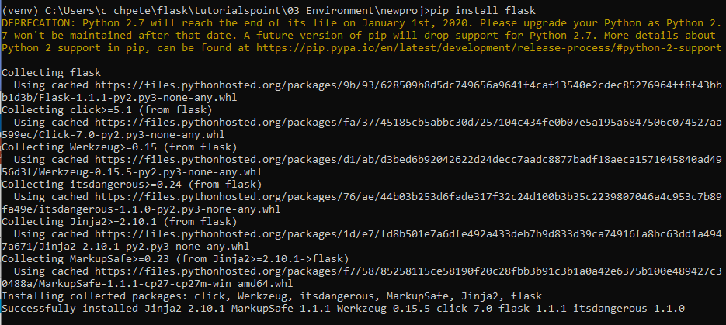
3 Environment
https://www.tutorialspoint.com/flask/flask_environment.htm
Install the Flask
> pip install flask

Slide 6
End of Chapter

