Slide 1

4 Application
Peter H. Chen

Slide 2
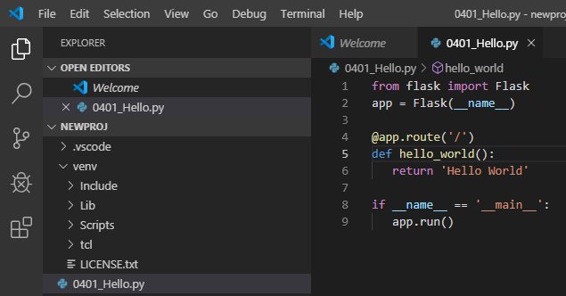
4 Application
https://www.tutorialspoint.com/flask/flask_application.htm
In order to test Flask installation, type the following code in the editor as 0401_Hello.py

Slide 3
4 Application
https://www.tutorialspoint.com/flask/flask_application.htm
Importing flask module in the project is mandatory. An object of Flask class is our WSGI (Web Server Gateway Interface) application.
Flask constructor takes the name of current module (__name__) as argument.
The route() function of the Flask class is a decorator, which tells the application which URL should call the associated function.
> app.route(rule, options)
The rule parameter represents URL binding with the function.
The options is a list of parameters to be forwarded to the underlying Rule object.
In the above example, ‘/’ URL is bound with hello_world() function. Hence, when the home page of web server is opened in browser, the output of this function will be rendered.

Slide 4
4 Application
https://www.tutorialspoint.com/flask/flask_application.htm
Finally the run() method of Flask class runs the application on the local development server.
> app.run (host, port, debug, options)
All parameters are optional
No. | Parameters & Description
1 | host: Hostname to listen on. Defaults to 127.0.0.1 (localhost). Set to ‘0.0.0.0’ to have server available externally
2 | port: Defaults to 5000
3 | debug: Defaults to false. If set to true, provides a debug information
4 | options: To be forwarded to underlying Werkzeug server.

Slide 5
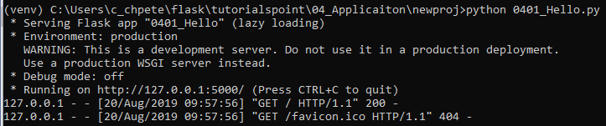
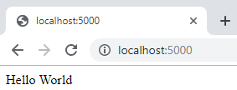
4 Application
https://www.tutorialspoint.com/flask/flask_application.htm
The above given Python script is executed from Python shell.
> python 0401_Hello.py
A message in Python shell informs you that
> * Running on http://127.0.0.1:5000/ (Press CTRL+C to quit)
Open the above URL (localhost:5000) in the browser. ‘Hello World’ message will be displayed on it.

Slide 6
4 Application
https://www.tutorialspoint.com/flask/flask_application.htm
The above given Python script is executed from Python shell.
> python 0401_Hello.py
A message in Python shell informs you that
> * Running on http://127.0.0.1:5000/ (Press CTRL+C to quit)
Open the above URL (localhost:5000) in the browser. ‘Hello World’ message will be displayed on it.

Slide 7
4 Application
https://www.tutorialspoint.com/flask/flask_application.htm
Debug mode
A Flask application is started by calling the run() method. However, while the application is under development, it should be restarted manually for each change in the code.
To avoid this inconvenience, enable debug support.
The server will then reload itself if the code changes. It will also provide a useful debugger to track the errors if any, in the application.
The Debug mode is enabled by setting the debug property of the application object to True before running or passing the debug parameter to the run() method.
> app.debug = True
> app.run()
or
> app.run (debug=True)

Slide 8
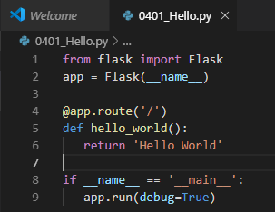
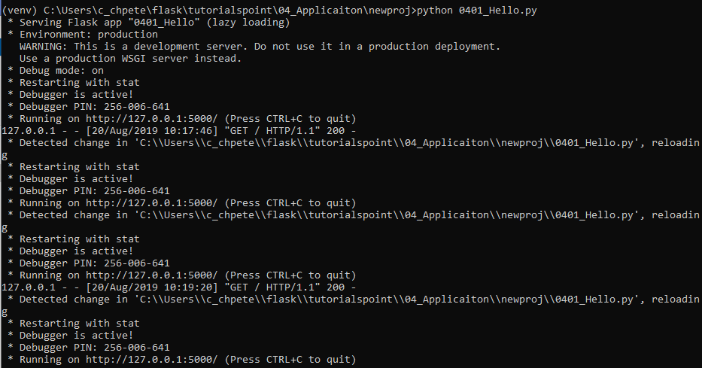
4 Application
https://www.tutorialspoint.com/flask/flask_application.htm
Debug mode
Debug mode: on
…
Restart with stat

Slide 9
End of Chapter

