Slide 1

5 Routing
Peter H. Chen

Slide 2
5 Routing
https://www.tutorialspoint.com/flask/flask_routing.htm
Modern web frameworks use the routing technique to help a user remember application URLs. It is useful to access the desired page directly without having to navigate from the home page.
The route() decorator in Flask is used to bind URL to a function. For example
> @app.route(‘/hello’)
> def hello_world():
> return ‘hello world’
Here, URL ‘/hello’ rule is bound to the hello_world() function.
As a result, if a user visits http://localhost:5000/hello URL, the output of the hello_world() function will be rendered in the browser.
The add_url_rule() function of an application object is also available to bind a URL with a function as in the above example, route() is used.
A decorator’s purpose is also served by the following representation

Slide 3
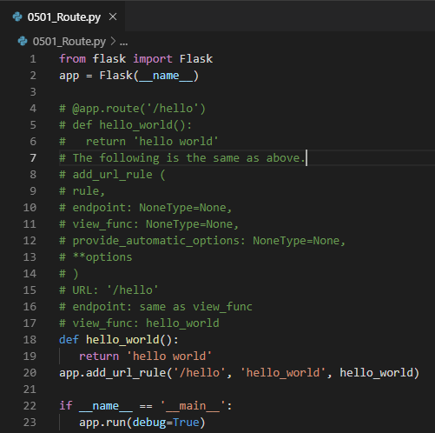
5 Routing
https://www.tutorialspoint.com/flask/flask_routing.htm
The add_url_rule() function of an application object is also available to bind a URL with a function as in the above example, route() is used.
A decorator’s purpose is also served by the following representation:
> def hello_world():
> return ‘hello world’
> app.add_url_rule(‘/hello’, ‘hello_world’, hello_world)

Slide 4
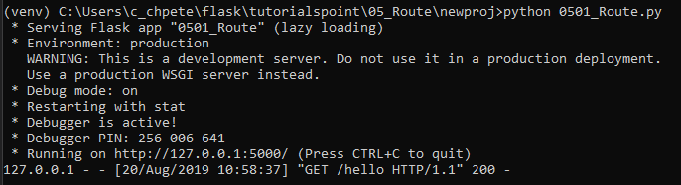
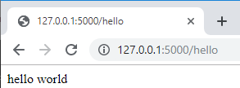
5 Routing
https://www.tutorialspoint.com/flask/flask_routing.htm
The add_url_rule() function of an application object is also available to bind a URL with a function as in the above example, route() is used.

Slide 5
End of Chapter

