Slide 1

6 Variable Rules
Peter H. Chen

Slide 2
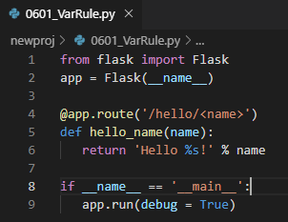
6 Variable Rules
https://www.tutorialspoint.com/flask/flask_variable_rules.htm#
It is possible to build a URL dynamically, by adding variable parts to the rule parameter. This variable part is marked as <variable-name>. It is passed as a keyword argument to the function with which the rule is associated.
In the following example, the rule parameter of route() decorator contains <name> variable part attached to URL ‘/hello’.
Hence, if the http://localhost:5000/hello/peter is entered as a URL in the browser, ‘peter’ will be supplied to hello() function as argument.
> from flask import Flask
> app = Flask(__name__)
>@app.route('/hello/<name>’)
> def hello_name(name):
> return 'Hello %s!' % name
>if __name__ == '__main__’:
> app.run(debug = True)

Slide 3
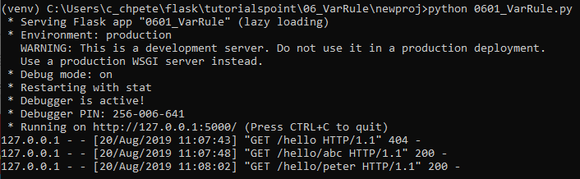

6 Variable Rules
https://www.tutorialspoint.com/flask/flask_variable_rules.htm#
Save the above script as 0601_VarRule.py and run it from Python shell.
Open the Chrome and enter URL http://localhost:5000/hello/peter.
The following displays the “Hello peter” on the browser.

Slide 4
6 Variable Rules
https://www.tutorialspoint.com/flask/flask_variable_rules.htm#
In addition to the default string variable part, rules can be constructed using the following converters.
No | Converters & Description
1 | int: accepts integer
2 | float: For floating point value
3 | path: accepts slashes used as directory separator character

Slide 5
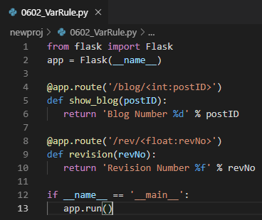
6 Variable Rules
https://www.tutorialspoint.com/flask/flask_variable_rules.htm#
In the following code 0602_VarRule.py, all these constructors are used.

Slide 6
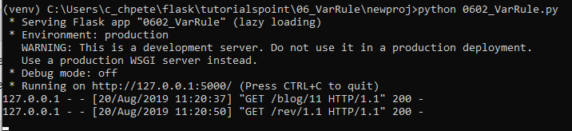

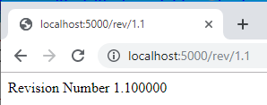
6 Variable Rules
https://www.tutorialspoint.com/flask/flask_variable_rules.htm#
> python 0602_VarRule.py
Open Chrome and enter “localhost:5000/blog/11” and “localhost:5000/rev/1.1”

Slide 7
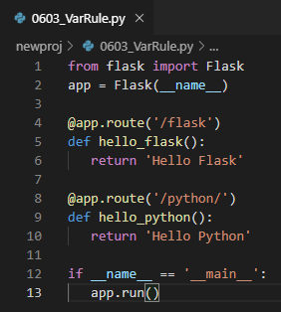
6 Variable Rules
https://www.tutorialspoint.com/flask/flask_variable_rules.htm#
The URL rules of Flask are based on Werkzeug’s routing module.
This ensures that the URLs formed are unique and based on precedents laid down by Apache.
Consider the rules defined in the following script.

Slide 8
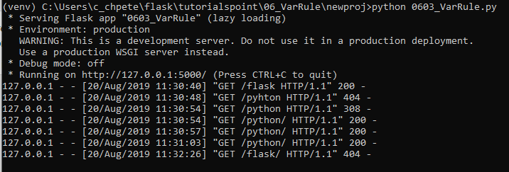
6 Variable Rules
https://www.tutorialspoint.com/flask/flask_variable_rules.htm#
> python 0603_VarRule.py

Slide 9
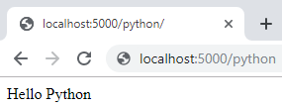
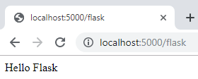
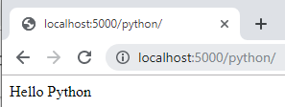
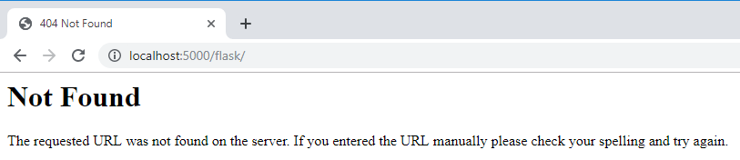
6 Variable Rules
https://www.tutorialspoint.com/flask/flask_variable_rules.htm#
Both the rules appear similar but in the second rule, trailing slash (/) is used.
As a result, it becomes a canonical URL (Official URL).
Hence, using /python or /python/ returns the same output.
However, in case of the first rule, /flask/ URL results in 404 Not Found page.

Slide 10
End of Chapter

