Slide 1

7 Dynamic URL
Peter H. Chen

Slide 2
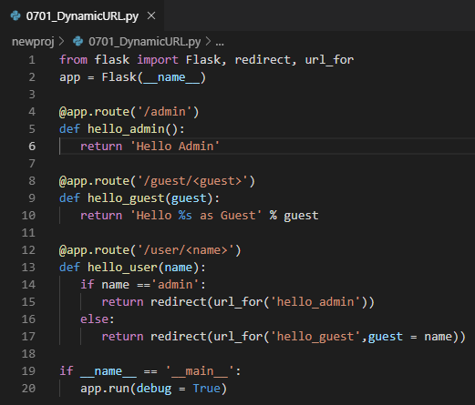
7 Dynamic URL
https://www.tutorialspoint.com/flask/flask_url_building.htm
The url_for() function is very useful for dynamically building a URL for a specific function.
The function accepts the name of a function as first argument, and one or more keyword arguments, each corresponding to the variable part of URL.
The following script demonstrates use of url_for() function.
This script has a function user/ <name> which accepts a value to its argument from the URL.
The user/<name> function checks if an argument received matches ‘admin’ or not. If it matches, the application is redirected to the hello_admin() function using url_for(), otherwise to the hello_guest() function passing the received argument as guest parameter to it.

Slide 3
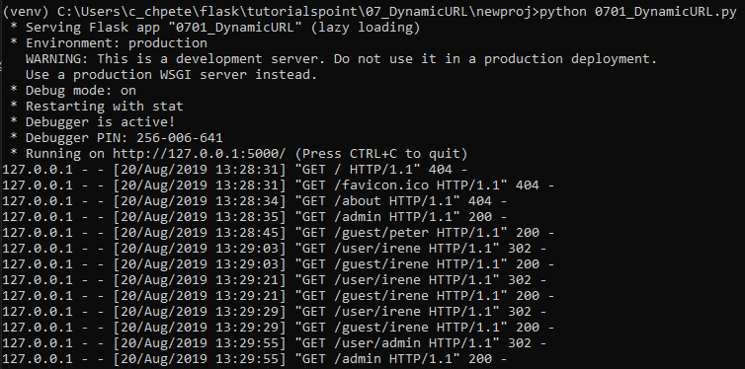
7 Dynamic URL
https://www.tutorialspoint.com/flask/flask_url_building.htm
> python 0701_DynamicURL.py

Slide 4

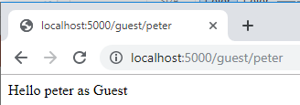
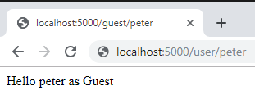

7 Dynamic URL
https://www.tutorialspoint.com/flask/flask_url_building.htm
> localhost:5000/admin
> localhost:5000/peter
> localhost:5000/user/peter
> localhost:5000/user/admin

Slide 5
End of Chapter

