Slide 1

8 Http Method
Peter H. Chen

Slide 2
8 Http Method
https://www.tutorialspoint.com/flask/flask_http_methods.htm
Http protocol is the foundation of data communication in world wide web.
Different methods of data retrieval from specified URL are defined in this protocol.
The following table summarizes different http methods:
No. | Methods & Description
1 | GET: Sends data in unencrypted form to the server. Most common method.
2 | HEAD: Same as GET, but without response body
3 | POST: Used to send HTML form data to server. Data received by POST method is not cached by server.
4 | PUT: Replaces all current representations of the target resource with the uploaded content.
5 | DELETE: Removes all current representations of the target resource given by a URL

Slide 3
8 Http Method
https://www.tutorialspoint.com/flask/flask_http_methods.htm
By default, the Flask route responds to the GET requests.
However, this preference can be altered by providing methods argument to route() decorator.

Slide 4
8.1 POST Request/POST Response

Slide 5
8.1 POST Request/POST Response
https://www.tutorialspoint.com/flask/flask_http_methods.htm
In order to demonstrate the use of POST method in URL routing, first let us create an HTML form and use the POST method to send form data to a URL.
After the development server starts running, open loginPost.html in the browser, enter name in the text field and click Submit.
Form data is POSTed to the URL in action clause of form tag.
http://localhost/login is mapped to the login() function. Since the server has received data by POST method, value of ‘nm’ parameter obtained from the form data is obtained by:
> user = request.form['nm’]
It is passed to ‘/success’ URL as variable part. The browser displays a welcome message in the window.

Slide 6
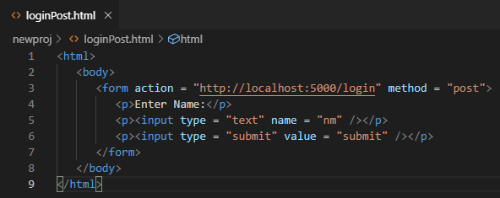
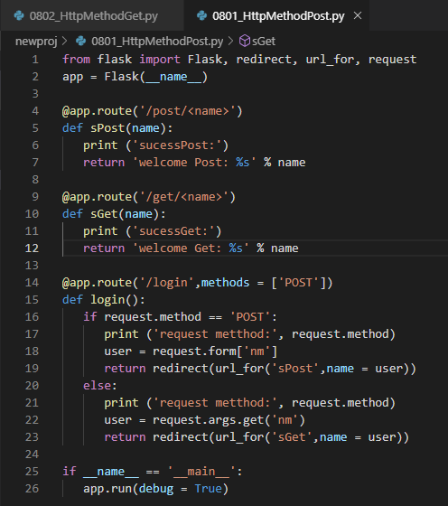
8.1 POST Request/POST Response
https://www.tutorialspoint.com/flask/flask_http_methods.htm
HTML Client POST Request:
Python Server POST Response:

Slide 7
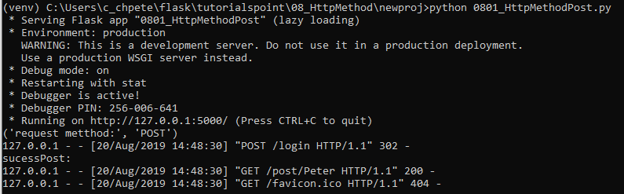
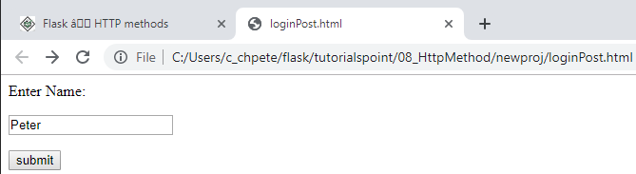
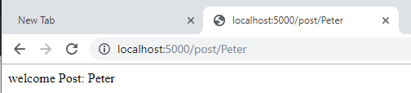
8.1 POST Request/POST Response
https://www.tutorialspoint.com/flask/flask_http_methods.htm
Python 0801_HttpMethodPost.py
loginPost.html

Slide 8
8.2 GET Request/GET Response

Slide 9
8.2 GET Request/GET Response
https://www.tutorialspoint.com/flask/flask_http_methods.htm
Change the method parameter to ‘GET’ in loginGet.html and open it again in the browser. The data received on server is by the GET method. The value of ‘nm’ parameter is now obtained by
> user = request.args.get(‘nm’)
Here, args is dictionary object containing a list of pairs of form parameter and its corresponding value.
The value corresponding to ‘nm’ parameter is passed on to ‘/success’ URL as before.

Slide 10
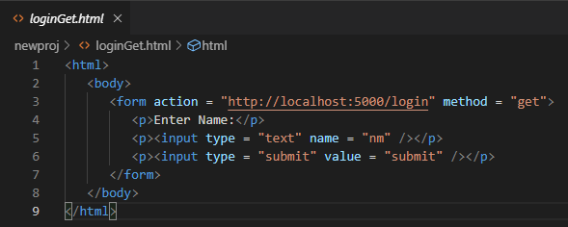
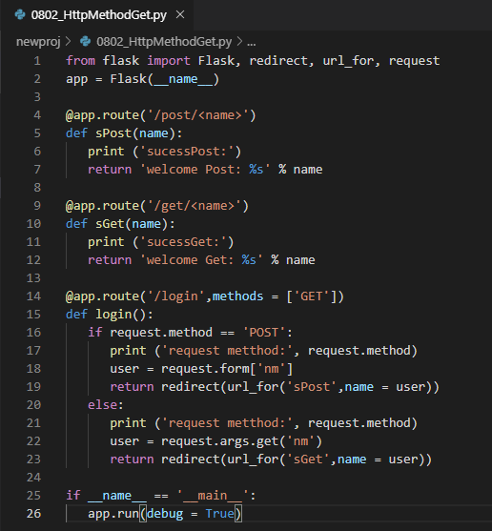
8.2 GET Request/GET Response
https://www.tutorialspoint.com/flask/flask_http_methods.htm
HTML Client GET Request:
Python Server GET Response:

Slide 11
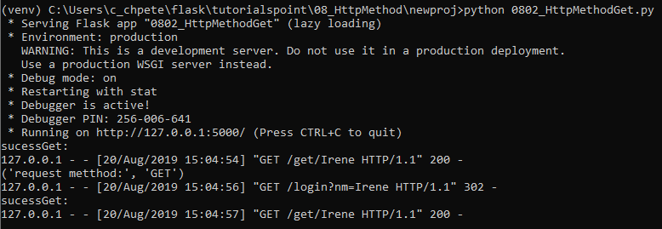
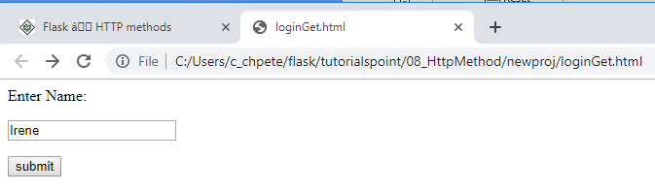
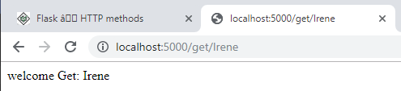
8.2 GET Request/GET Response
https://www.tutorialspoint.com/flask/flask_http_methods.htm
Python 0802_HttpMethodGet.py
loginGet.html

Slide 12
8.3 Set GET/POST in Server

Slide 13
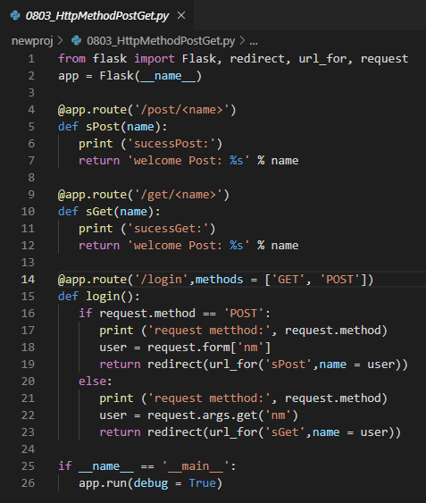
8.2 GET Request/GET Response
https://www.tutorialspoint.com/flask/flask_http_methods.htm
> Python 0803_HttpMethodPostGet.py.
By default, the GET is used.

Slide 14
End of Chapter

