Slide 1

9 Template
Peter H. Chen

Slide 2
9 Template
https://www.tutorialspoint.com/flask/flask_templates.html
It is possible to return the output of a function bound to a certain URL in the form of HTML.

Slide 3
9.1 Return HTML
Peter H. Chen

Slide 4
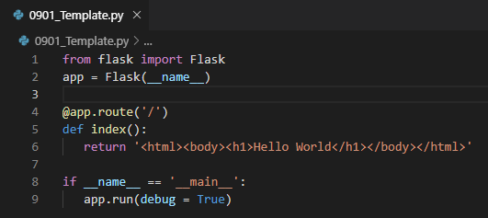
9.1 Return HTML
https://www.tutorialspoint.com/flask/flask_templates.html
For instance, in the following script, index() function will render “Hello World” with <h1> tag attached to it.

Slide 5
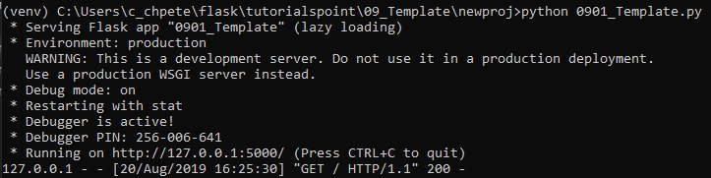
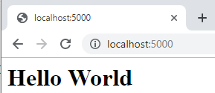
9.1 Return HTML
https://www.tutorialspoint.com/flask/flask_templates.html
> python 0901_Template.py
Open Chrome. Enter “localhost:5000”

Slide 6
9.2 Render Template
Peter H. Chen

Slide 7
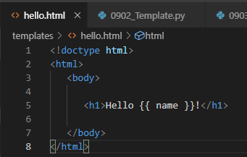
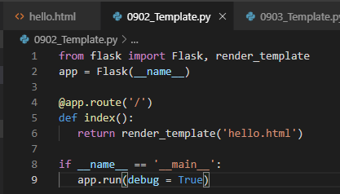
9.2 Render Template
https://www.tutorialspoint.com/flask/flask_templates.html
However, generating HTML content from Python code is cumbersome (tedious), especially when variable data and Python language elements like conditionals or loops need to be put. This would require frequent escaping from HTML.
This is where one can take advantage of Jinja2 template engine, on which Flask is based. Instead of returning hardcode HTML from the function, a HTML file can be rendered by the render_template() function.

Slide 8
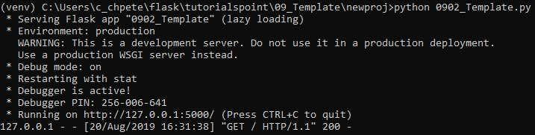
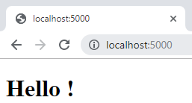
9.2 Render Template
https://www.tutorialspoint.com/flask/flask_templates.html
> python 0902_Template.py
Open Chrome. Enter “localhost:5000”

Slide 9
9.3 Template Parameter
Peter H. Chen

Slide 10
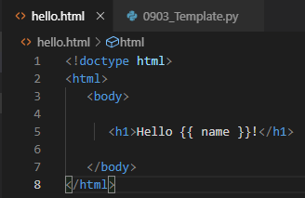
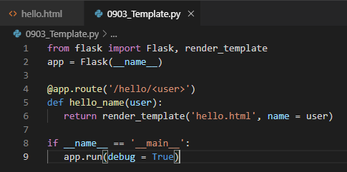
9.3 Template Parameter
https://www.tutorialspoint.com/flask/flask_templates.html
In hello.html under the templates folder, the parameter {{ name }} is a template parameter.
In 0903_Template.py, pass the <user> is the URL variable.
The URL variable <user> passed to render_template (‘hello.thml’, name= user)

Slide 11
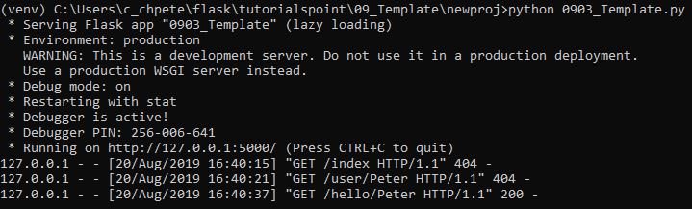
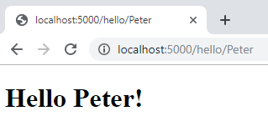
9.3 Template Parameter
https://www.tutorialspoint.com/flask/flask_templates.htm
> python 0903_Template.py
Open chrome and enter “localhost:5000/hello/Peter”

Slide 12
9.4 Jinja2 Template
Peter H. Chen

Slide 13
9.4 Jinja2 Template
https://www.tutorialspoint.com/flask/flask_templates.html
The Jinja2 template engine uses the following delimiters for escaping from HTML.
{% ... %} for Statements
{{ ... }} for Expressions to print to the template output
{# ... #} for Comments not included in the template output
# ... ## for Line Statements
In the following example, use of conditional statement in the template is demonstrated. The URL rule to the hello() function accepts the integer parameter. It is passed to the hello.html template. Inside it, the value of number received (marks) is compared (greater or less than 50) and accordingly HTML is conditionally rendered.

Slide 14
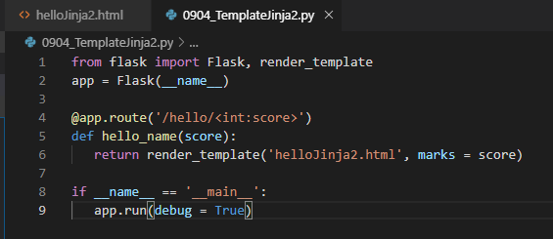
9.4 Jinja2 Template
https://www.tutorialspoint.com/flask/flask_templates.html
Create “newproj/0904_TemplateJinj2.py”.
The file “helloJinja2.html” is rendered with score passed from URL.
The “marks” is the id defined in helloJinja2.html

Slide 15
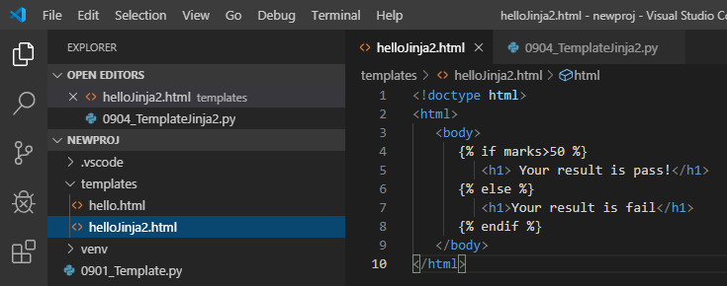
9.4 Jinja2 Template
https://www.tutorialspoint.com/flask/flask_templates.html
Create “newproj/templates/helloJinja2.html”
Note that the conditional statements if-else and endif are enclosed in delimiter {%..%}.
The id “marks” is defined in the html with value passed from URL.

Slide 16
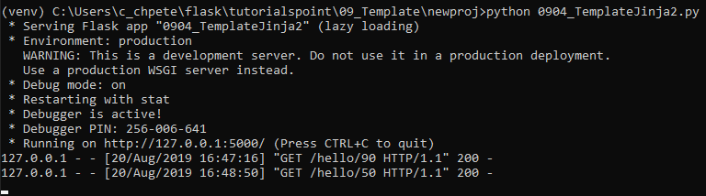
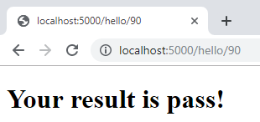
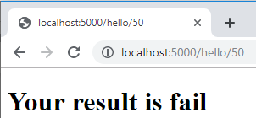
9.4 Jinja2 Template
https://www.tutorialspoint.com/flask/flask_templates.html
> python 0904_TemplateJinj2.py
Open chrome. Enter “localhost:5000/hello/90” get pass score.
Enter “localhost:5000/hello/50” gets fail score.

Slide 17
9.5 Linja2 Loop
Peter H. Chen

Slide 18
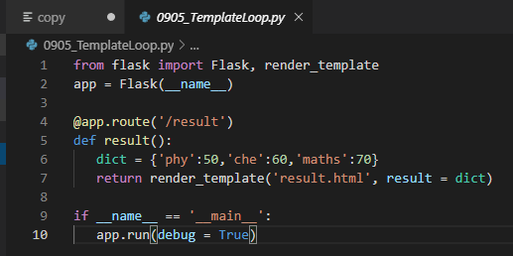
9.5 Linja2 Loop
https://www.tutorialspoint.com/flask/flask_templates.html
The Python loop constructs can also be employed inside the template. In the following script, the result() function sends a dictionary object to template results.html when URL http://localhost:5000/result is opened in the browser.
The Template part of result.html employs a for loop to render key and value pairs of dictionary object result{} as cells of an HTML table.

Slide 19
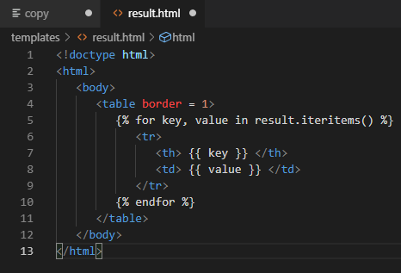
9.5 Linja2 Loop
https://www.tutorialspoint.com/flask/flask_templates.html
Create newproj\templates\result.html

Slide 20
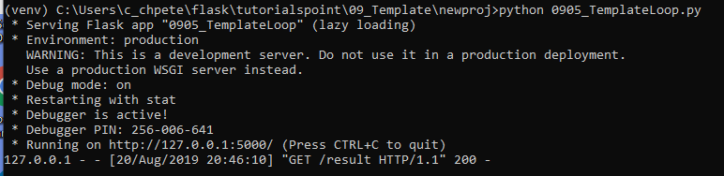
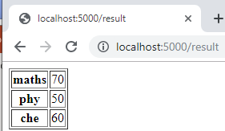
9.5 Linja2 Loop
https://www.tutorialspoint.com/flask/flask_templates.html
Here, again the Python statements corresponding to the For loop are enclosed in {%..%} whereas, the expressions key and value are put inside {{ }}.
After the development starts running, open http://localhost:5000/result in the browser to get the following output:

Slide 21
End of Chapter

