Slide 1

8 Parent/Child Values in JsTree
Peter H. Chen

Slide 2
8 JsTree and Parent/Child Values
https://www.jstree.com/
Display the JsTree in JSON Format
Get the children bandwidth and sum at children’s direct parent from generation to generation.

Slide 3
8.1 Code

Slide 4
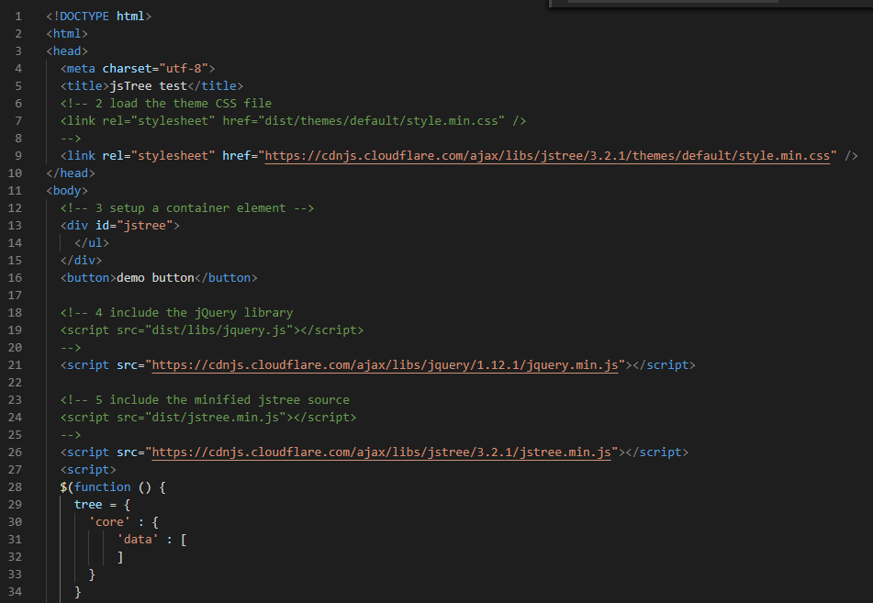
8.1 Code
https://www.jstree.com/
Path JSON: Parse into JSON and then sum of children from the parent nodes:

Slide 5
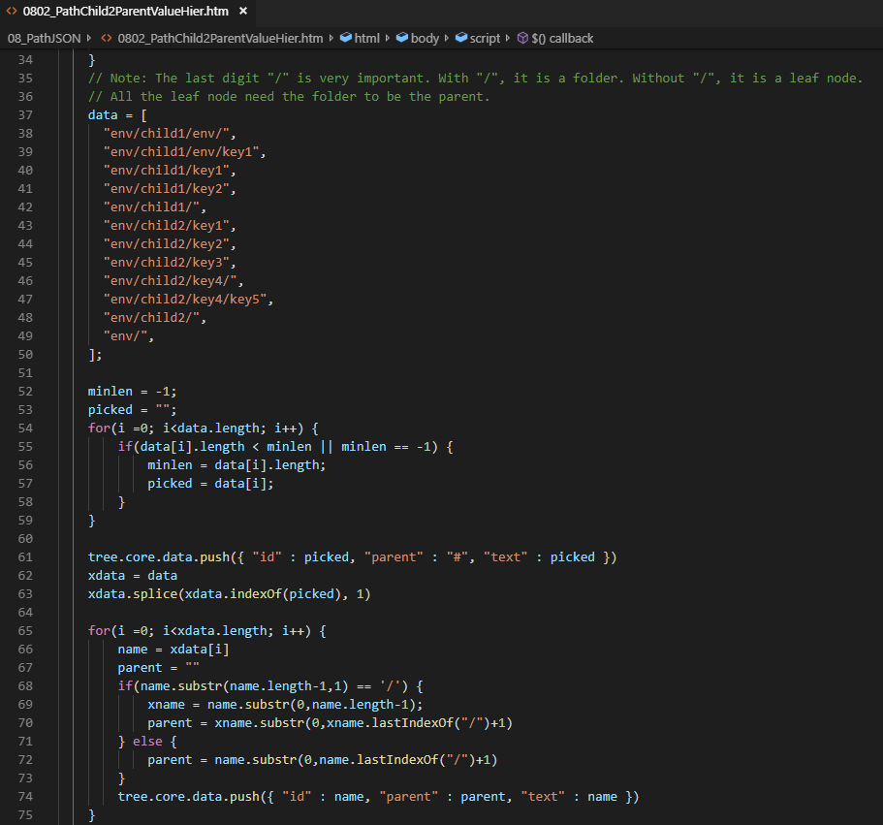
8.1 Code
https://www.jstree.com/
Path JSON: Parse into JSON and then sum of children from the parent nodes:

Slide 6
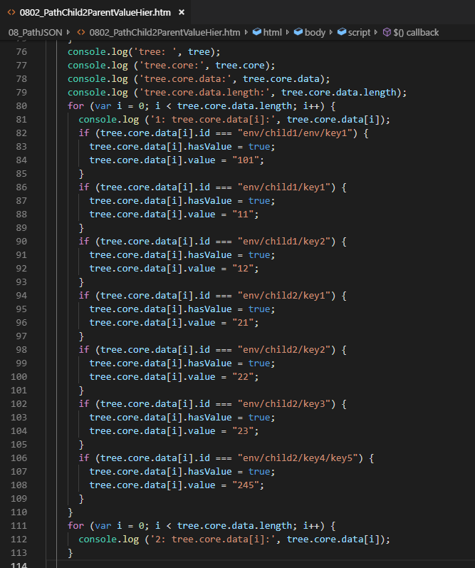
8.1 Code
https://www.jstree.com/
Path JSON: Parse into JSON and then sum of children from the parent nodes:

Slide 7
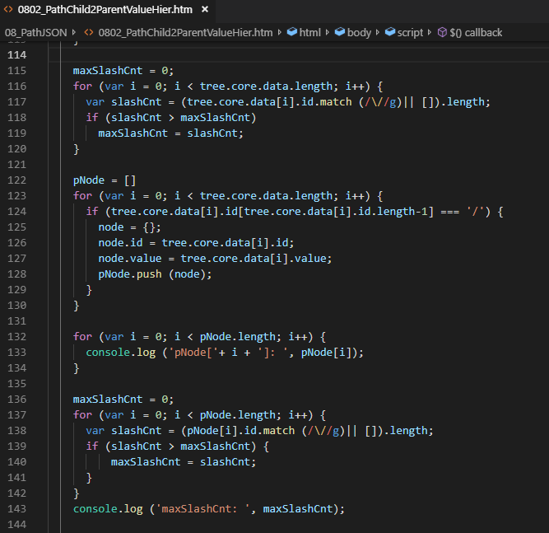
8.1 Code
https://www.jstree.com/
Path JSON: Parse into JSON and then sum of children from the parent nodes:

Slide 8
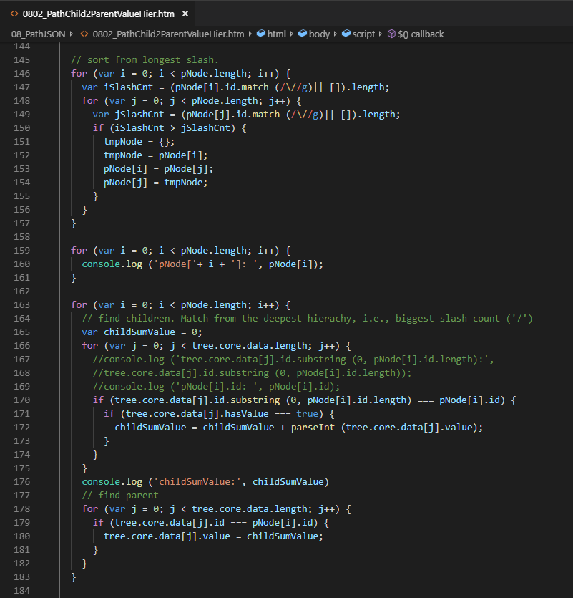
8.1 Code
https://www.jstree.com/
Path JSON: Parse into JSON and then sum of children from the parent nodes:

Slide 9
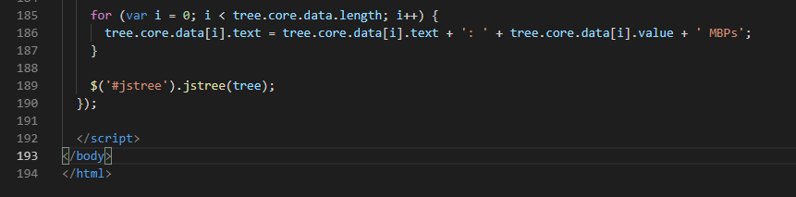
8.1 Code
https://www.jstree.com/
Path JSON: Parse into JSON and then sum of children from the parent nodes:

Slide 10
8.1 Code

Slide 11
8.2 Verify Sum of Child Bandwidth
Peter H. Chen

Slide 12
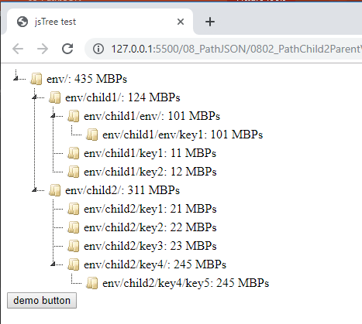
8.2 Verify Sum of Child Bandwidth
https://www.jstree.com/
Verify the Output:

Slide 13
End of Chapter

