Slide 1

4 JSON
Peter H. Chen

Slide 2
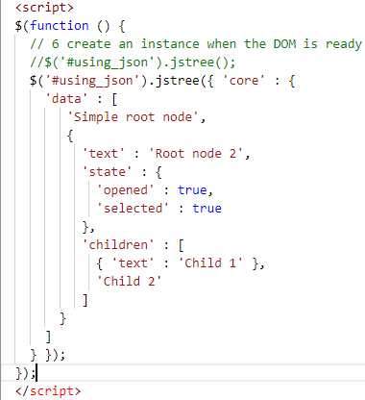
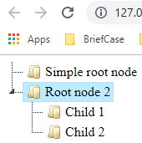
4 JSON
https://www.jstree.com/
0401_JSON.htm:
Simple root node)
Root node 2
Child 1
Child 2

Slide 3
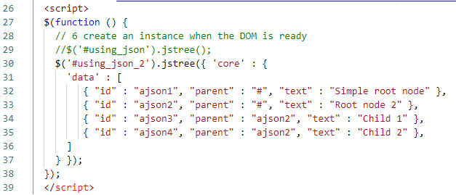
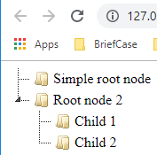
4 JSON
https://www.jstree.com/
0402_JSON2.htm: This is the alternative form and clearer than the last example.
#
Id: ajson1
(Simple root node)
Id: ajson2
(Root node 2)
Id: ajson3
(Child 1)
Id: ajson4
(Child 2)

Slide 4
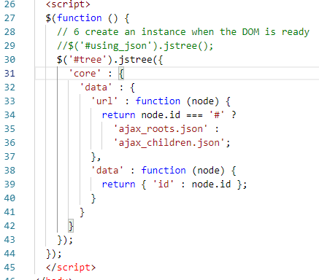
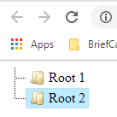
4 JSON
https://www.jstree.com/
0403_AJAX.htm: This example is incomplete.
Root1
Root2

Slide 5
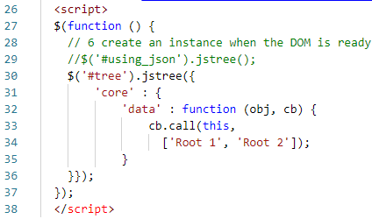
4 JSON
https://www.jstree.com/
0404_func.htm: This is the alternative form and clearer than the last example.
Root1
Root2

Slide 6
End of Chapter

