Slide 1

5 Event
Peter H. Chen

Slide 2
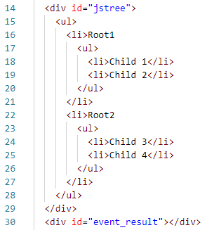
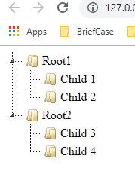
5 HTML and Event
https://www.jstree.com/
0501_HTML_Event.htm: HTML creates elements.

Slide 3
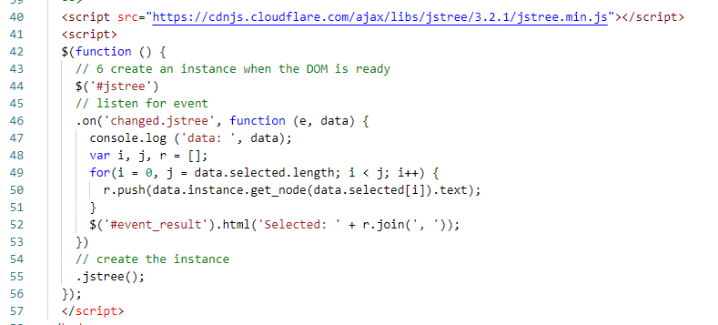
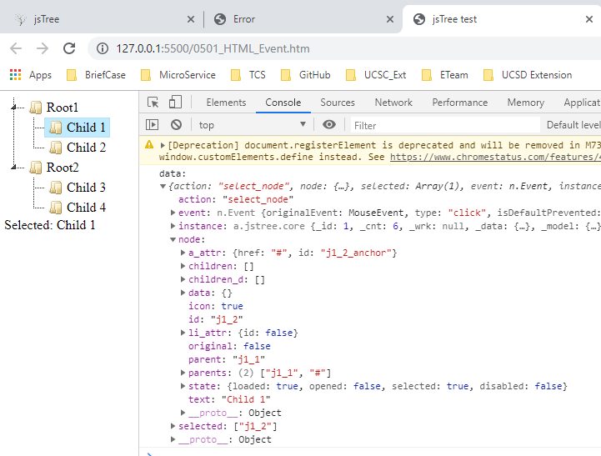
5 HTML and Event
https://www.jstree.com/
0501_HTML_Event.htm: Tie events to HTML element.

Slide 4
End of Chapter

