Slide 1

6 Interactive
Peter H. Chen

Slide 2
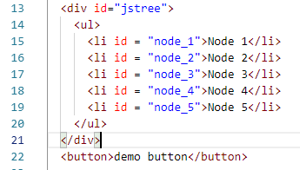
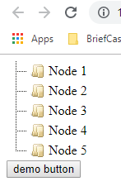
6 Interative
https://www.jstree.com/
0601_SelectNode.htm: HTML creates elements.

Slide 3
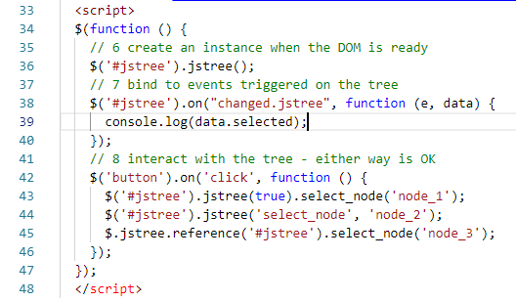
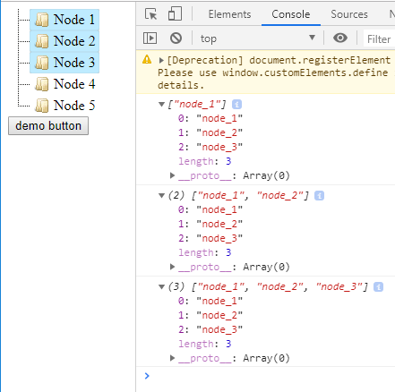
6 Interactive
https://www.jstree.com/
0501_HTML_Event.htm: Click button to and high light the specified IDs.

Slide 4
End of Chapter

