Slide 1

2 Setup
Peter H. Chen

Slide 2
2 Setup
https://www.tutorialspoint.com/graphql/graphql_environment_setup.htm
Setup
We setup environmental for GraphQL.
To execute the examples in this tutorial you will need the following −
A computer running Linux, MacOS, or Windows.
A web browser, preferably the latest version of Google Chrome.
A recent version of Node.js installed.
Visual Studio Code with extension GraphQL for VSCode installed or any code editor of your choice.

Slide 3
2 Setup
https://www.tutorialspoint.com/graphql/graphql_environment_setup.htm
How to Build a GraphQL server with Nodejs
We will go through a detailed step-wise approach to build GraphQL server with Nodejs as shown below −

Slide 4
2.1 Step 1

Slide 5

2.1 Step 1
https://www.tutorialspoint.com/graphql/graphql_environment_setup.htm
How to Build a GraphQL server with Nodejs
We will go through a detailed step-wise approach to build GraphQL server with Nodejs as shown below −
Step 1 − Verify Node and Npm Versions
Under the Anaconda3 environment, we install NodeJS.
After installing NodeJs, verify the version of node and npm using following commands on the terminal −

Slide 6
2.2 Step 2

Slide 7
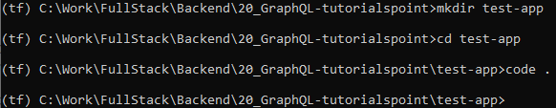
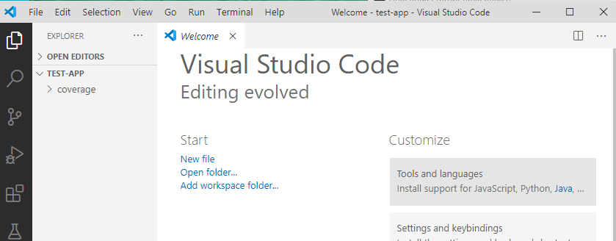
2.2 Step 2
https://www.tutorialspoint.com/graphql/graphql_environment_setup.htm
Step 2 − Create a Project Folder and Open in VSCode
The root folder of project can be named as test-app.
Open the folder using visual studio code editor by using the instructions below

Slide 8
2.3 Step 3

Slide 9
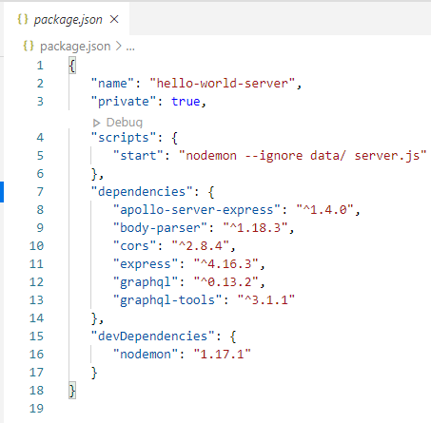
2.3 Step 3
https://www.tutorialspoint.com/graphql/graphql_environment_setup.htm
Step 3 − Create package.json and Install the Dependencies
Create a package.json file which will contain all the dependencies of the GraphQL server application

Slide 10
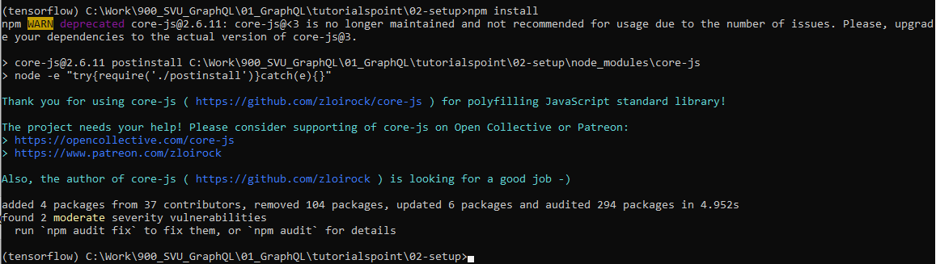
2.3 Step 3
https://www.tutorialspoint.com/graphql/graphql_environment_setup.htm
Install the dependencies by using the command as given below
> npm install

Slide 11
2.4 Step 4

Slide 12
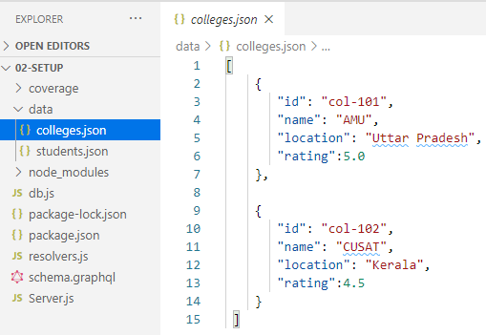
2.4 Step 4
https://www.tutorialspoint.com/graphql/graphql_environment_setup.htm
Step 4 − Create Flat File Database in Data Folder
In this step, we use flat files to store and retrieve data. Create a folder data and add two files students.json and colleges.json.
Following is the colleges.json file

Slide 13
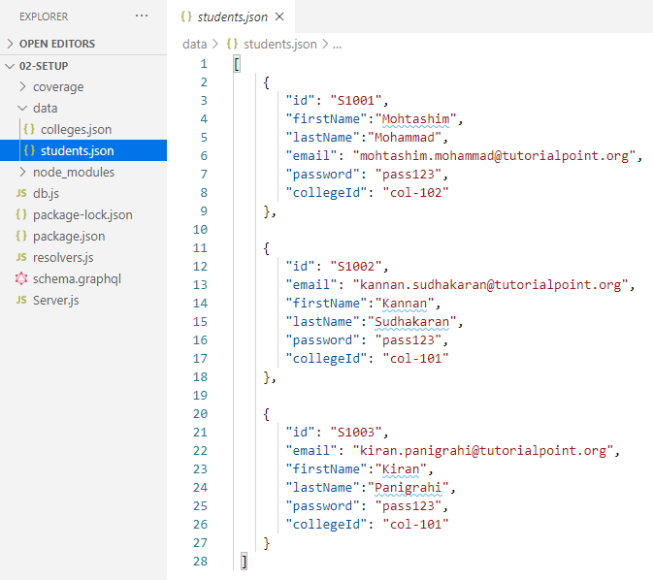
2.4 Step 4
https://www.tutorialspoint.com/graphql/graphql_environment_setup.htm
Step 4 − Create Flat File Database in Data Folder
Following is the students.json file

Slide 14
2.5 Step 5

Slide 15
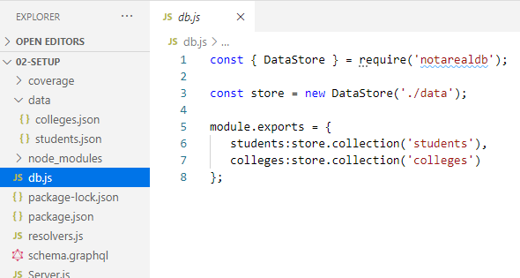
2.5 Step 5
https://www.tutorialspoint.com/graphql/graphql_environment_setup.htm
Step 5 − Create a Data Access Layer
We need to create a datastore that loads the data folder contents.
In this case, we need collection variables, students and colleges.
Whenever the application needs data, it makes use of these collection variables.
Create file db.js with in the project folder as follows
Note: db.js is not a real database.

Slide 16
2.6 Step 6

Slide 17
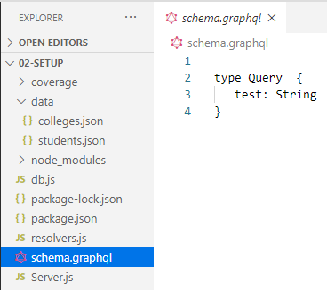
2.6 Step 6
https://www.tutorialspoint.com/graphql/graphql_environment_setup.htm
Step 6 − Create Schema File, schema.graphql
Create a schema file (schema/graphql) in the current project folder and add the following contents −

Slide 18
2.7 Step 7

Slide 19
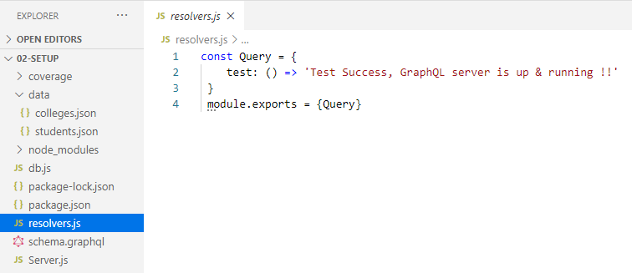
2.7 Step 7
https://www.tutorialspoint.com/graphql/graphql_environment_setup.htm
Step 7 − Create Resolver File, resolvers.js
Create a resolver file (resolvers.js) in the current project folder and add the following contents.

Slide 20
2.8 Step 8

Slide 21
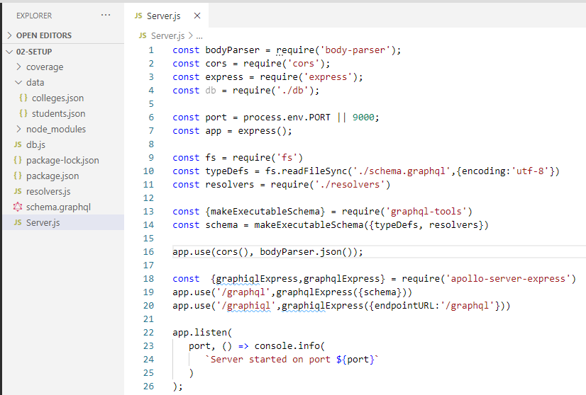
2.8 Step 8
https://www.tutorialspoint.com/graphql/graphql_environment_setup.htm
Step 8 − Create Server.js and Configure GraphQL
Create a server file (Server.js) and configure GraphQL as follows

Slide 22
2.9 Step 9

Slide 23
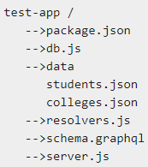
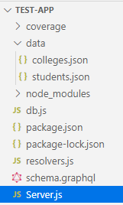
2.9 Step 9
https://www.tutorialspoint.com/graphql/graphql_environment_setup.htm
Step 9 − Run the Application and Test with GraphiQL
Verify the folder structure of project test-app as follows −

Slide 24
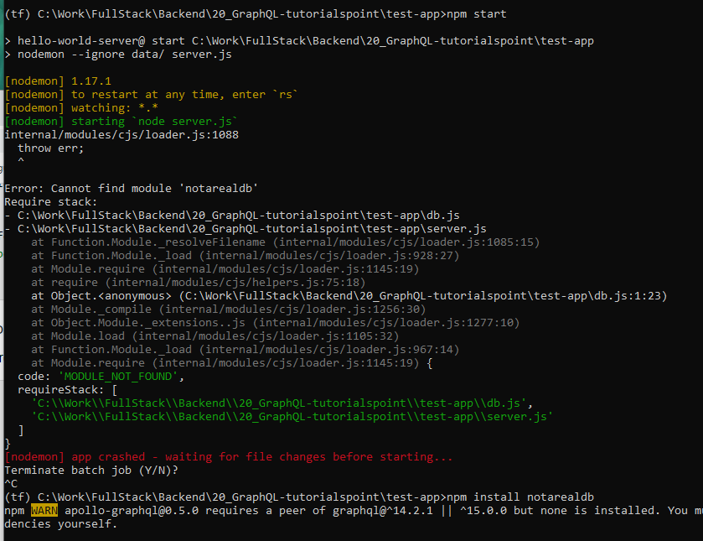
2.9 Step 9
https://www.tutorialspoint.com/graphql/graphql_environment_setup.htm
Run the command npm start as given below
> npm start
ERRO: cannot find “notarealdb”
> npm install notarealdb

Slide 25
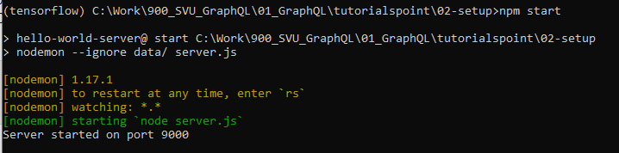
2.9 Step 9
https://www.tutorialspoint.com/graphql/graphql_environment_setup.htm
Run the command npm start as given below
> npm start
The server is running in 9000 port

Slide 26
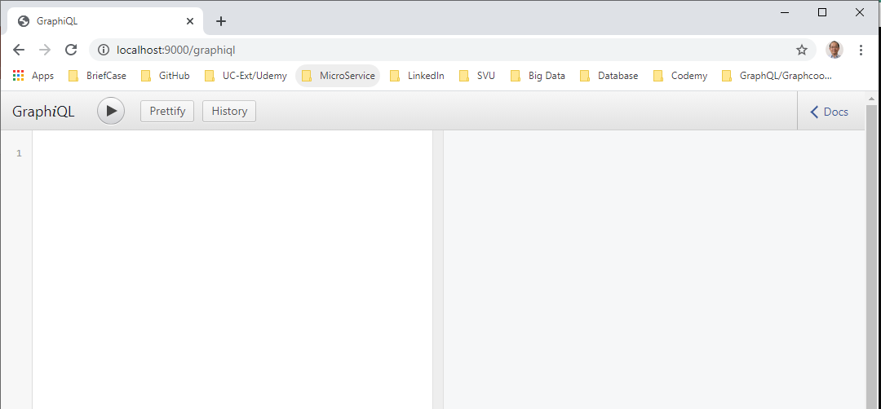
2.9 Step 9
https://www.tutorialspoint.com/graphql/graphql_environment_setup.htm
The server is running in 9000 port, so we can test the application using GraphiQL tool.
Open the browser and enter the URL http://localhost:9000/graphiql.

Slide 27
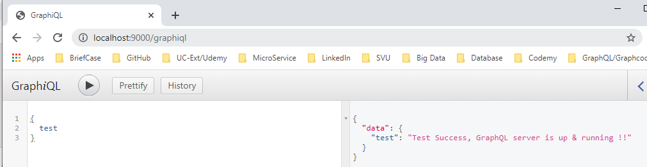
2.9 Step 9
https://www.tutorialspoint.com/graphql/graphql_environment_setup.htm
1. Type the following query in the editor:
> {
> test
>}
2. Click “>”
3. GraphiQL display the result.
2
1
3

Slide 28
End of Chapter

