Slide 1

14 React Integration: Part 1
Peter H. Chen

Slide 2
14 React Integration: Part 1
https://www.tutorialspoint.com/graphql/graphql_react_integration.htm
This section discusses the integration of ReactJS and GraphQL.
React is a JavaScript library for building user interfaces. This chapter explains how one can integrate GraphQL with a React application.
Illustration
The quickest way to set up a react project is by using the Create React App (create_react_app) tool.
In the subsequent sections, we will discuss how to set up both the Server and the Client.

Slide 3
14.1 Step 1

Slide 4
14.1 Step 1
https://www.tutorialspoint.com/graphql/graphql_react_integration.htm
Step 1: Download and install required dependencies for the project.
Create a folder 14-react-server-app.
Follow the step 3 - step5 of 03_Setup.pptx

Slide 5
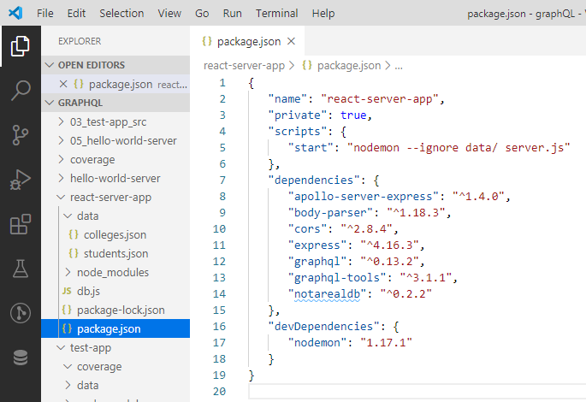
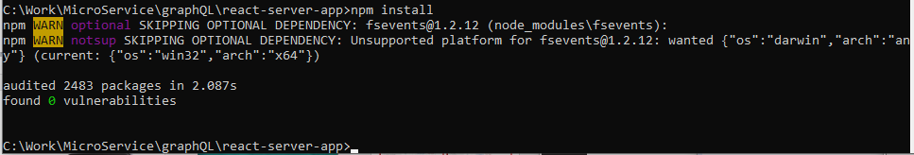
14.1 Step 1
https://www.tutorialspoint.com/graphql/graphql_environment_setup.htm
Environment Setup Step 3. Create package.json as follow and install the dependencies:
> npm install

Slide 6
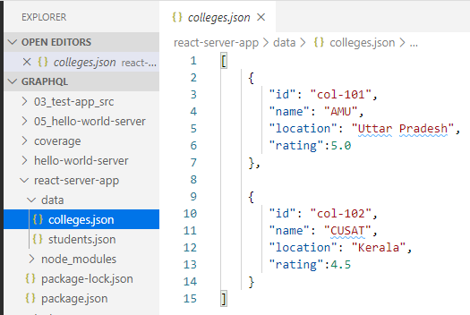
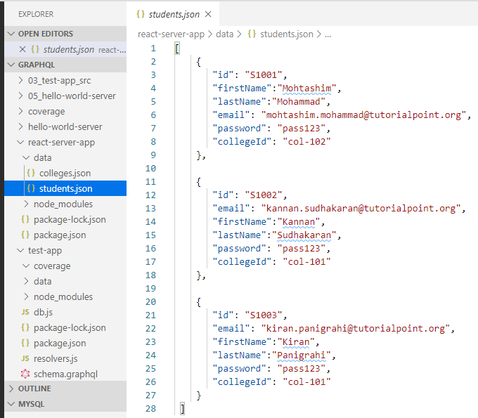
14.1 Step 1
https://www.tutorialspoint.com/graphql/graphql_react_integration.htm
Environment setup step 4 (Create Flat File Database in Data Folder).
> data/colleges.json
> data/students.json

Slide 7
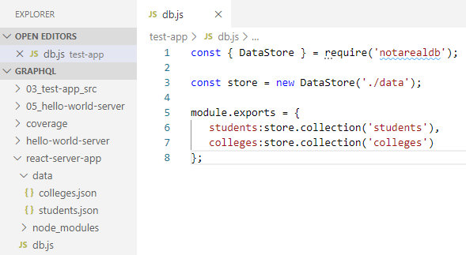
14.1 Step 1
https://www.tutorialspoint.com/graphql/graphql_react_integration.htm
Environment setup step 5 (Create Data Access Layer).
> db.js

Slide 8
14.2 Step 2

Slide 9
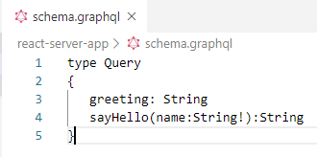
14.2 Step 2
https://www.tutorialspoint.com/graphql/graphql_react_integration.htm
Step 2: Create Schema
Add schema.graphql file in the folder 14-react-server-app.
The file has two queries: greeting and sayHello.
The sayHello query accepts an string parameter and return another string.
The parameter to the sayHello() function is not NULL.

Slide 10
14.3 Step 3

Slide 11
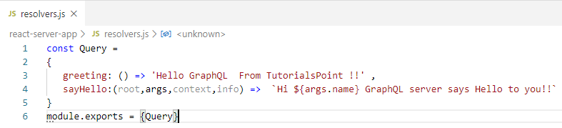
14.3 Step 3
https://www.tutorialspoint.com/graphql/graphql_react_integration.htm
Step 3: Create resolvers
Create a file resolvers.js.
The greeting and sayHello are two resolvers.
In the sayHello resolver, the value passed to the name parameter can be access through args. To access resolver functions outside the module, Query object has to be exported using the module.exports.

Slide 12
14.4 Step 4

Slide 13
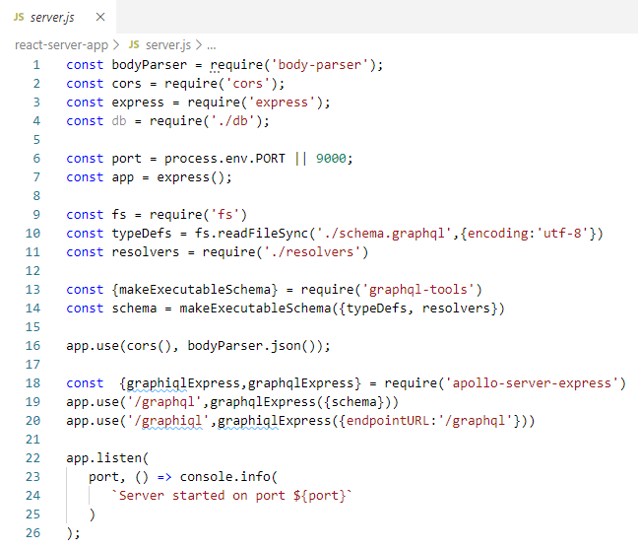
14.4 Step 4
https://www.tutorialspoint.com/graphql/graphql_react_integration.htm
Step 4: run the Application
Create servers.js file. Use server.js in the Environment Setup step 8.

Slide 14
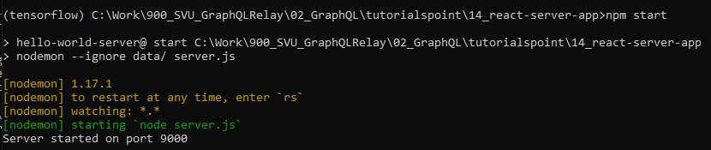
14.4 Step 4
https://www.tutorialspoint.com/graphql/graphql_react_integration.htm
Open Anaconda command prompt:
> conda activate tensorflow
> cd [work-directory]
(tensorflow) [work-directory] > npm start

Slide 15
14.5 Verify GraphQL

Slide 16
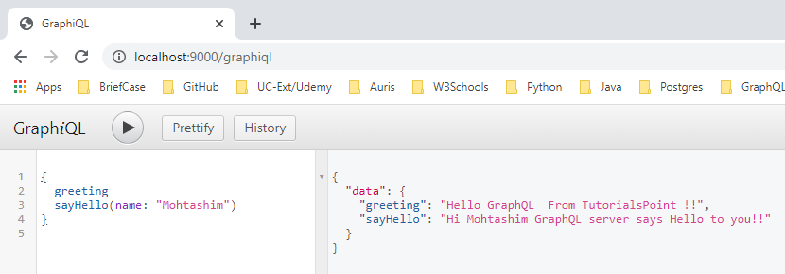
14.5 Verify GraphQL
https://www.tutorialspoint.com/graphql/graphql_react_integration.htm
Open Chrome.
> http://localhost:9000/graphiql
> type {
greeting,
sayHello(name: “Mohtashim”)
}

Slide 17
14.6 Summary

Slide 18
14.6 Summary
https://www.tutorialspoint.com/graphql/graphql_react_integration.htm
Summary
We have done the GraphQL setup and verification.
Next, we will connect GraphQL to ReactJS.

Slide 19
End of Chapter

