Slide 1

14 React Integration: Part 2
Peter H. Chen

Slide 2
14 React Integration: Part 2
https://www.tutorialspoint.com/graphql/graphql_react_integration.htm
React Integration: Part 2
We Setup up the React Client
Open a new terminal for client.
The server terminal should be kept running before executing the client application.
React application will be running on port number 3000 and server application on port number 9000.

Slide 3
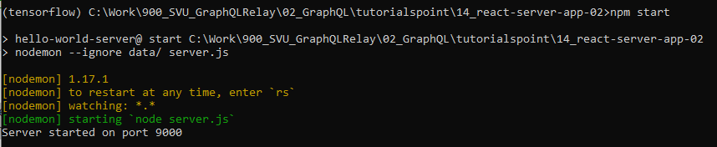
14 React Integration: Part 2
https://www.tutorialspoint.com/graphql/graphql_react_integration.htm
React Integration: Part 2
Keep the server running before Run React Client.
> conda activate tensorflow
(tensorflow) > cd [work-directory]
(tensorflow) [work-directory] > npm start

Slide 4
14.1 Step 1

Slide 5
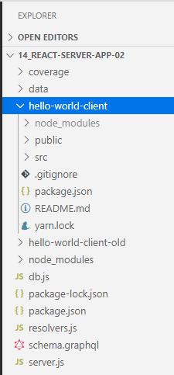
14.1 Step 1
https://www.tutorialspoint.com/graphql/graphql_react_integration.htm
Step 1: Create frontend project hello-world-client
> conda activate tensorflow
(tensorflow) > cd [work-directory, i.e., 14-react-server-app02]
(tensorflow) [work-directory] > create-react-app hello-world-client
This will install everything needed for a typical react application.
You can use either
> create-react-app hello-world-client
Or
npx create-react-app hello-world-client
The npx utility and create-react-app tool create a project with name hello-world-client.
Once the installation is completed, open the project in VSCode. You will see the “hello-world-client” folder is created with default ReactJS application.

Slide 6
14.2 Step 2

Slide 7
14.2 Step 2
https://www.tutorialspoint.com/graphql/graphql_react_integration.htm
Step 2: Start hello-world-client app
Open new anaconda terminal
> conda activate tensorflow
Change the current folder path in the terminal to hello-world-client.
Type npm start to launch the project.
This will run a development server at port 3000 and will automatically open the browser and load the index page.

Slide 8
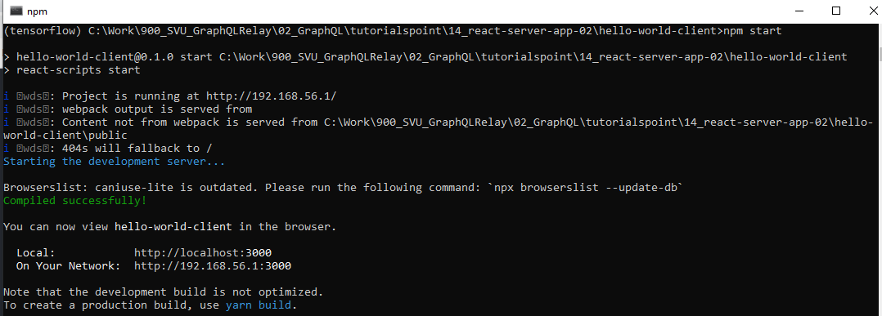
14.2 Step 2
https://www.tutorialspoint.com/graphql/graphql_react_integration.htm
Step 2: Start hello-world-client app
(tensorflow) > cd [work-directory, i.e., 14_react-server-app02/hello-world-client]
(tensorflow) [work-directory , i.e., 14_react-server-app02 /hello-world-client] > npm start
This is shown in the screenshot given below

Slide 9
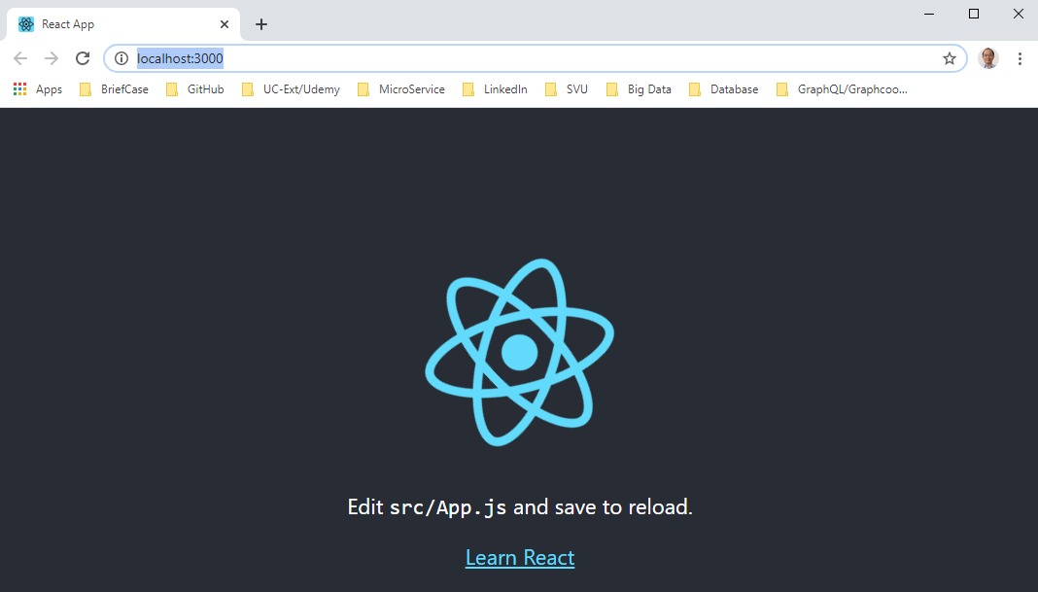
14.2 Step 2
https://www.tutorialspoint.com/graphql/graphql_react_integration.htm
Step 2: Start hello-world-client app
The react client is automatically bring up as below.

Slide 10
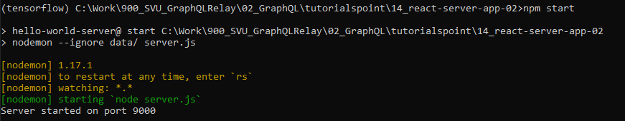
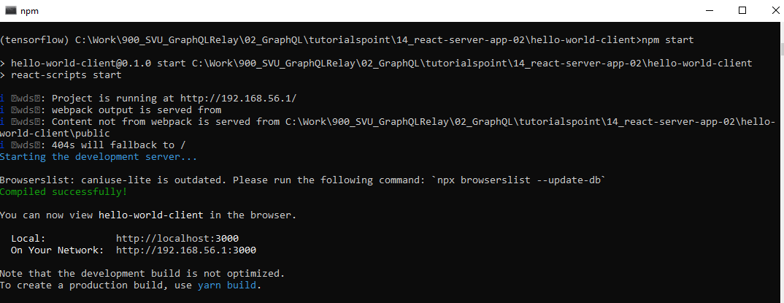
14.2 Step 2
https://www.tutorialspoint.com/graphql/graphql_react_integration.htm
Step 2: Start hello-world-client app
Now, in folder 14_reacrt-server-app-02, we have server run on port 9000.
In folder 14_reacrt-server-app-02/hello-world-client, we also have react client run on port 3000.

Slide 11
14.3 Step 3

Slide 12
14.3 Step 3
https://www.tutorialspoint.com/graphql/graphql_react_integration.htm
Step 3: Modify hello-world-client App Component
In the App.js inside src folder, add two functions, one to load greeting and another to load sayHello messages.
Following is the loadGreeting function which sends GraphQL query for greeting.

Slide 13
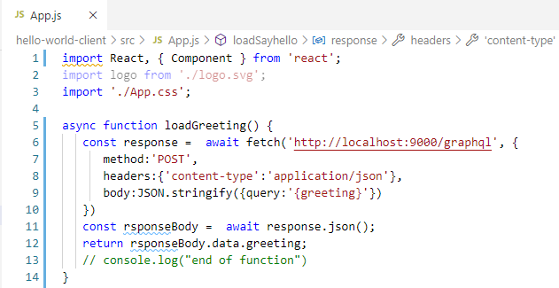
14.3 Step 3
https://www.tutorialspoint.com/graphql/graphql_react_integration.htm
Step 3: Modify hello-world-client App Component
Add async function loadGreeting() { … }
It fetches data from ‘http://localhost:9000/graphql’.

Slide 14
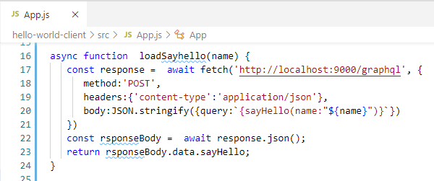
14.3 Step 3
https://www.tutorialspoint.com/graphql/graphql_react_integration.htm
Step 3: Modify hello-world-client App Component
Add async function loadSayhello() { … }
It fetches data from ‘http://localhost:9000/graphql’.

Slide 15
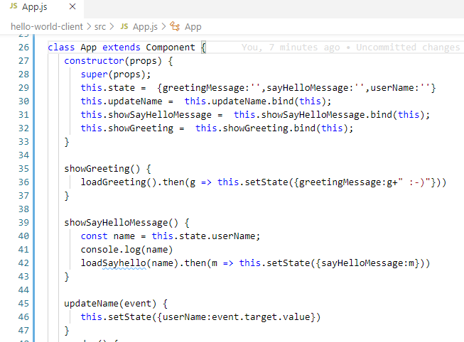
14.3 Step 3
https://www.tutorialspoint.com/graphql/graphql_react_integration.htm
Step 3: Modify hello-world-client App Component
In App class component, we add functions to call loadGreeting() and loadSyahello().

Slide 16
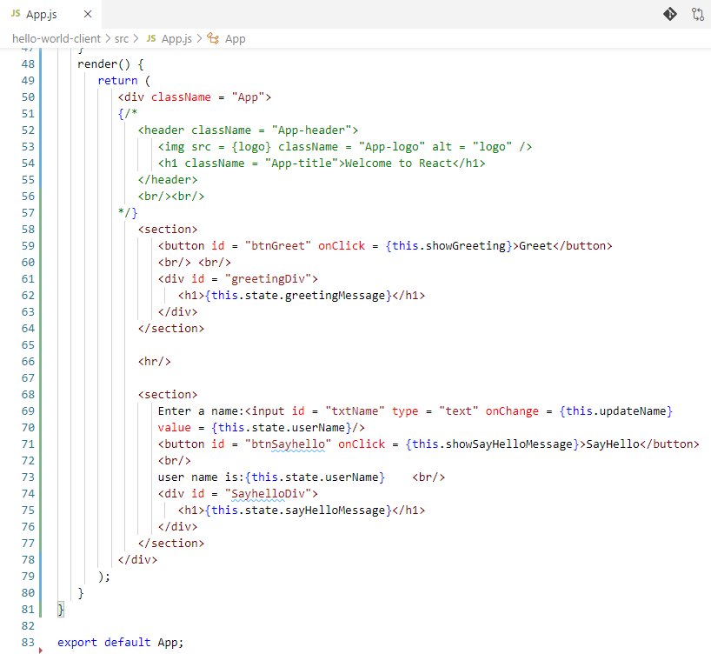
14.3 Step 3
https://www.tutorialspoint.com/graphql/graphql_react_integration.htm
Step 3: Modify hello-world-client App Component
Render all the components for “Greet” button, text field, and “SayHello” Button.

Slide 17
14.4 Verify

Slide 18
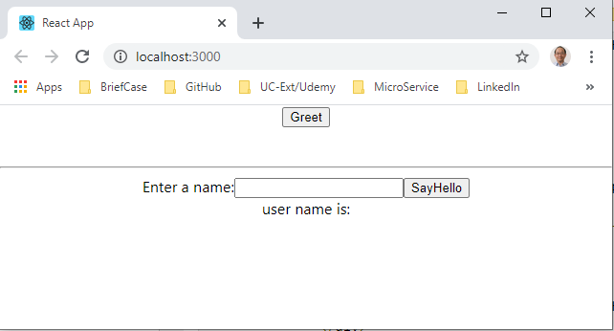
14.4 Verify
https://www.tutorialspoint.com/graphql/graphql_react_integration.htm
Verify

Slide 19
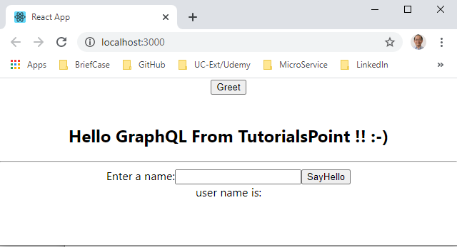
14.4 Verify
https://www.tutorialspoint.com/graphql/graphql_react_integration.htm
Verify: Click Greet Button

Slide 20
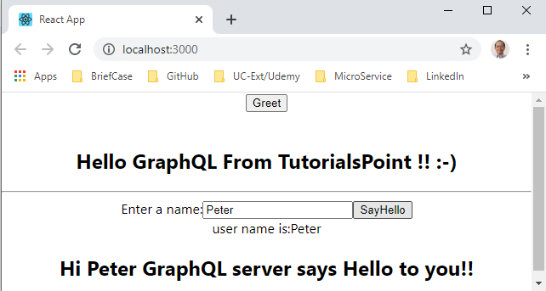
14.4 Verify
https://www.tutorialspoint.com/graphql/graphql_react_integration.htm
Verify: Type ‘Peter’ and click SayHello Button

Slide 21
14.5 Summary

Slide 22
14.5 Summary
https://www.tutorialspoint.com/graphql/graphql_react_integration.htm
Summary
We connect the GraphQL with Frontend ReactJS.

Slide 23
End of Chapter

