Slide 1

13 jQuery Server App: Part 1
Peter H. Chen

Slide 2
13 jQuery Server App: Part 1
https://www.tutorialspoint.com/graphql/graphql_validation.htm
jQuery Server App
Web applications send and retrieve data asynchronously (in the background).
AJAX allows websites to load content onto the screen without refreshing the page.
jQuery provides several methods for AJAX functionality thus making it easier to use AJAX.
In this section, we discuss how we can integrate GraphQL with jQuery.
Consider an application using client server architecture.
We can build a front end webpage that requests data from a GraphQL server.
The webpage will make AJAX calls using jQuery to the GraphQL server.
To integrate GraphQL with jQuery, let us inspect the GraphiQL request headers and understand the request parameters.
Copy 06-example to 13-jquery-server-app (06_Exmaple.pptx).

Slide 3
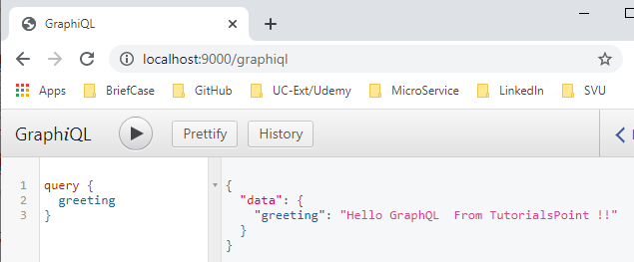
13 jQuery Server App: Part 1
https://www.tutorialspoint.com/graphql/graphql_validation.htm
jQuery Server App
> npm start
Open chrome
> localhost:9000/graphiql
Type the graphql query {greeting} in the GraphiQL Editor and click > to run.

Slide 4
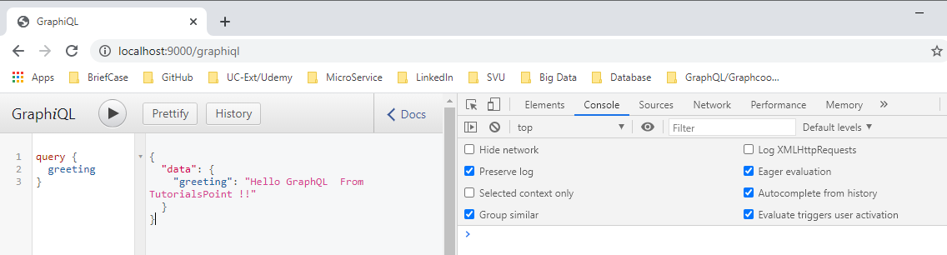
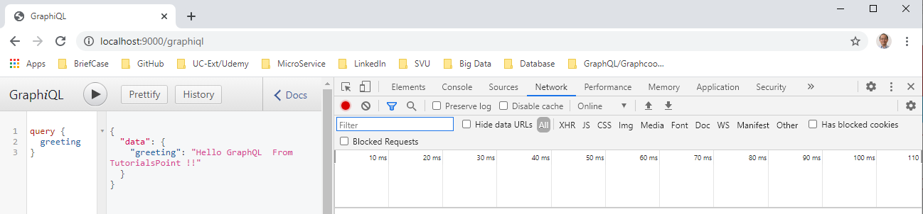
13 jQuery Server App: Part 1
https://www.tutorialspoint.com/graphql/graphql_validation.htm
jQuery Server App
Fn-F13 (ctrl + shift + I) on chrome
Click network tab as shown below

Slide 5
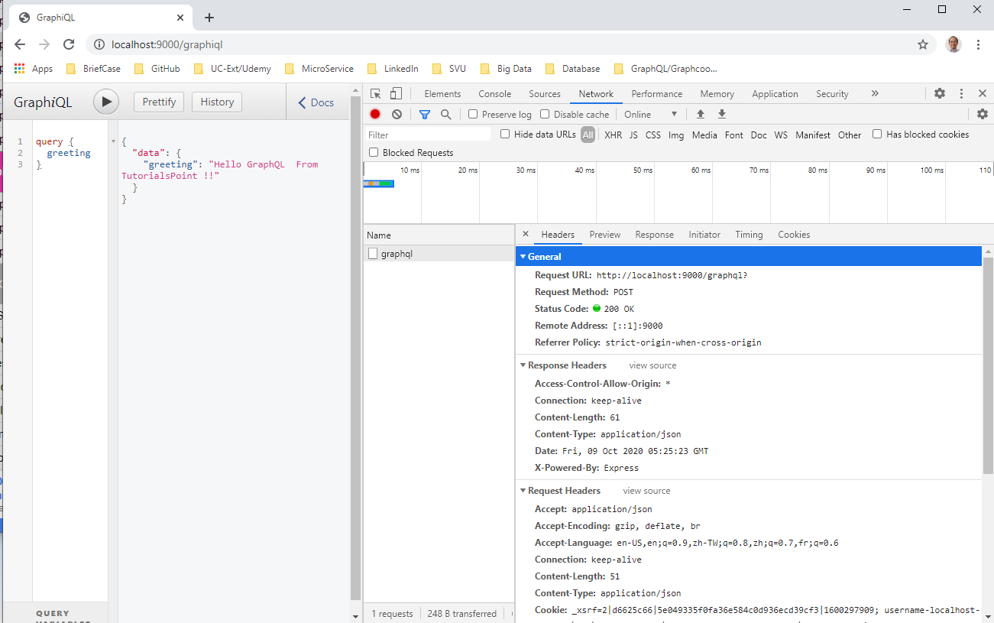
13 jQuery Server App: Part 1
https://www.tutorialspoint.com/graphql/graphql_validation.htm
jQuery Server App
Click > Run again.
Click Name: grapql and click header tab. We see the POST method is used to request the data.

Slide 6
13 jQuery Server App: Part 1
https://www.tutorialspoint.com/graphql/graphql_validation.htm
Illustration
Let us understand how to integrate GraphQL with jQuery using a step-wise process.

Slide 7
13.1 Step 1

Slide 8
13.1 Step 1
https://www.tutorialspoint.com/graphql/graphql_validation.htm
Step 1: Create 13-jquery-server-app project folder
Copy 10-query-app-03 to 13-jquery-server-app (06_Exmaple.pptx).

Slide 9
13.2 Step 2

Slide 10
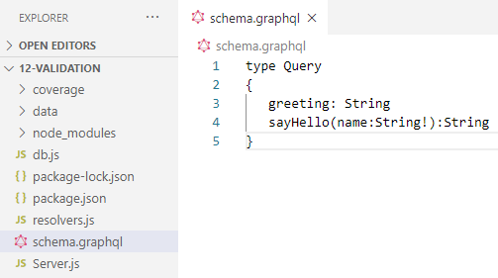
13.2 Step 2
https://www.tutorialspoint.com/graphql/graphql_validation.htm
Step 2: Create Schema
Add schema.graphql file in the project folder 13-jquery-server-app and add the following code.
The file has defined two queries greeting and sayHello.
The sayHello query accepts a string parameter and returns another string.
The parameter to the sayHello() function is not null.

Slide 11
13.3 Step 3

Slide 12
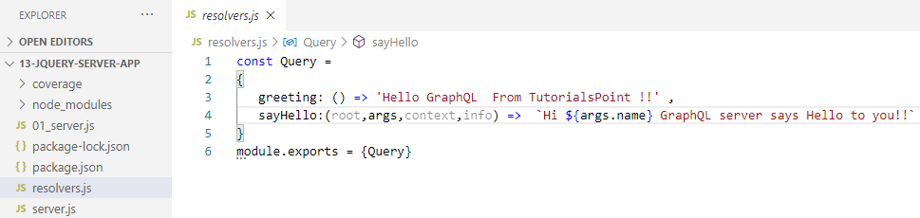
13.3 Step 3
https://www.tutorialspoint.com/graphql/graphql_validation.htm
Step 3: Create Resolvers
Create a file resolvers.js in the project folder and add the following code.
Here, greeting and sayHello are two resolvers.
In sayHello resolver, the value passed to the name parameter can be accessed through args.
To access resolver functions outside the module, Query object has to be exported using module.exports.

Slide 13
13.4 Run Application

Slide 14
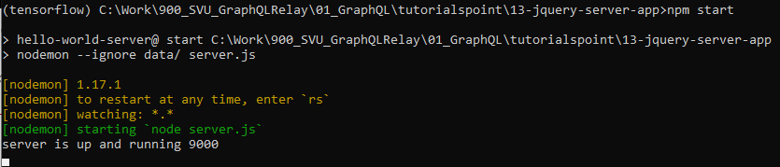
13.4 Run Application
https://www.tutorialspoint.com/graphql/graphql_validation.htm
Run Application
> npm start

Slide 15
13.5 Verify

Slide 16
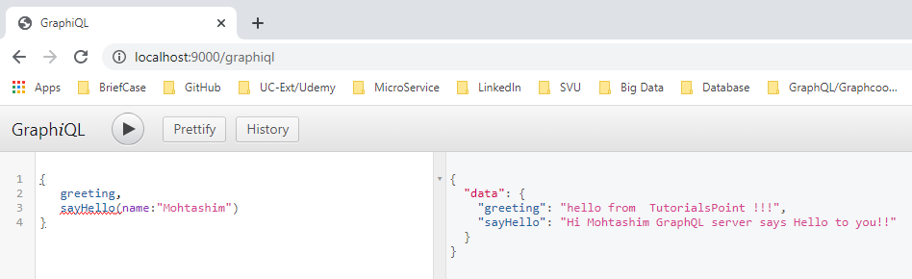
13.5 Verify
https://www.tutorialspoint.com/graphql/graphql_validation.htm
Verify
Open Chrome
> localhost:9000/graphiql

Slide 17
End of Chapter

