Slide 1

7 Type System
Peter H. Chen

Slide 2
7 Type System
https://www.tutorialspoint.com/graphql/graphql_type_system.htm
GraphQL is a strong typed language.
Type System defined various data types that can be used in a GraphQL application.
The type system helps to define the schema, which is a contract between client and server.

Slide 3
7 Type System
https://www.tutorialspoint.com/graphql/graphql_type_system.htm
GraphQL is a strong typed language.
The commonly used GraphQL data types are as follows:
No | Types & Description
1 | Scalar Stores a single value
2 | Object Shows what kind of object can be fetched
3 | Query Entry point type to other specific types
4 | Mutation Entry point for data manipulation
5 | Enum Useful in a situation where you need the user to pick from a prescribed list of options

Slide 4
7.1 Scalar Type

Slide 5

7.1 Scalar Type
https://www.tutorialspoint.com/graphql/graphql_type_system.htm
GraphQL is a strong typed language.
Scalar types are primitive data types that can store only a single value. The default scalar types that GraphQL offers are:
Int − Signed 32-bit Integer
Float − Signed double precision floating point value
String − UTF - 8-character sequence
Boolean − True or false
ID − A unique identifier, often used as a unique identifier to fetch an object or as the key for a cache.
The syntax for defining a scalar type is as follows
The snippet given below defines a field named greeting which returns String value

Slide 6
7.2 Object Type

Slide 7
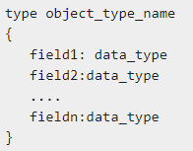
7.2 Object Type
https://www.tutorialspoint.com/graphql/graphql_type_system.htm
Object Type
The object type is the most common type used in a schema and represents a group of fields.
Each field inside an object type maps to another type, thereby allowing nested types.
In other words, an object type is composed of multiple scalar types or object types.
The syntax for defining an object type is given below

Slide 8
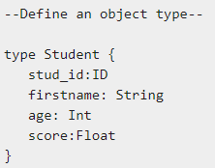
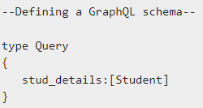
7.2 Object Type
https://www.tutorialspoint.com/graphql/graphql_type_system.htm
Object Type
You can consider the following code snippet:
The example given above defines an object data-type Student.
The stud_details field in the root Query schema will return a list of Student objects.

Slide 9
7.3 Query Type

Slide 10
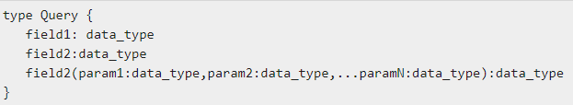
7.3 Query Type
https://www.tutorialspoint.com/graphql/graphql_type_system.htm
Query Type
A GraphQL query is used to fetch data.
It is like requesting a resource in REST-based APIs.
To keep it simple, the Query type is the request sent from a client application to the GraphQL server.
GraphQL uses the Schema Definition Language (SDL) to define a Query.
Query type is one of the many root-level types in GraphQL.
The syntax for defining a Query is as given below −

Slide 11

7.3 Query Type
https://www.tutorialspoint.com/graphql/graphql_type_system.htm
Query Type
An example of defining a Query

Slide 12
7.4 Mutation Type

Slide 13

7.4 Mutation Type
https://www.tutorialspoint.com/graphql/graphql_type_system.htm
Mutation Type
Mutations are operations sent to the server to create, update or delete data.
These are analogous to the PUT, POST, PATCH and DELETE verbs to call REST-based APIs.
Mutation is one of the root-level data-types in GraphQL.
The Query type defines the entry-points for data-fetching operations whereas the Mutation type specifies the entry points for data-manipulation operations.
The syntax for defining a Mutation type is given below

Slide 14
7.5 Enum Type

Slide 15
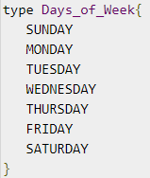
7.5 Enum Type
https://www.tutorialspoint.com/graphql/graphql_type_system.htm
Enum Type
Following snippet illustrates how an enum type can be defined:

Slide 16

7.5 Enum Type
https://www.tutorialspoint.com/graphql/graphql_type_system.htm
Enum Type
An Enum is similar to a scalar type.
Enums are useful in a situation where the value for a field must be from a prescribed list of options.
The syntax for defining an Enum type is:

Slide 17
7.6 List Type

Slide 18


7.6 List Type
https://www.tutorialspoint.com/graphql/graphql_type_system.htm
List Type
Lists can be used to represent an array of values of specific type.
Lists are defined with a type modifier [] that wraps object types, scalars, and enums.
The following syntax can be used to define a list type
The below example defines a list type todos.

Slide 19
7.7 Non-Nullable Type

Slide 20
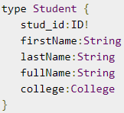
7.7 Non-Nullable Type
https://www.tutorialspoint.com/graphql/graphql_type_system.htm
Non-Nullable Type
By default, each of the core scalar types can be set to null.
In other words, these types can either return a value of the specified type or they can have no value.
To override this default and specify that a field must be defined, an exclamation mark (!) can be appended to a type.
This ensures the presence of value in results returned by the query.
The following syntax can be used to define a non-nullable field
In the below example, stud_id is declared as a mandatory field.

Slide 21
End of Chapter

