Slide 1

16 Authentication Server: Part 1
Peter H. Chen

Slide 2
16 Authentication Server: Part 1
https://www.tutorialspoint.com/graphql/graphql_authenticating_client.htm
Authentication is the process or action of verifying the identity of a user or a process.
It is important that an application authenticates a user to ensure that the data is not available to an anonymous user.
In this discussion, we discuss how to authenticate a GraphQL client.

Slide 3
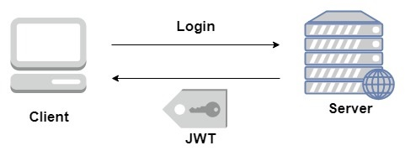
16 Authentication Server: Part 1
https://www.tutorialspoint.com/graphql/graphql_authenticating_client.htm
Express JWT (Json Web Token)
In this example, we will use jQuery to create a client application.
To authenticate requests, we will use express-jwt module on the server-side.
The express-jwt module is a middleware that lets you authenticate HTTP requests using JWT tokens.
JSON Web Token (JWT) is a long string that identifies the logged in user.

Slide 4
16 Authentication Server: Part 1
https://www.tutorialspoint.com/graphql/graphql_authenticating_client.htm
Express JWT (Json Web Token)
Once the user logs in successfully, the server generates a JWT token. This token distinctly identifies a log.
In other words, the token is a representation of user's identity.
So next time, when the client comes to the server, it has to present this token to get the required resources.
The client can be either a mobile application or a web application.
Illustration
We will follow a step-wise procedure to understand this illustration.

Slide 5
16.1 Step 1

Slide 6
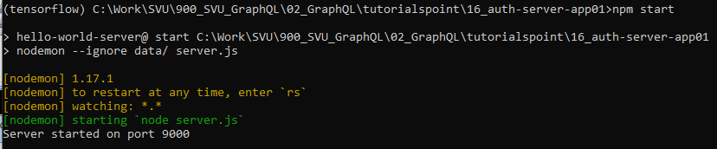
16.1 Step 1
https://www.tutorialspoint.com/graphql/graphql_authenticating_client.htm
Step 1: Create auto-server-app01
Copy 15-apollo-server-app02 to 16-auth-server-app01
> conda activate tensorflow
> cd [work-directory]
> npm start
> Control-C to stop

Slide 7
16.2 Step 2

Slide 8
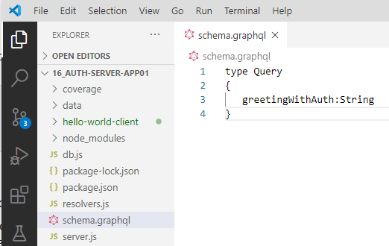
16.2 Step 2
https://www.tutorialspoint.com/graphql/graphql_authenticating_client.htm
Step 2: Create Schema
Add schema.graphql file in the project folder auth-server-app and add the following code:

Slide 9
16.3 Step 3

Slide 10
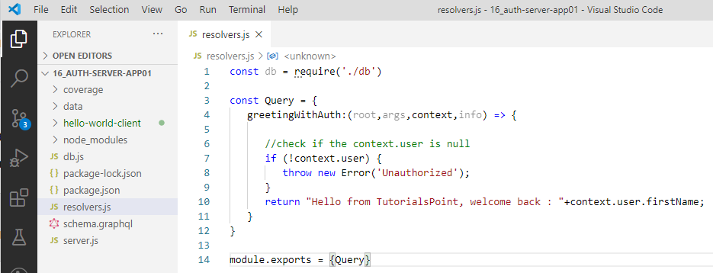
16.3 Step 3
https://www.tutorialspoint.com/graphql/graphql_authenticating_client.htm
Step 3: Add Resolver
Create a file resolvers.js in the project folder and add the following code −
The resolver will verify if an authenticated user object is available in the context object of GraphQL.
It will raise an exception if an authenticated user is not available.

Slide 11
16.4 Step 4

Slide 12
16.4 Step 4
https://www.tutorialspoint.com/graphql/graphql_authenticating_client.htm
Step 5: Create Server.js File
The authentication middleware authenticates callers using a JSON Web Token.
The URL for authentication is http://localhost:9000/login.
This is a post operation.
The user has to submit his email and password which will be validated from the backend.
If a valid token is generated using jwt.sign method, the client will have to send this in header for subsequent requests.
If the token is valid, req.user will be set with the JSON object decoded to be used by later middleware for authorization and access control.

Slide 13
16.4 Step 4
https://www.tutorialspoint.com/graphql/graphql_authenticating_client.htm
Step 4: Create Server.js File
The following code uses two modules − jsonwebtoken and express-jwt to authenticate requests −
When the user clicks on the greet button, a request for the /graphql route is issued. If the user is not authenticated, he will be prompted to authenticate himself.
The user is presented with a form that accepts email id and password. In our example, the /login route is responsible for authenticating the user.
The /login route verifies if a match is found in the database for credentials provided by the user.
If the credentials are invalid, a HTTP 401 exception is returned to the user.
If the credentials are valid, a token is generated by the server. This token is sent as a part of response to the user. This is done by the jwt.sign function.

Slide 14
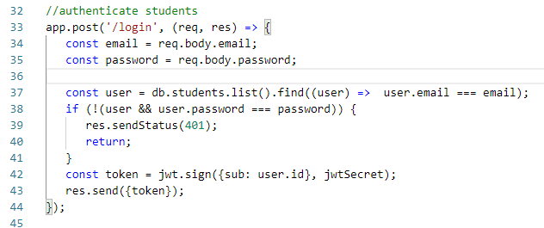
16.4 Step 4
https://www.tutorialspoint.com/graphql/graphql_authenticating_client.htm
Step 4: Create Server.js File
Login and JWT Token code as follow:

Slide 15
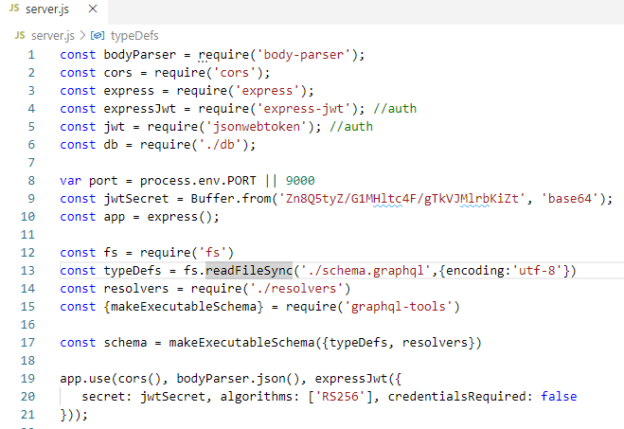
16.4 Step 4
https://www.tutorialspoint.com/graphql/graphql_authenticating_client.htm
Step 4: Create Server.js File
For every request, the app.use() function will be called.
This in turn will invoke the expressJWT middleware.
This middleware will decode the JSON Web Token.
The user id stored in the token will be retrieved and stored as a property user in the request object.

Slide 16
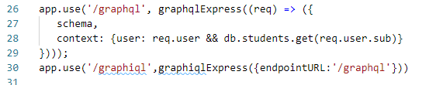
16.4 Step 4
https://www.tutorialspoint.com/graphql/graphql_authenticating_client.htm
Step 4: Create Server.js File
To make available the user property within GraphQL context, this property is assigned to the context object as shown below.

Slide 17
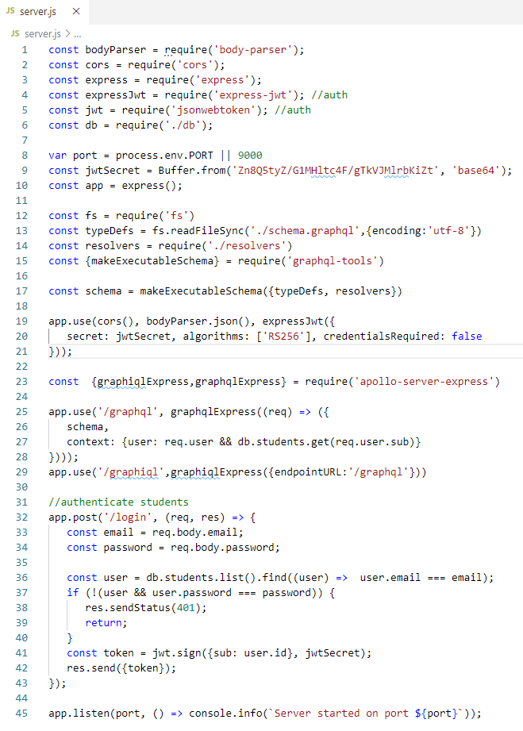
16.4 Step 4
https://www.tutorialspoint.com/graphql/graphql_authenticating_client.htm
Step 4: Create Server.js File
Create server.js in current folder path.
The complete server.js file is as follows.

Slide 18
16.5 Step 5

Slide 19
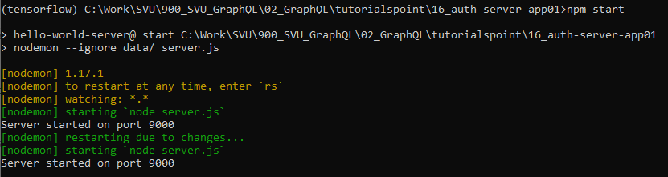
16.5 Step 5
https://www.tutorialspoint.com/graphql/graphql_authenticating_client.htm
Step 5: Start Server
> npm install express-jwt
> npm start

Slide 20
16.6 Verify

Slide 21

16.6 Verify
https://www.tutorialspoint.com/graphql/graphql_authenticating_client.htm
Step 6: Verify
Open Chrome
> localhost:9000/graphiql
Type the following query in the editor:

Slide 22
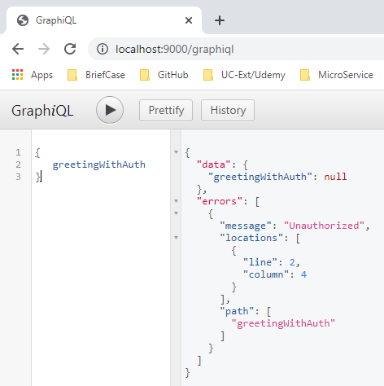
16.6 Verify
https://www.tutorialspoint.com/graphql/graphql_authenticating_client.htm
Step 6: Verify
In the below response, we got an error as we are not authenticated user.
Next discussion, we create client application to authenticate.

Slide 23
End of Chapter

