Slide 1

16 Apollo Client: Part 2
Peter H. Chen

Slide 2
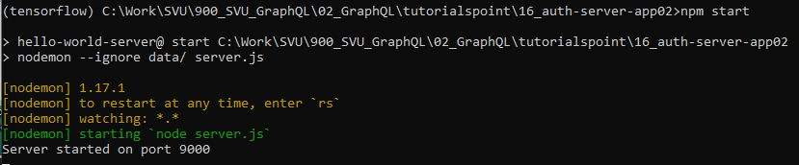
16 Apollo Client: Part 2
https://www.tutorialspoint.com/graphql/graphql_apollo_client.htm
Apollo Client
Copy the 16_apollo-server-app01 to 16_apollo-server-app02
Verify the server is working properly.

Slide 3
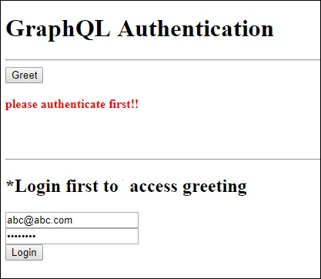
16 Apollo Client: Part 2
https://www.tutorialspoint.com/graphql/graphql_apollo_client.htm
Apollo Client
We want to create authenticate screen.
In the client application, a greet button is provided which will invoke the schema greetingWithAuth.
If you click the button without login, it will give you the error message as below

Slide 4
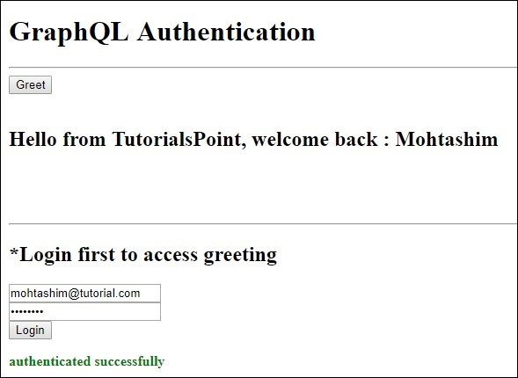
16 Apollo Client: Part 2
https://www.tutorialspoint.com/graphql/graphql_apollo_client.htm
Apollo Client
Once you log in with a user available in database, the following screen will appear

Slide 5
16.1 Step 1

Slide 6
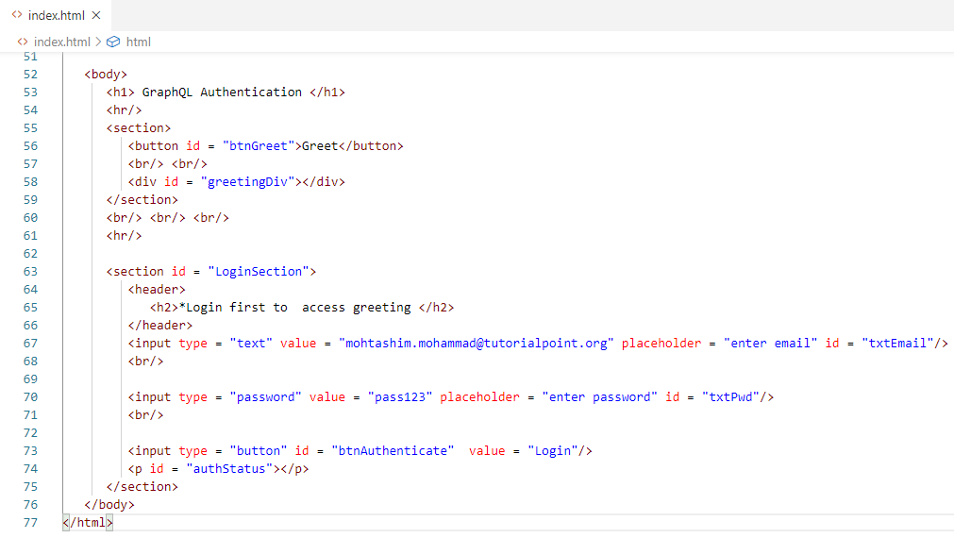
16.1 Step 1
https://www.tutorialspoint.com/graphql/graphql_apollo_client.htm
Step 1: Create HTML and jQuery Code
1. We create Greet Button with id.
2. Email mail text filed, password text field, and Login button with default texts and ids.
1
2

Slide 7
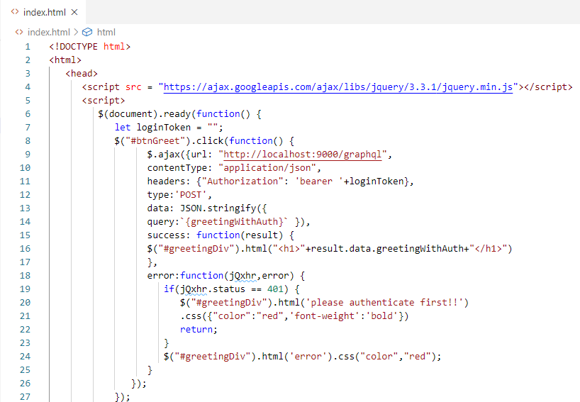
16.1 Step 1
https://www.tutorialspoint.com/graphql/graphql_apollo_client.htm
Step 1: Create HTML and jQuery Code.
Greet button callback with id (“#btnGreet”), fetch data from “http://localhost:9000/graphql” and error message processing.
greetingWithAuth and display error message “please authenticate first!”

Slide 8
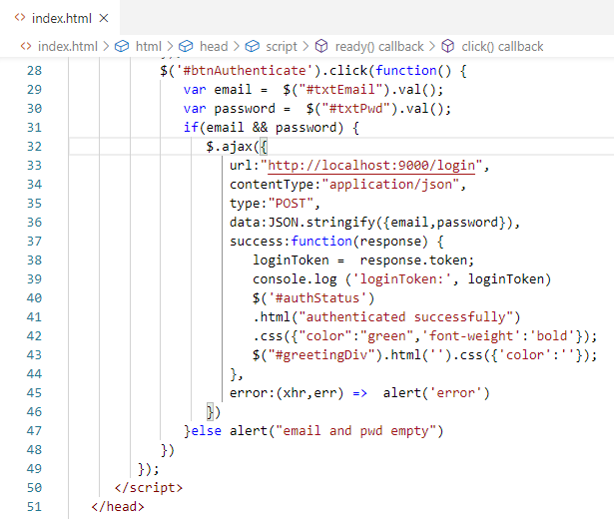
16.1 Step 1
https://www.tutorialspoint.com/graphql/graphql_apollo_client.htm
Step 1: Create HTML and jQuery Code.
Click Login (Authenticate) button get data from “http://localhost:9000/login”.
Check password data and get Token and display.

Slide 9
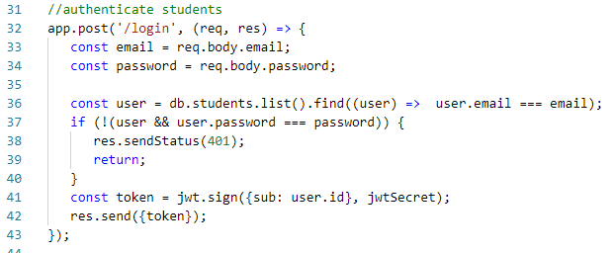
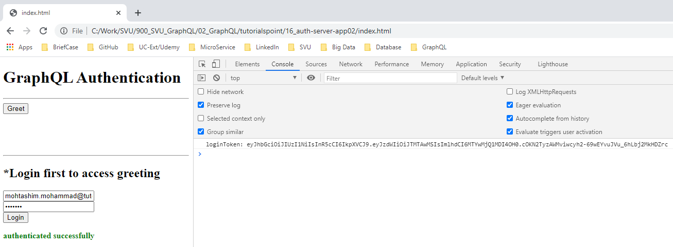
16.1 Step 1
https://www.tutorialspoint.com/graphql/graphql_apollo_client.htm
Step 1: Create HTML and jQuery Code.
1. Server side check the password at “/login” and then send token to frontend.
2. Frontend display the JSON token at console.
1
2

Slide 10
16.2 Verify

Slide 11
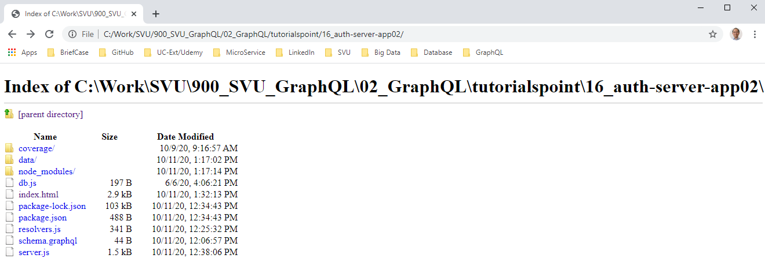
16.2 Verify
https://www.tutorialspoint.com/graphql/graphql_apollo_client.htm
Open index.html
> file:///C:/Work/SVU/900_SVU_GraphQL/02_GraphQL/tutorialspoint/16_auth-server-app02/
Double click “index.html”

Slide 12
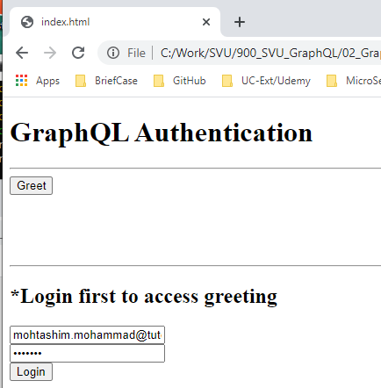
16.2 Verify
https://www.tutorialspoint.com/graphql/graphql_apollo_client.htm
Open index.html
> click “index.html”

Slide 13
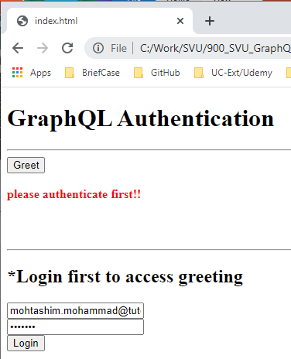
16.2 Verify
https://www.tutorialspoint.com/graphql/graphql_apollo_client.htm
Open index.html
> click “Greet” button.

Slide 14
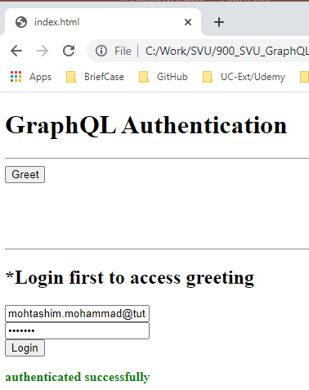
16.2 Verify
https://www.tutorialspoint.com/graphql/graphql_apollo_client.htm
Open index.html
> click “Login” button.

Slide 15
End of Chapter

