Slide 1

14 React Integration
Peter H. Chen

Slide 2
14 React Integration
https://www.tutorialspoint.com/graphql/graphql_react_integration.htm
This document discusses the integration of ReactJS.

Slide 3
14 React Integration
https://www.tutorialspoint.com/graphql/graphql_react_integration.htm
Step 1: Download and install required dependencies for the project.
Create a folder react-server-app. Follow the Environment setup step 3 - step5

Slide 4
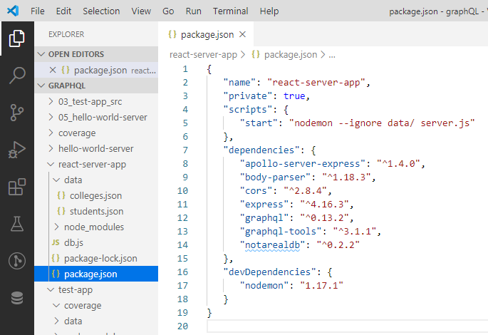
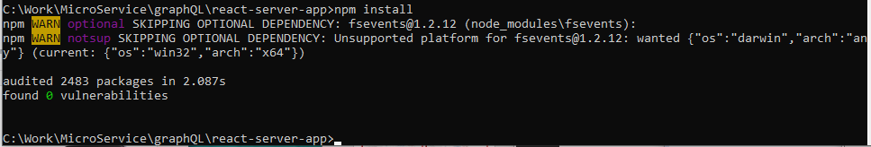
3 Environment Setup
https://www.tutorialspoint.com/graphql/graphql_environment_setup.htm
Environment Setup Step 3. Create package.json as follow and install the dependencies:
> npm install

Slide 5
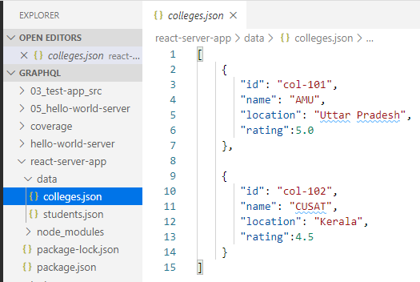
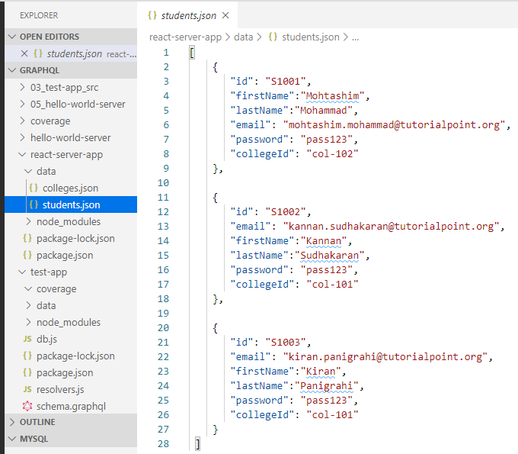
14 React Integration
https://www.tutorialspoint.com/graphql/graphql_react_integration.htm
Environment setup step 4 (Create Flat File Database in Data Folder).
> data/colleges.json
>data/students.json

Slide 6
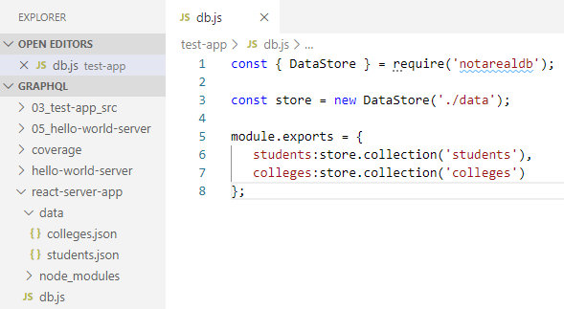
14 React Integration
https://www.tutorialspoint.com/graphql/graphql_react_integration.htm
Environment setup step 5 (Create Data Access Layer).
> db.js

Slide 7
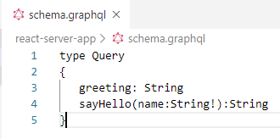
14 React Integration
https://www.tutorialspoint.com/graphql/graphql_react_integration.htm
Step 2. Create Schema:
Add schemar.graphql file in the folder readt-server-app.
The file has two queries: greeting and sayHello.
The sayHello query accepts an string parameter and return another string.
The parameter to the sayHello() function is not NULL.

Slide 8
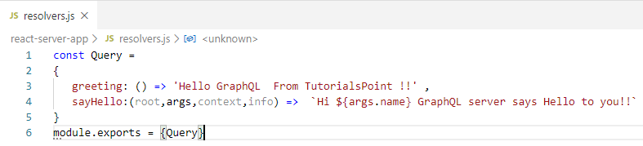
14 React Integration
https://www.tutorialspoint.com/graphql/graphql_react_integration.htm
Step 3. Create resolvers:
Create a file resolvers.js.
The greeting and sayHello are two resolvers.
In the sayHello resolver, the value passed to the name parameter can be access through args. To access resolver functions outside the module, Query object has to be exported using the module.exports.

Slide 9
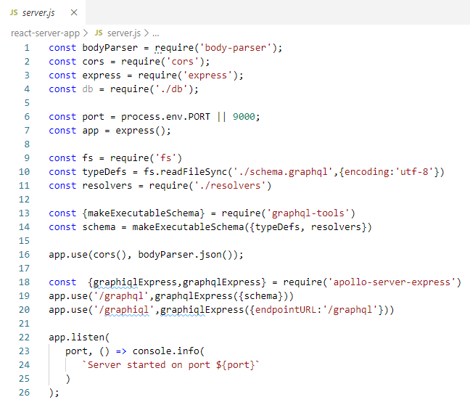
14 React Integration
https://www.tutorialspoint.com/graphql/graphql_react_integration.htm
Step 4. run the Application
Create servers.js file. Use server.js in the Environment Setup step 8.

Slide 10
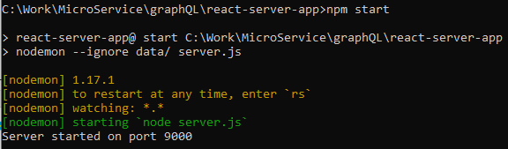
14 React Integration
https://www.tutorialspoint.com/graphql/graphql_react_integration.htm
Open command prompt:
> npm start

Slide 11
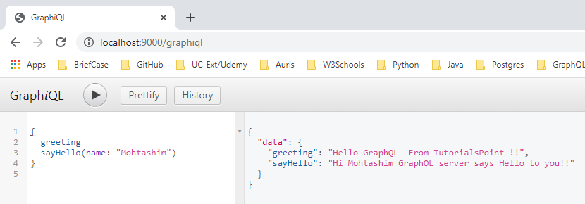
14 React Integration
https://www.tutorialspoint.com/graphql/graphql_react_integration.htm
Open Chrome.
> http://localhost:9000/graphiql
> type {
greeting,
sayHello(name: “Mohtashim”)
}

Slide 12
14.1 Setup Client

Slide 13
14.1 Setup Client
https://www.tutorialspoint.com/graphql/graphql_react_integration.htm
Setup up the Client
The server terminal should be kept on running before executing the client application.
Open a new terminal for client. This terminal can be anywhere.
React application will be running on port number 3000 and

Slide 14
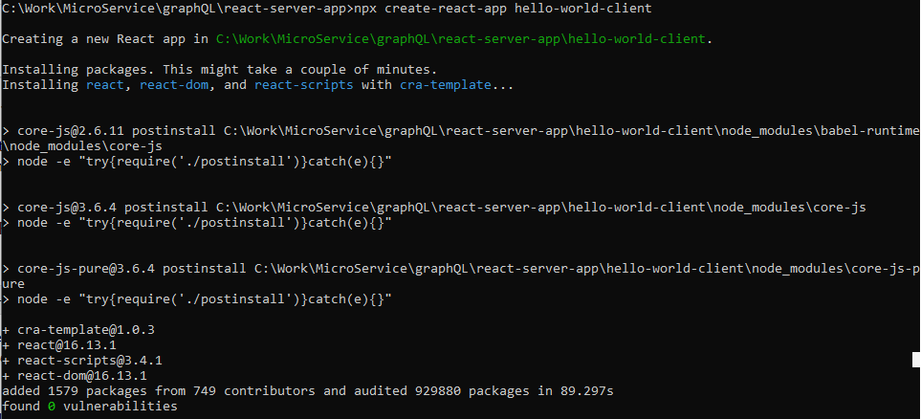
14.1 Setup Client
https://www.tutorialspoint.com/graphql/graphql_react_integration.htm
Step 1: Create a React Project hello-world-client
> npx create-react-app hello-world-client

Slide 15
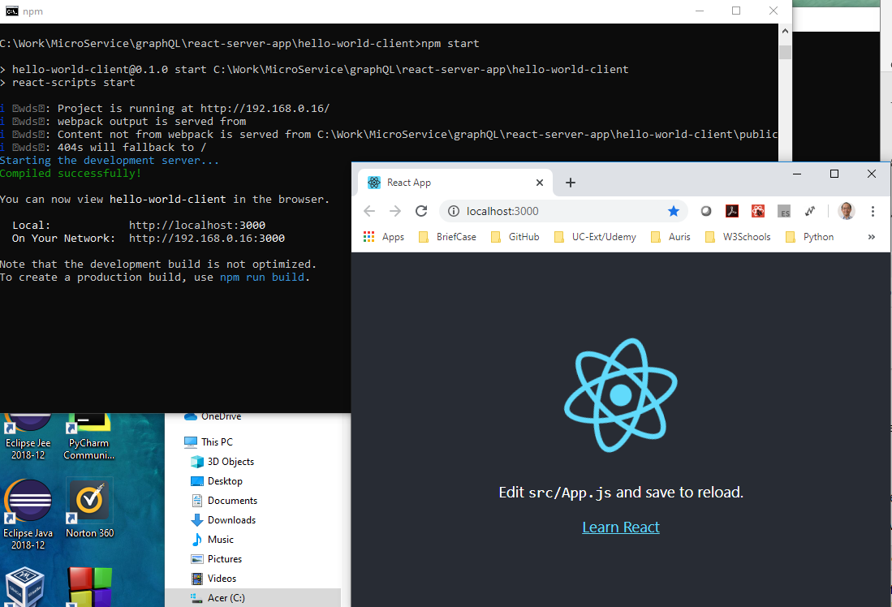
14.1 Setup Client
https://www.tutorialspoint.com/graphql/graphql_react_integration.htm
Step 2. Start hello-world-client:
> cd hello-world-client
> npm start
The react age is started at port 3000.

Slide 16
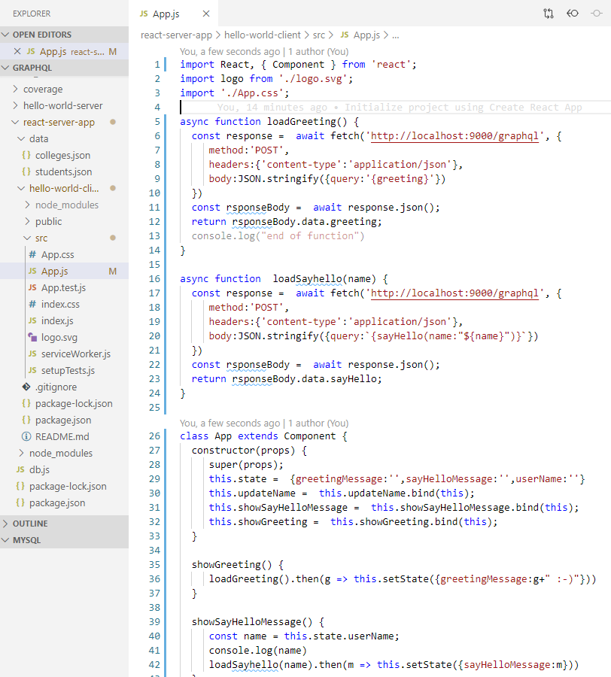
14.1 Setup Client
https://www.tutorialspoint.com/graphql/graphql_react_integration.htm
Step 3. Modify App Component:
In the App.js inside src folder, add two functions, one to loadGreeting() and another to load sayHello() messages as below:

Slide 17
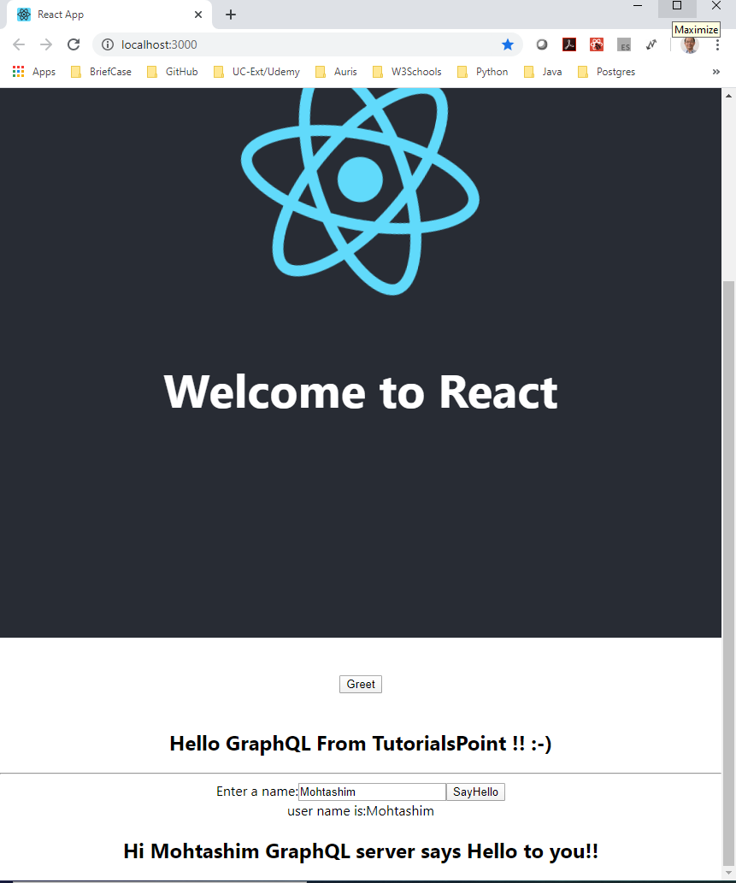
14.1 Setup Client
https://www.tutorialspoint.com/graphql/graphql_react_integration.htm
After modified App.js, the chrome is automatically refresh.
Click “Greet” button.
Enter “Mohtashim” and click “SayHello” displays the message.

Slide 18
End of Chapter

