Slide 1

10 Query Type with Enum: Part 4
Peter H. Chen

Slide 2
10 Query Type with Enum: Part 4
https://www.tutorialspoint.com/graphql/graphql_query.htm
Define Query Type with Enum
Let us see how to use a query variable when field parameter is enum type.
This Enum does not work properly. Do not use it.

Slide 3
10.1 Step 1

Slide 4
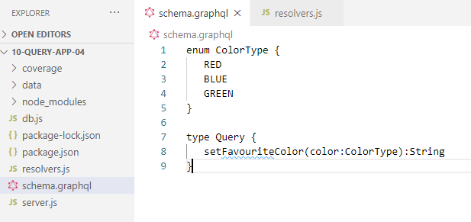
10.1 Step 1
https://www.tutorialspoint.com/graphql/graphql_query.htm
Step 1: Modify schema.graphql
The setFavouriteColor function takes enum as input and returns a string value.

Slide 5
10.2 Step 2

Slide 6
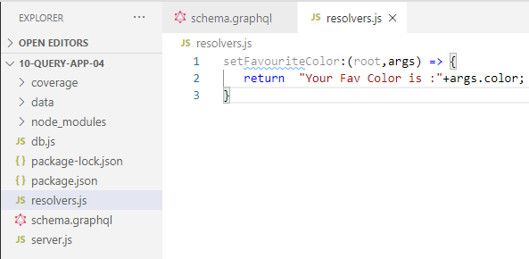
10.2 Step 2
https://www.tutorialspoint.com/graphql/graphql_query.htm
Step 2: Modify resolver.js
The resolver function setFavouriteColor takes root and args.
The enum value passed to function at runtime can be accessed through args parameter.

Slide 7
10.3 Step 3

Slide 8
10.3 Step
https://www.tutorialspoint.com/graphql/graphql_query.htm
Step 3: Declare a Query Variable in GraphiQL
The query is named query_to_setColor which takes a variable of the name color_variable of ColorType.
This variable is passed on to method setFavoriteColor.

Slide 9
10.4 Run Application

Slide 10
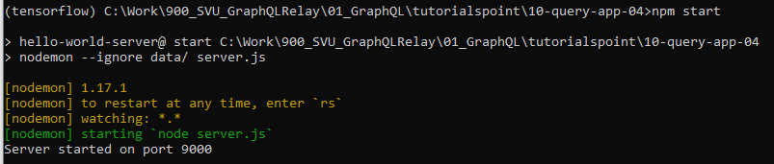
10.4 Run Application
https://www.tutorialspoint.com/graphql/graphql_query.htm
Step 4: Run Application
Open Anaconda prompt.
> cd [work directory]
> npm start

Slide 11
10.6 Verify

Slide 12
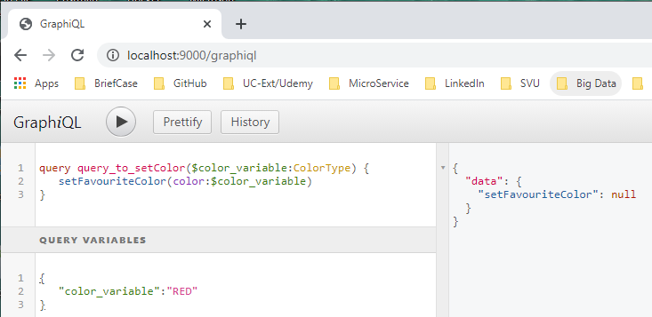
10.6 Verify
https://www.tutorialspoint.com/graphql/graphql_query.htm
Step 6: Verify
Open Chrome
Define
Query Editor query_to_setColor ( … ) { … }
Query Variable:
Run: It does not work properly.

Slide 13
End of Chapter

