Slide 1

8 Schema
Peter H. Chen

Slide 2
8 Schema
https://www.tutorialspoint.com/graphql/graphql_schema.htm
Schema
A GraphQL schema is at the core of any GraphQL server implementation.
Schema describes the functionality available to the client applications that connect to it.
We can use any programming language to create a GraphQL schema and build an interface around it.
The GraphQL runtime defines a generic graph-based schema to publish the capabilities of the data service it represents.
Client applications can query the schema within its capabilities.
This approach decouples clients from servers and allows both to evolve and scale independently.
In this discussion, we use Apollo server to execute GraphQL queries.
The makeExecutableSchema function in graphql-tools helps you to bind schema and resolvers.

Slide 3
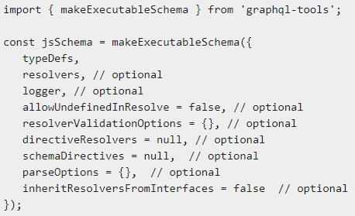
8 Schema
https://www.tutorialspoint.com/graphql/graphql_schema.htm
makeExecutableSchema Function
The makeExecutableSchema function takes a single argument {} of Object type.
The syntax for using this function is given below:

Slide 4
8 Schema
https://www.tutorialspoint.com/graphql/graphql_schema.htm
makeExecutableSchema Function
The syntax for using this function is given below:
No | Parameter & Description
1 | typeDefs This is a required argument. It represents a GraphQL query as a UTF-8 string.
2 | Resolvers This is an optional argument (empty object by default). This has functions that handle the query.
3 | logger This is an optional argument and can be used to print errors to the server console.
4 | parseOptions This is an optional argument and allows customization of parse when specifying typeDefs as a string.

Slide 5
8 Schema
https://www.tutorialspoint.com/graphql/graphql_schema.htm
makeExecutableSchema Function
The syntax for using this function is given below:
No | Parameter & Description
5 | allowUndefinedInResolve This is true by default. When set to false, causes your resolve functions to throw errors if they return undefined.
6 | resolverValidationOptions This is an optional argument and accepts an object with Boolean properties.
7 | inheritResolversFromInterfaces This is an optional argument and accepts a Boolean argument to check resolvers object inheritance.

Slide 6
8 Schema
https://www.tutorialspoint.com/graphql/graphql_schema.htm
Illustration
Let us create a simple application to understand this schema.
This will create a schema for querying list of students from the server.
The student data will be stored in a flat file and we will use a node module called notarealdb to fake a database and read from the flat file.

Slide 7
8.1 Step 1

Slide 8
8.1 Step 1
https://www.tutorialspoint.com/graphql/graphql_schema.htm
Step 1: Download and Install Required Dependencies for the Project
Copy previous 06-example-src a folder named 08-schema-app.
In 08-schema-app
> npm install
To install the package.
> node server.js
Verify it work just like before.
Then, follow steps below (or steps 3 to 5 in 03_Setup.pptx) to complete the download and the installation process and step 2 to create schema.

Slide 9
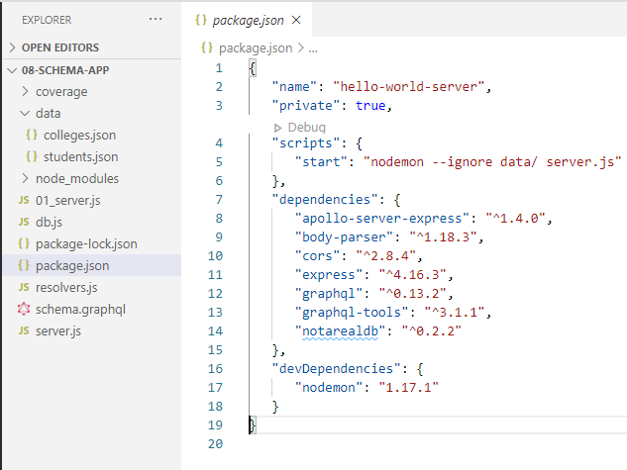
8.1 Step 1
https://www.tutorialspoint.com/graphql/graphql_schema.htm
In 03_stepup.pptx, Step 3 − Create package.json and Install the Dependencies
Create a package.json file which will contain all the dependencies of the GraphQL server application.
Note:
We use “notarealdb “ package. We define our ./daya/database in this example.

Slide 10
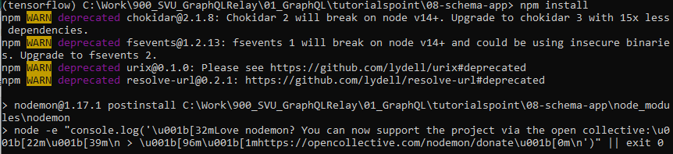
8.1 Step 1
https://www.tutorialspoint.com/graphql/graphql_schema.htm
In 03_stepup.pptx, Step 3 − Create package.json and Install the Dependencies
Install the dependencies by using the command as given below
> npm install

Slide 11
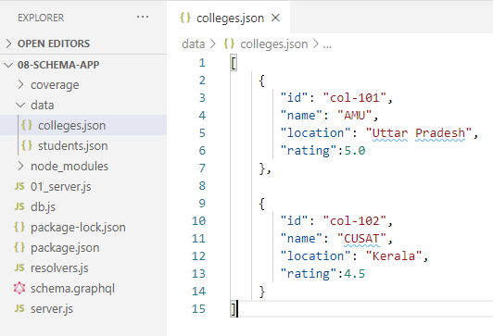
8.1 Step 1
https://www.tutorialspoint.com/graphql/graphql_schema.htm
In 03_stepup.pptx, Step 4 − Create Flat File Database in Data Folder
In this step, we use flat files to store and retrieve data. Create a folder data and add two files ./data/students.json and ./data/colleges.json.
Following is the ./data/colleges.json file

Slide 12
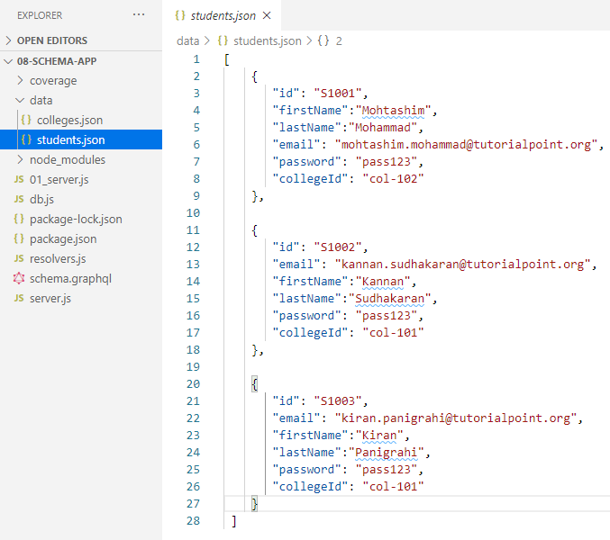
8.1 Step 1
https://www.tutorialspoint.com/graphql/graphql_schema.htm
In 03_stepup.pptx, Step 4 − Create Flat File Database in Data Folder
Following is the ./data/students.json file

Slide 13
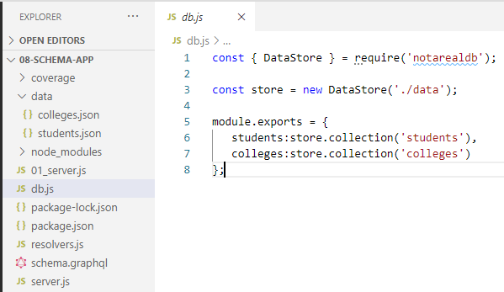
8.1 Step 1
https://www.tutorialspoint.com/graphql/graphql_schema.htm
In 03_stepup.pptx, Step 5 − Create a Data Access Layer
We need to create a datastore that loads the data folder contents.
In this case, we need collection variables, students and colleges.
Whenever the application needs data, it makes use of these collection variables.
Create file db.js with in the project folder as follows

Slide 14
8.2 Step 2

Slide 15
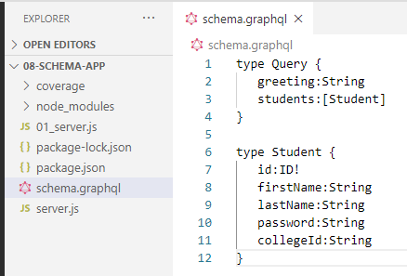
8.2 Step 2
https://www.tutorialspoint.com/graphql/graphql_schema.htm
Step 2 − Create a Schema
Add schema.graphql file with the following code
The root of the schema will be Query type.
The query has two fields: greeting and Students that returns String and a list of students respectively.
Student is declared as an Object type since it contains multiple fields.
The ID field is declared as non-nullable by (!).

Slide 16
8.3 Step 3

Slide 17
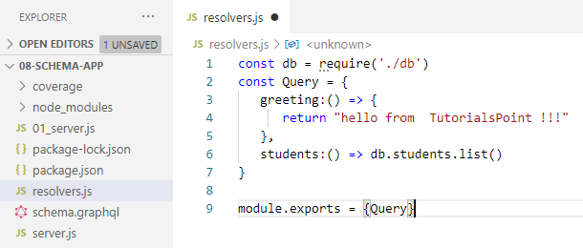
8.3 Step 3
https://www.tutorialspoint.com/graphql/graphql_schema.htm
Step 3 − Create Resolver
Create a file resolvers.js in the project folder and add the following code.
Here greeting and students are the resolvers that handle the query.
The students resolver function returns a list of students from the data access layer.
To access resolver functions outside the module, Query object has to be exported using module.exports.

Slide 18
8.4 Step 4

Slide 19
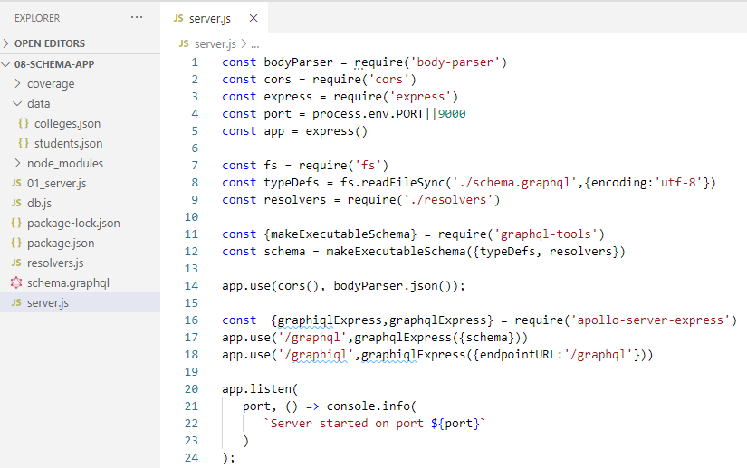
8.4 Step 4
https://www.tutorialspoint.com/graphql/graphql_schema.htm
Step 4 − Run the Application
Create a server.js file as below (or step 8 in the 03_Setup.pptx).
The read the schema.graphql and resolver read students/colleges data from database.

Slide 20
8.4 Step 4
https://www.tutorialspoint.com/graphql/graphql_schema.htm
Step 4 − Run the Application
The next step is to execute the command npm start in the terminal.
> node server.js
The server will be up and running on 9000 port.

Slide 21
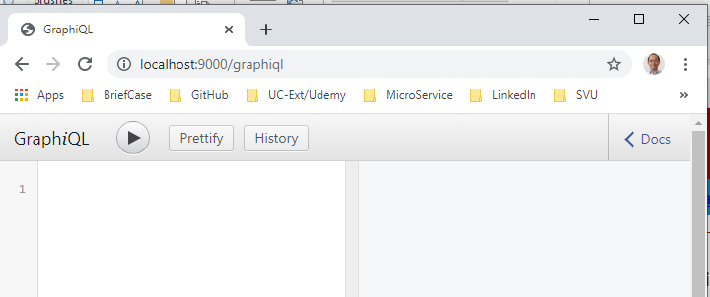
8.4 Step 4
https://www.tutorialspoint.com/graphql/graphql_schema.htm
Step 4 − Run the Application
Here, we use GraphiQL as a client to test the application. Open browser and type the URL, http://localhost:9000/graphiql.

Slide 22
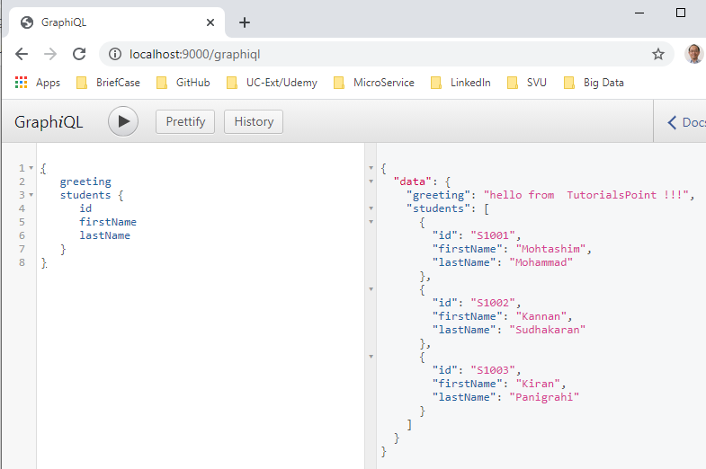
8.4 Step 4
https://www.tutorialspoint.com/graphql/graphql_schema.htm
Step 4 − Run the Application
In the GraphiQL editor, type the following:
Click “>” to run.
We see the query result on the right below.

Slide 23
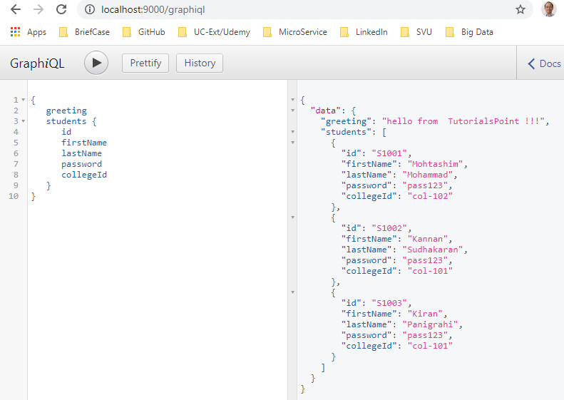
8.4 Step 4
https://www.tutorialspoint.com/graphql/graphql_schema.htm
Step 4 − Run the Application
In the GraphiQL editor, type additional password and collegeId as the following:
Click “>” to run.
We see the query result on the right below.

Slide 24
8.4 Step 4
https://www.tutorialspoint.com/graphql/graphql_schema.htm
Step 4 − Run the Application
Note:
We can replace the students.json with a RESTful API call to retrieve student data or even a real database like MySQL or MongoDB.
GraphQL becomes a thin wrapper around your original application layer to improve performance.

Slide 25
8.5 Summary

Slide 26
8.5 Sumamry
https://www.tutorialspoint.com/graphql/graphql_schema.htm
Summary
We discuss how to create Schema for GraphQL.

Slide 27
End of Chapter

