Slide 1

9 Resolver
Peter H. Chen

Slide 2
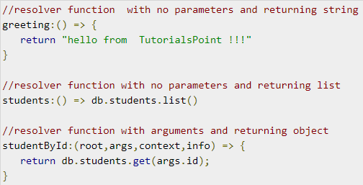
9 Resolver
https://www.tutorialspoint.com/graphql/graphql_resolver.htm
Resolver
Resolver is a collection of functions that generate response for a GraphQL query.
In simple terms, a resolver acts as a GraphQL query handler.
Every resolver function in a GraphQL schema accepts four positional arguments as given below:
An example of resolver functions is shown below.

Slide 3
9 Resolver
https://www.tutorialspoint.com/graphql/graphql_resolver.htm
Resolver
Given below are the positional arguments and their description
No | Arguments & Description
1 | root The object that contains the result returned from the resolver on the parent field.
2 | args An object with the arguments passed into the field in the query.
3 | context This is an object shared by all resolvers in a particular query.
4 | info It contains information about the execution state of the query, including the field name, path to the field from the root.

Slide 4
9 Resolver
https://www.tutorialspoint.com/graphql/graphql_resolver.htm
Resolver Result Format
Resolvers in GraphQL can return different types of values as given below
No | Arguments and Description
1 | null or undefined this indicates the object could not be found
2 | array this is only valid if the schema indicates that the result of a field should be a list
3 | promise resolvers often do asynchronous actions like fetching from a database or backend API, so they can return promises
4 | scalar or object a resolver can also return other values

Slide 5
9 Resolver
https://www.tutorialspoint.com/graphql/graphql_resolver.htm
Illustration
Let us create a simple application to understand resolver.
This will create schema for querying a student by id from the server.
The student data will be stored in a flat file and we will use a node module called notarealdb to fake a database and read from flat file.
The following is a step-wise process to create a simple application.

Slide 6
9.1 Step 1

Slide 7
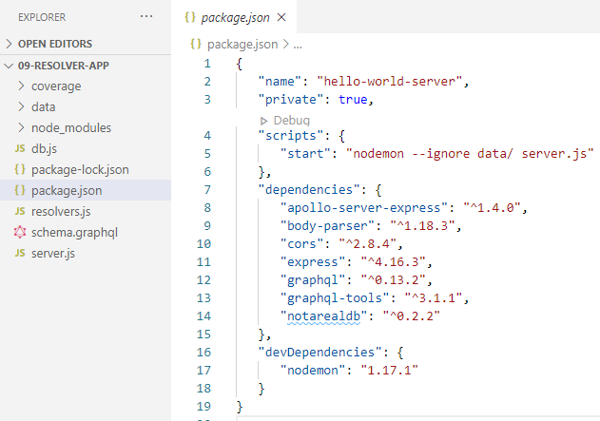
9.1 Step 1
https://www.tutorialspoint.com/graphql/graphql_resolver.htm
Step 1 − Project Setup
Copy a folder named 09-resolver-app from 08-schema-app (or you can follow steps 3 to 5 in the 03_Setup.pptx).
Step 3 in the 03_Setup.pptx: package.json

Slide 8
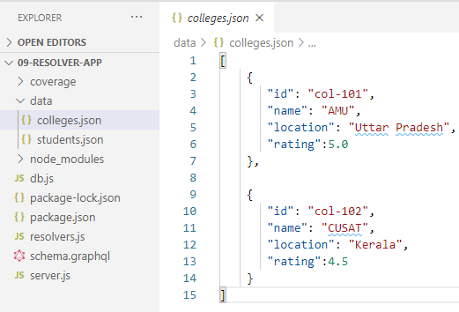
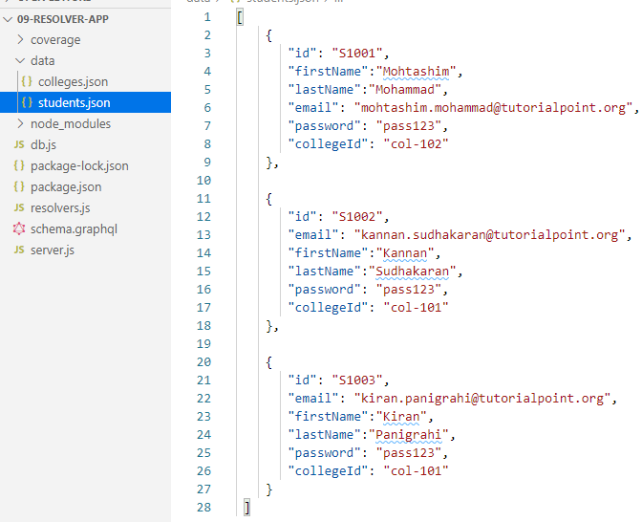
9.1 Step 1
https://www.tutorialspoint.com/graphql/graphql_resolver.htm
Step 1 − Project Setup
Step 4 in the 03_Setup.pptx: ./data/colleges.json and ./data/students.json for database.

Slide 9
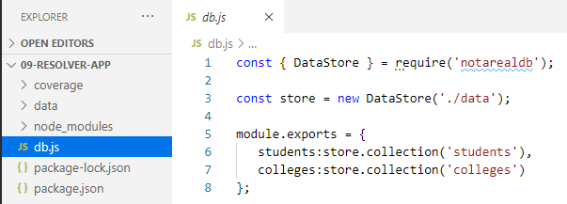
9.1 Step 1
https://www.tutorialspoint.com/graphql/graphql_resolver.htm
Step 1 − Project Setup
Step 5 in the 03_Setup.pptx: db.js for database access layer.

Slide 10
9.2 Step 2

Slide 11
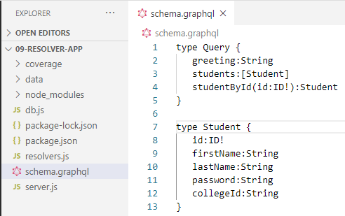
9.2 Step 2
https://www.tutorialspoint.com/graphql/graphql_resolver.htm
Step 2 − Create a Schema
Add schema.graphql file in the project folder resolver-app and add the following code.
The schema file shows that user can query for greeting, students and studentById.
To retrieve students with specific id, we use data type ID! which shows a non nullable unique identifier field. (! means non-null)
The students field returns an array of students, and greeting returns a simple string value.

Slide 12
9.3 Step 3

Slide 13
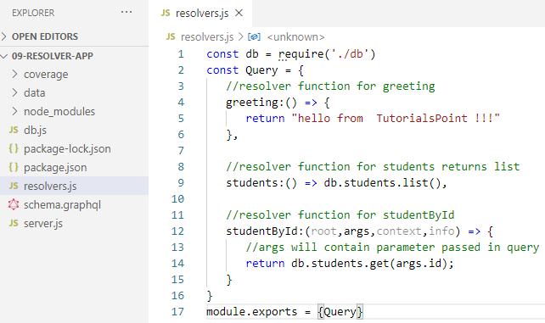
9.3 Step 3
https://www.tutorialspoint.com/graphql/graphql_resolver.htm
Step 3 − Create Resolver
Create a file resolvers.js in the project folder and add the following code.
Here, studentById takes in three parameters.
In this discussion, the studentId can be retrieved from args; root will contain the Query object itself.
To return a specific student, we need to call get method with id parameter in the students collection.
Here greeting, students, and studentById are the resolvers that handle the query.
The students resolver function returns a list of students from the data access layer.
To access resolver functions outside the module, Query object has to be exported using module.exports.

Slide 14
9.4 Step 4

Slide 15
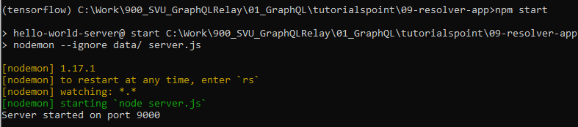
9.4 Step 4
https://www.tutorialspoint.com/graphql/graphql_resolver.htm
Step 4 – Run the Application
Create a server.js file.
Refer step 8 in the 03_Setup.pptx.
Execute the command in the terminal.
> npm start
Or
> node server.js
The server will be up and running on 9000 port. Here, we use GraphiQL as a client to test the application.

Slide 16
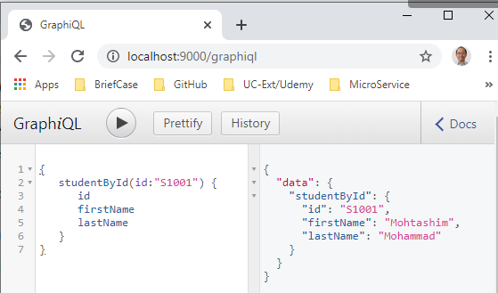
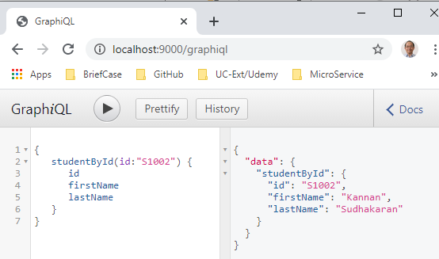
9.4 Step 4
https://www.tutorialspoint.com/graphql/graphql_resolver.htm
Step 4 – Run the Application
Open the browser and enter the url, http://localhost:9000/graphiql.
Type the following query for “S101” and “S102” in the GraphiQL editor.

Slide 17
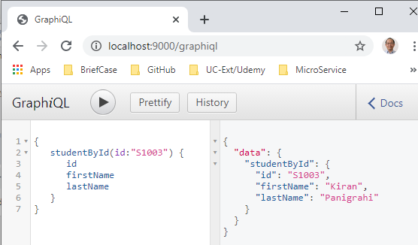
9.4 Step 4
https://www.tutorialspoint.com/graphql/graphql_resolver.htm
Step 4 – Run the Application
Open the browser and enter the url, http://localhost:9000/graphiql.
Type the following query for “S103” in the GraphiQL editor.

Slide 18
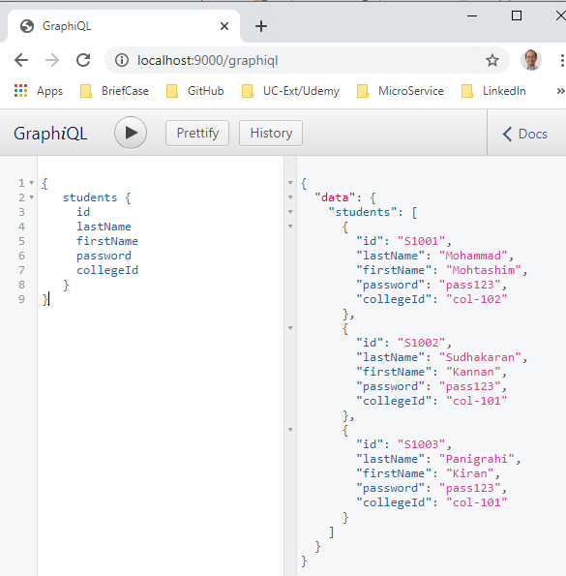
9.4 Step 4
https://www.tutorialspoint.com/graphql/graphql_resolver.htm
Step 4 – Run the Application
Open the browser and enter the url, http://localhost:9000/graphiql.
Type the following query for students in the GraphiQL editor.

Slide 19
9.5 Summary

Slide 20
9.5 Summary
https://www.tutorialspoint.com/graphql/graphql_resolver.htm
Summary
We discuss how to create resolver in this discussion.

Slide 21
End of Chapter

