Slide 1
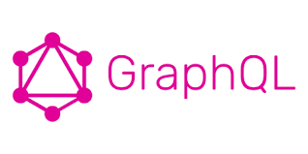
1 Home
Peter H. Chen

Slide 2
1 Home
https://www.tutorialspoint.com/graphql/index.htm
Home
GraphQL is an open source server-side technology which was developed by Facebook to optimize RESTful API calls.
It is an execution engine and a data query language.
This discussion introduce you to the fundamental concepts of GraphQL including:
Implement GraphQL API using Apollo server
Test GraphQL API using GraphiQL
Build ReactJS (with Apollo Client library) and jQuery client applications to consume the API
Prerequisites
This discussion is based on NodeJs and Express.
NodeJS is easy to GraphQL.
For frontends for GraphQL, we can use ReactJs, JQuery, andECMA Script 6 (ES6).

Slide 3
End of Chapter

