Slide 1

4 Architecture
Peter H. Chen

Slide 2
4 Architecture
https://www.tutorialspoint.com/graphql/graphql_environment_setup.htm
GraphQL is a specification that describes the behavior of a GraphQL server.
It is a set of guidelines on how requests and responses should be handled like supported protocols, format of the data that can be accepted by the server, format of the response returned by the server, etc.
The request is made by the client to GraphQL server is called a Query.
Another important concept of GraphQL is its transport layer agnostics (unknown).
GraphQL can be used any available network protocol like TCP, websocket or any other transport layer protocol.
GraphQL is also neutral to databases.
You can use it with relational or NoSQL database.
GraphQL Server can be deployed by using any of three methods:
GraphQL server with connected database
GraphQL Server that integrate existing systems
Hybrid approach

Slide 3
4.1 GraphQL Server with Connected Database
Peter H. Chen

Slide 4
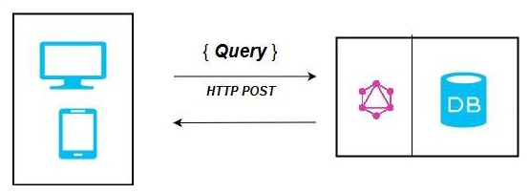
4.1 GraphQL Server with Connected Database
https://www.tutorialspoint.com/graphql/graphql_environment_setup.htm
GraphQL Server with Connected Database
This architecture has a GraphQL Server with an integrated database and can often be used with new projects.
On the receipt of a Query, the server reads the request payload and fetches data from the database.
This is called resolving the query.
The response returned to the client adheres to the format specified in the official GraphQL specification.

Slide 5
4.1 GraphQL Server with Connected Database
https://www.tutorialspoint.com/graphql/graphql_environment_setup.htm
GraphQL Server with Connected Database
In the below diagram, GraphQL server and the database are integrated on a single node.
The client (desktop/mobile) communicates with GraphQL server over HTTP.
The server processes the request, fetches data from the database and returns it to the client.

Slide 6
4.2 GraphQL Server Integrating Existing System
Peter H. Chen

Slide 7
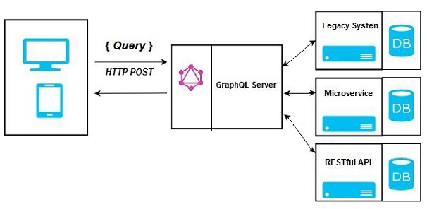
4.2 GraphQL Server Integrating Existing System
https://www.tutorialspoint.com/graphql/graphql_environment_setup.htm
GraphQL Server Integrating with Existing System
This approach is helpful for companies which have legacy infrastructure and different APIs.
GraphQL can be used to unify microservices, legacy infrastructure and third-party APIs in the existing system.

Slide 8
4.2 GraphQL Server Integrating Existing System
https://www.tutorialspoint.com/graphql/graphql_environment_setup.htm
GraphQL Server Integrating with Existing System
In the below diagram, a GraphQL API acts as an interface between the client and the existing systems.
Client applications communicate with the GraphQL server which in turn resolves the query.

Slide 9
4.3 Hybrid Approach
Peter H. Chen

Slide 10
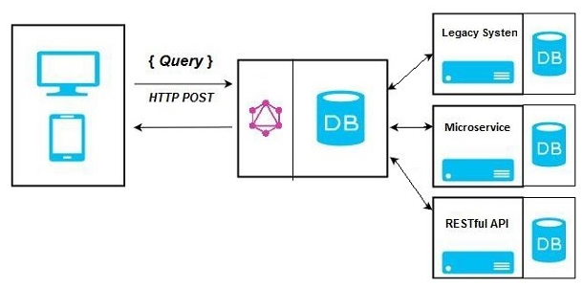
4.3 Hybrid Approach
https://www.tutorialspoint.com/graphql/graphql_environment_setup.htm
Hybrid Approach
Finally, we can combine the above two approaches and build a GraphQL server.
In this architecture, the GraphQL server will resolve any request that is received.
It will either retrieve data from connected database or from the integrated API’s.
This is represented in the below diagram.

Slide 11
End of Chapter

