Slide 1

6 Example
Peter H. Chen

Slide 2
6 Example
https://www.tutorialspoint.com/graphql/graphql_example.htm
Create a Simple API that return a greeting message, Hello world, and access it by GraphQL.
Build a graphQL API on top of express framework.

Slide 3
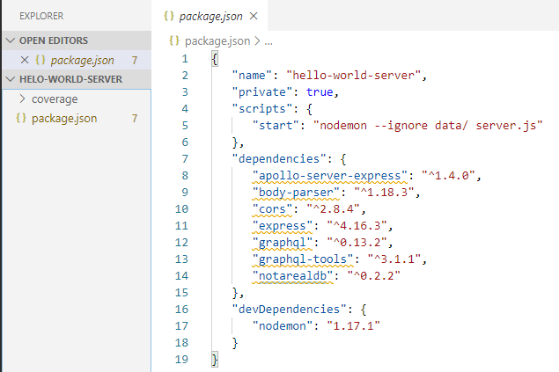
6 Example
https://www.tutorialspoint.com/graphql/graphql_example.htm
Step 1: Setup Express: create a folder “hello-world-server”.
In package.json, “name”: “hello-world-server”, “private”: true

Slide 4
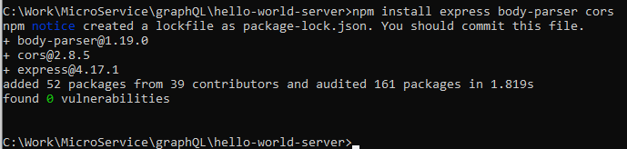
6 Example
https://www.tutorialspoint.com/graphql/graphql_example.htm
Install the dependencies for Express Server as below:
> npm install express body-parser cors
Body-parser is a middleware package which helps express to handle HTTP POST requests efficiently. The cors is another middleware package that handle cross-origin resource sharing.

Slide 5
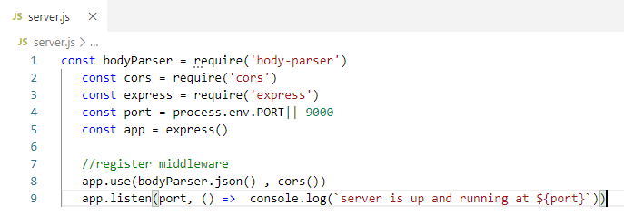

6 Example
https://www.tutorialspoint.com/graphql/graphql_example.htm
Create server.js:
> node server.js

Slide 6
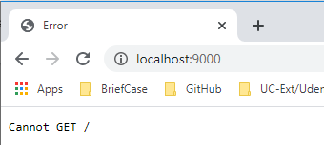
6 Example
https://www.tutorialspoint.com/graphql/graphql_example.htm
Open Chrome:
> localhost:9000
Cntrol+C to stop server.

Slide 7
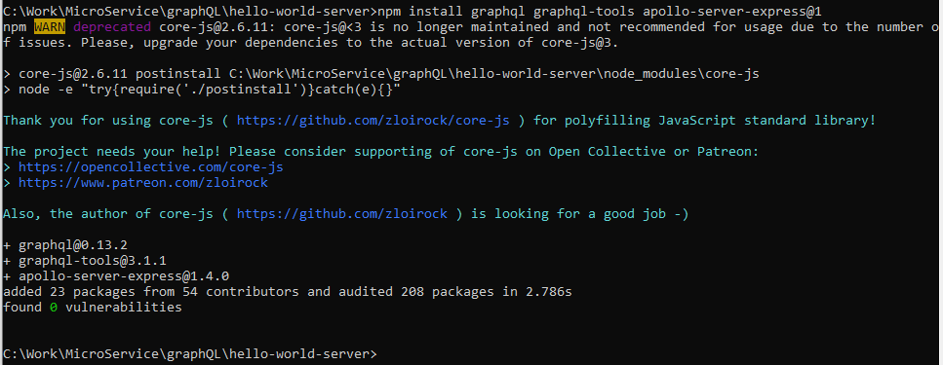
6 Example
https://www.tutorialspoint.com/graphql/graphql_example.htm
Step 2: Install GraphQL and Apollo Server
Now Express is configured, the next step is to download GraphQL dependencies:
graphql
graphql-tools
apollo-server-express@1
We use Apollo server v1.0 as it is a stable release. Type the following to install these dependencies:
> npm install graphql graphql-tools apollo-server-express@1

Slide 8
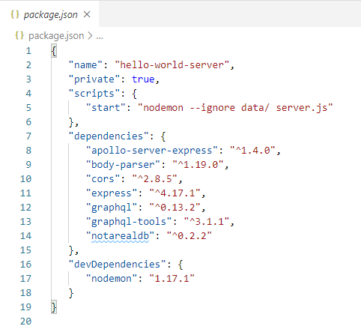
6 Example
https://www.tutorialspoint.com/graphql/graphql_example.htm
Verify the package.json:

Slide 9
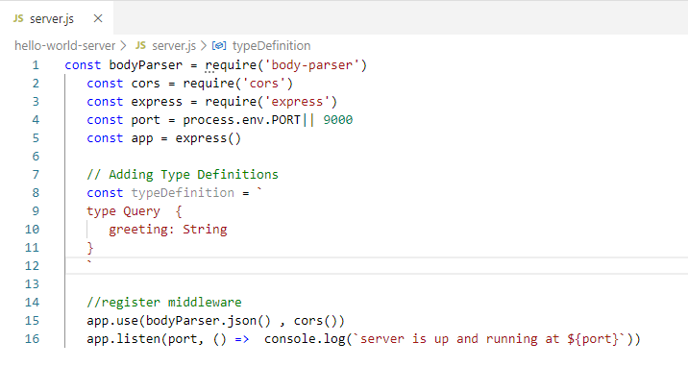
6 Example
https://www.tutorialspoint.com/graphql/graphql_example.htm
Step 3: Define the Schema
GraphQL schema defines what kind of object can be fetched from a service, and what fields it has. The schema can be defined using GraphQL Schema Definition Language.
Add the following code in the server.js. Here, the query contains a greeting attribute that returns a string value

Slide 10
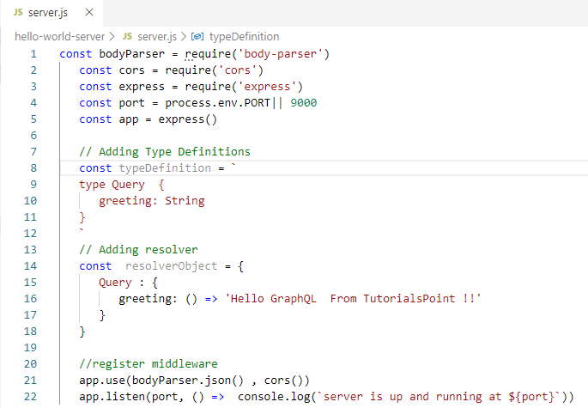
6 Example
https://www.tutorialspoint.com/graphql/graphql_example.htm
Step 4: Create a Resolver.
The first step in creating a resolver is to add some code to process the request for greeting field. This is specified in a resolver. The structure of the resolver function must match the schema. Add the following code snippet in the server.js file.

Slide 11
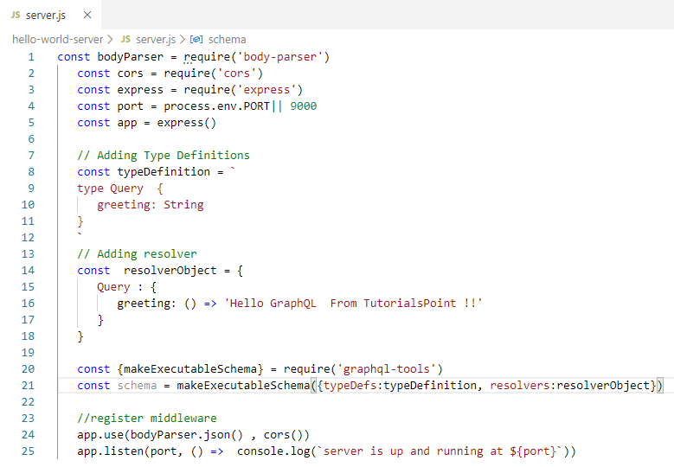
6 Example
https://www.tutorialspoint.com/graphql/graphql_example.htm
The second step is to bind the schema and resolver using makeExectuableSchem.
This function is pre-defined in the graphql-tools module. Add the following code snippet in the server.js file.

Slide 12
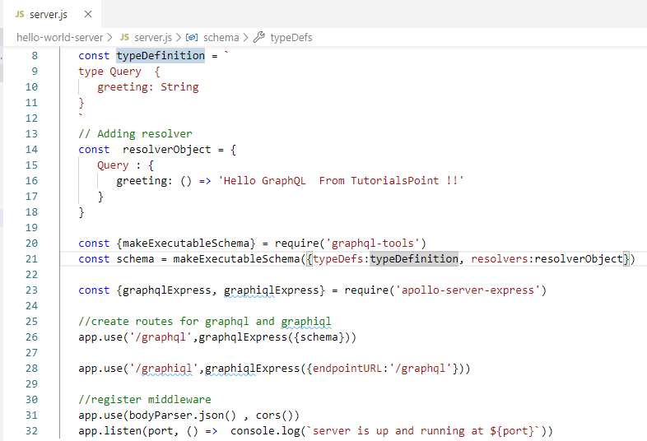
6 Example
https://www.tutorialspoint.com/graphql/graphql_example.htm
Step 5: Define Routes to Fetch data from ReactJS/GraphQL Application.
Add the following code snippet in the server.js.
The graphqlExpress function help to register the route “http://localhost:9000/grapql” . The ReactJS application can ise thie endpoint to query data. Simliarly, the graphiqlExpress function helps register the route http://localhost:9000/graphiql. This is used by GraphiQL browser to test the API.

Slide 13
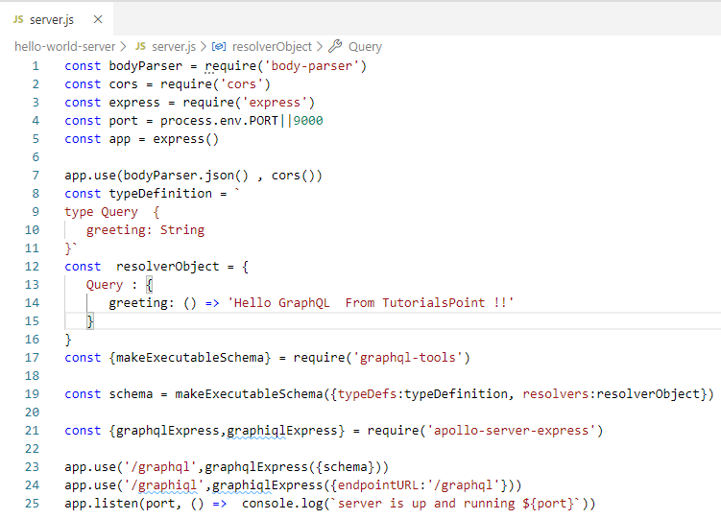
6 Example
https://www.tutorialspoint.com/graphql/graphql_example.htm
The complete code is as follow:

Slide 14
6 Example
https://www.tutorialspoint.com/graphql/graphql_example.htm
Step 6: Start the application.
> node server.js

Slide 15
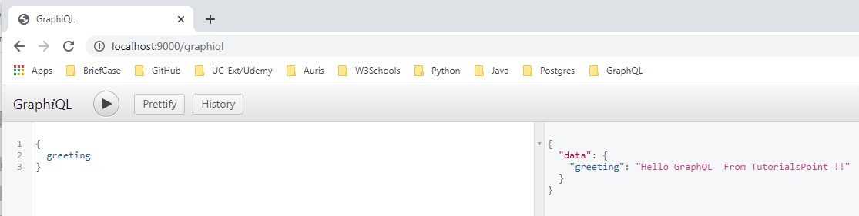
6 Example
https://www.tutorialspoint.com/graphql/graphql_example.htm
Open Chrome
> localhost:9000/graphiql
Enter:
> { Greeting }
Click “>” to run

Slide 16
End of Chapter

