Slide 1

10 Query Variable: Part 3
Peter H. Chen

Slide 2
10 Query Variable: Part 3
https://www.tutorialspoint.com/graphql/graphql_query.htm
What is Query Variable: Part 3
If a query has some dynamic values to be passed, then represent these dynamic values using variables. Hence, the query can be reused by the client applications.
Illustration
Let us create a simple application to understand the query variable.

Slide 3
10.1 Step 1

Slide 4
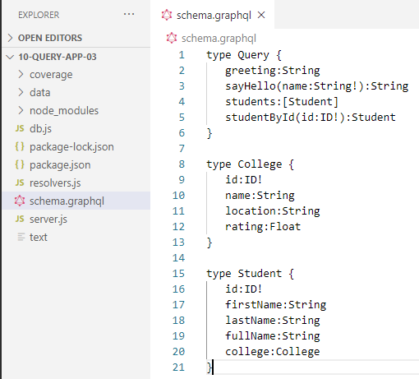
10.1 Step 1
https://www.tutorialspoint.com/graphql/graphql_query.htm
Step 1: Modify schema.graphql
Add a sayHello field which takes a string parameter and returns a string.
The name values will be dynamic in client application.

Slide 5
10.2 Step 2

Slide 6
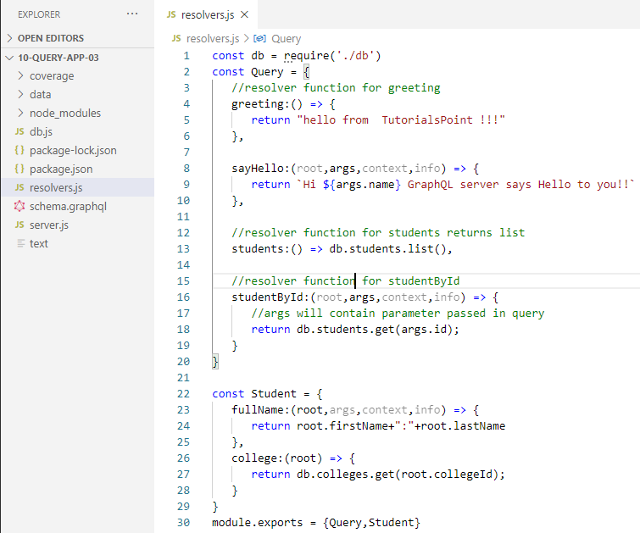
10.2 Step 2
https://www.tutorialspoint.com/graphql/graphql_query.htm
Step 2: Modify resolver.js
Add a sayHello resolver which takes parameter as below:

Slide 7
10.3 Step 3

Slide 8
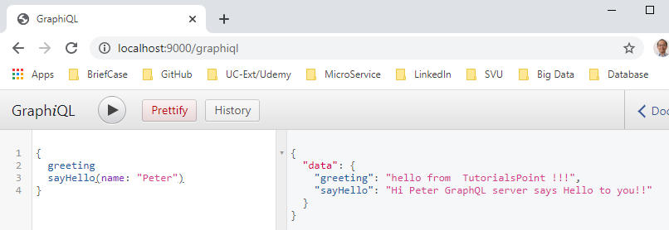
10.4 Run Application
https://www.tutorialspoint.com/graphql/graphql_query.htm
Step 4: Run Application
A variable is declared with $ followed by name of the variable. For example: $myname_Variable.
Once $myname_Variable is declared, it has to be used with a named query syntax.
The query, myQuery takes string value and passes it on to sayHello as shown below:

Slide 9
10.5 Run Application

Slide 10
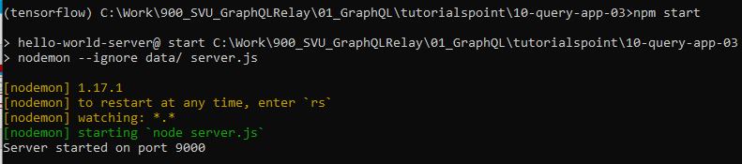
10.5 Run Application
https://www.tutorialspoint.com/graphql/graphql_query.htm
Step 5: Run Application
Open Anaconda prompt.
> cd [work directory]
> npm start

Slide 11
10.6 Verify

Slide 12
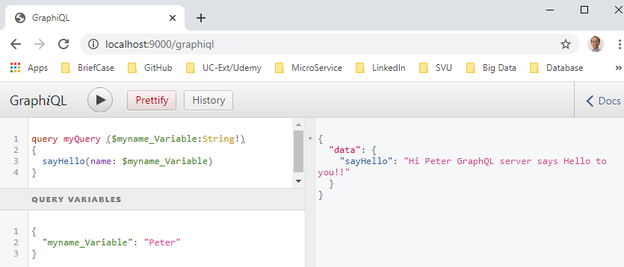
10.6 Verify
https://www.tutorialspoint.com/graphql/graphql_query.htm
Step 6: Verify
Open Chrome
In GraphQL Editor, type in: Query myQuery ($myname_Variable) { … }.
In Query Variables, define: { “myname_Variable” …}

Slide 13
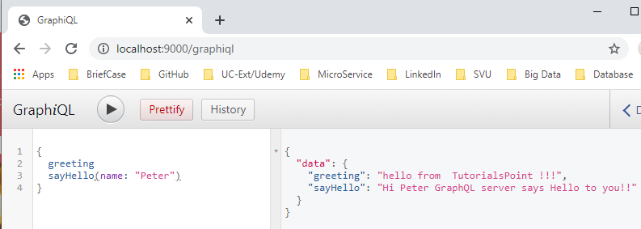
10.6 Verify
https://www.tutorialspoint.com/graphql/graphql_query.htm
Step 6: Verify
Open Chrome
Below is passing parameter without defining Query Variable.

Slide 14
End of Chapter

