Slide 1

12 Validation
Peter H. Chen

Slide 2
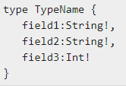
12 Validation
https://www.tutorialspoint.com/graphql/graphql_validation.htm
Validation
While adding or modifying data, it is important to validate the user input.
For example, we may need to ensure that the value of a field is always not null. We can use ! (non-nullable) type marker in GraphQL to perform such validation.
The syntax for using the ! type marker is as given below
The right syntax ensures that all the fields are not null.
If we want to implement additional rules like checking a string's length or checking if a number is within a given range, we can define custom validators.
The custom validation logic will be a part of the resolver function.
Let us understand this with the help of an example.
Illustration - Implementing Custom Validators
Let us create a signup form with basic validation. The form will have email, firstname and password fields

Slide 3
12.1 Step 1

Slide 4
12.1 Step 1
https://www.tutorialspoint.com/graphql/graphql_validation.htm
Step 1: Create 12-valiation project folder
Copy folder 03-setp to folder 12-validation (or follow step 3 to step 5 of03_Setup.pptx)

Slide 5
12.2 Step 2

Slide 6
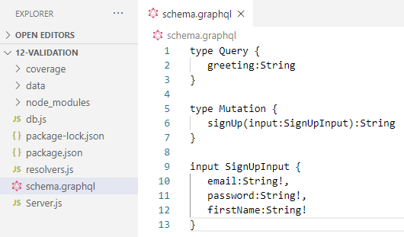
12.2 Step 2
https://www.tutorialspoint.com/graphql/graphql_validation.htm
Step 2: Create schema.graphql
Add schema.graphql file in the project folder validation-app and add the following code.
Note:
We can use the input type SignUpInput to reduce the number of parameters in signUp function.
So, signUp function takes only one parameter of type SignUpInput.

Slide 7
12.3 Step 3

Slide 8
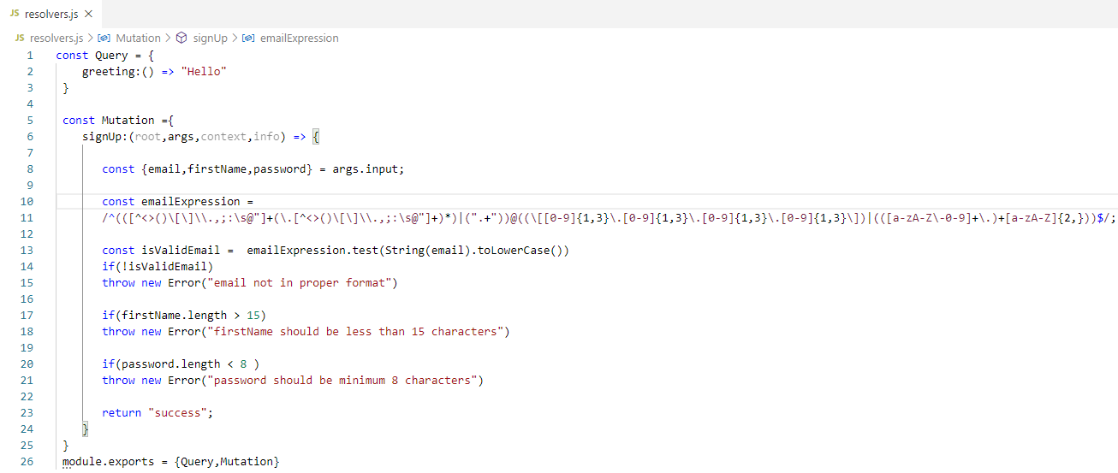
12.3 Step 3
https://www.tutorialspoint.com/graphql/graphql_validation.htm
Step 3: Create Resolver
Create a file resolvers.js in the project folder and add the following code.
The resolver function, signUp accepts parameters email, password and firstName. These will be passed through input variable so that it can be accessed through args.input

Slide 9
12.4 Step 4

Slide 10
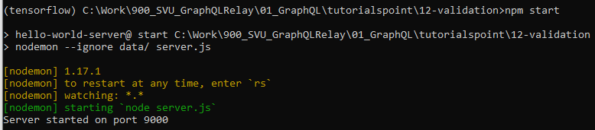
12.4 Step 4
https://www.tutorialspoint.com/graphql/graphql_validation.htm
Step 4: Run Application
> npm start

Slide 11
12.5 Verify

Slide 12
12.5 Verify
https://www.tutorialspoint.com/graphql/graphql_validation.htm
Verify
> localhost:9000/graphiql
Since input to signup function is a complex type, we need to use query variables in graphiql.

Slide 13
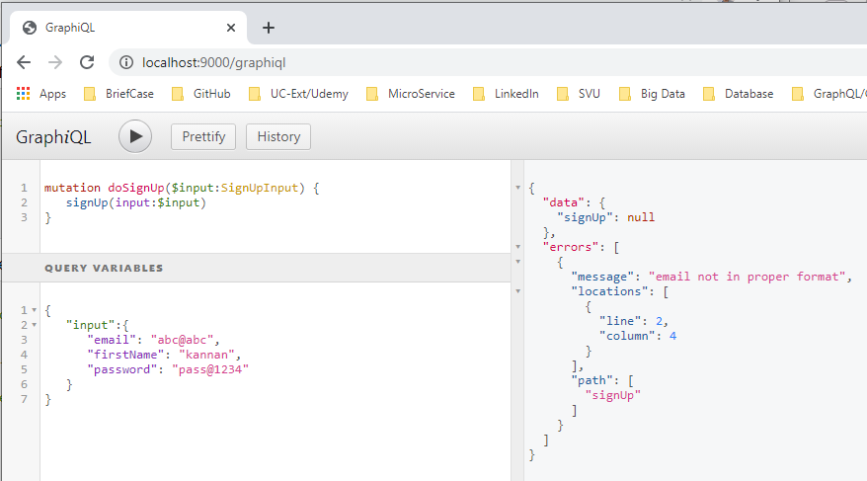
12.5 Verify
https://www.tutorialspoint.com/graphql/graphql_validation.htm
Verify
For this, we need to first give a name to the query and call it doSignUp, the $input is a query variable.
The following query variable must be entered in query variables tab of graphiql.
There is error messages.

Slide 14
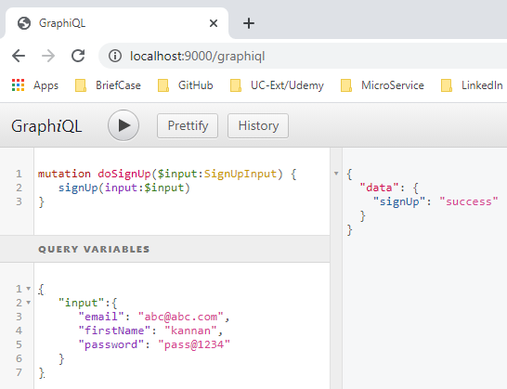
12.5 Verify
https://www.tutorialspoint.com/graphql/graphql_validation.htm
Verify
> localhost:9000/graphiql
Correct the input syntax and run again.

Slide 15
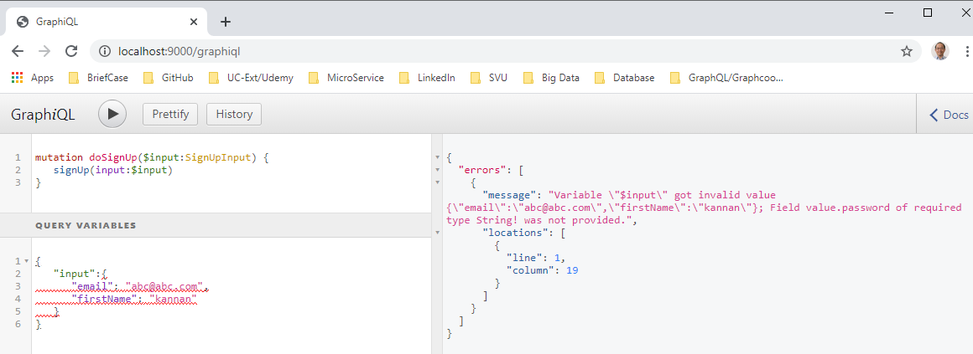
12.5 Verify
https://www.tutorialspoint.com/graphql/graphql_validation.htm
Verify
> localhost:9000/graphiql
Missing password.

Slide 16
End of Chapter

