Slide 1

10 Nested Query: Part 2
Peter H. Chen

Slide 2
10 Nested Query: Part 2
https://www.tutorialspoint.com/graphql/graphql_query.htm
Nested Query: Part 2
Let us create a nested query for fetching the student details and their college details.
We will work with the same project folder.

Slide 3
10.1 Step 1

Slide 4
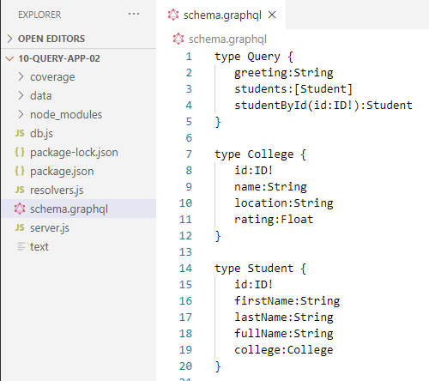
10.1 Step 1
https://www.tutorialspoint.com/graphql/graphql_query.htm
Step 1: Modify schema.graphql
The schema.graphql file already has the Type Student with defined fields.
Let us add a field college and define College type.

Slide 5
10.2 Step 2

Slide 6
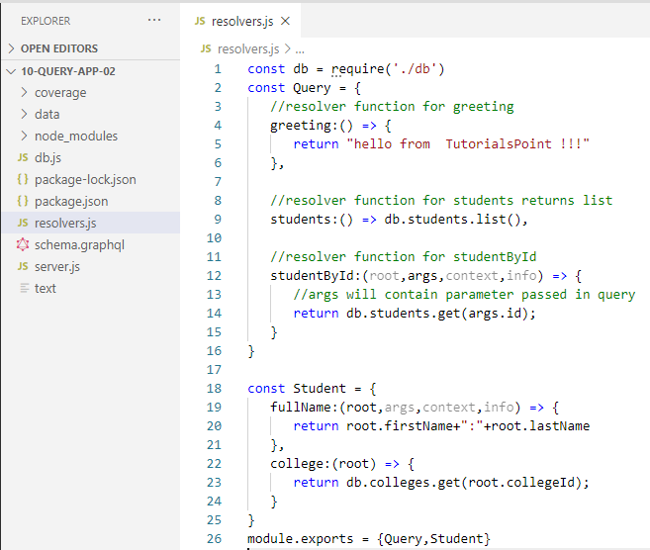
10.2 Step 2
https://www.tutorialspoint.com/graphql/graphql_query.htm
Step 2: Modify resolver.js
We need to add a college resolver function as below.
The college resolver function will be executed for each student object returned.
The root parameter of resolver in this case will contain student.
The resolver returns college of each student by calling the get method of college collection and passing the collegeId.
We have association relationship between Student and College through the collegeId.

Slide 7
10.3 Step 3

Slide 8
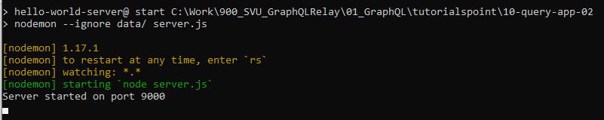
10.3 Step 3
https://www.tutorialspoint.com/graphql/graphql_query.htm
Step 3: Run Application
Anaconda prompt
> cd 10_query-app-02
> npm start

Slide 9
10.4 Verify

Slide 10
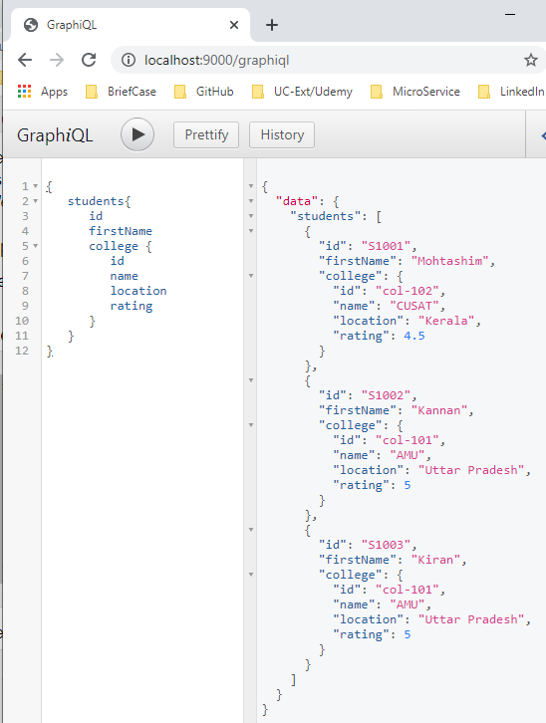
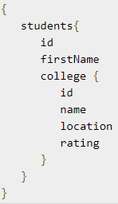
10.4 Verify
https://www.tutorialspoint.com/graphql/graphql_query.htm
Step 4: Verify
Open Chrome
> localhost:9000/graphiql
Type in below in the GraphQL Editor.
The Query results are displayed.

Slide 11
10.5 Summary

Slide 12
10.5 Summary
https://www.tutorialspoint.com/graphql/graphql_query.htm
Sumam5ry
We discussed the second example for Query Application.

Slide 13
End of Chapter

