Slide 1

15 Apollo Server
Peter H. Chen

Slide 2
15 Apollo Server
https://www.tutorialspoint.com/graphql/graphql_apollo_client.htm
Apollo Server is used to build graphql specification on server side.
Apollo Server is used to build production ready GraphQL server.
Apollo Client is the best way to use GraphQL to build client application.
Apollo client is used to help developer to build a UI that fetches data with GraphQL and can be used in JavaScript front-end.
Apollo Client supports JavaScript (React, Angular, Vue, Meteor, Ember), WebComponent (Polymer, lit-Apollo), and Native Mobile (Native Android with Java, Native IOS with Swift).
Caching is one of features of Apollo client. Apollo-boost is a convenience package which brings in a bunch of other dependencies.

Slide 3
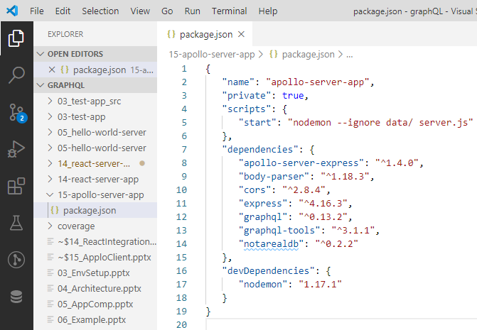
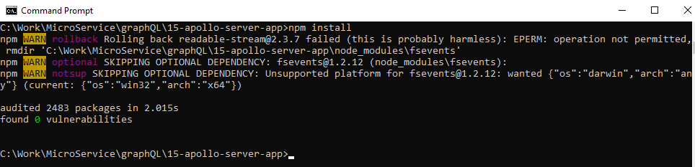
3 Environment Setup
https://www.tutorialspoint.com/graphql/graphql_environment_setup.htm
Environment Setup Step 3. Create package.json as follow and install the dependencies:
> npm install

Slide 4
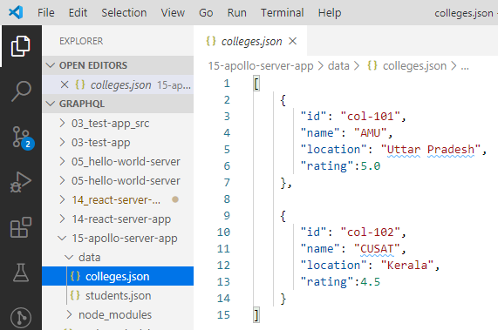
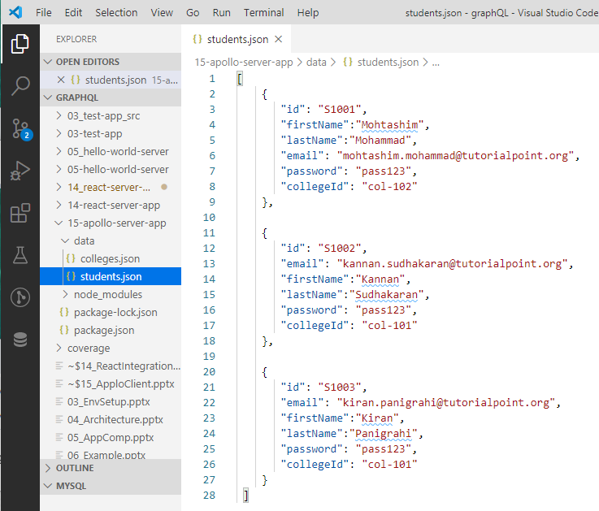
14 React Integration
https://www.tutorialspoint.com/graphql/graphql_react_integration.htm
Environment setup step 4 (Create Flat File Database in Data Folder).
> data/colleges.json
>data/students.json

Slide 5
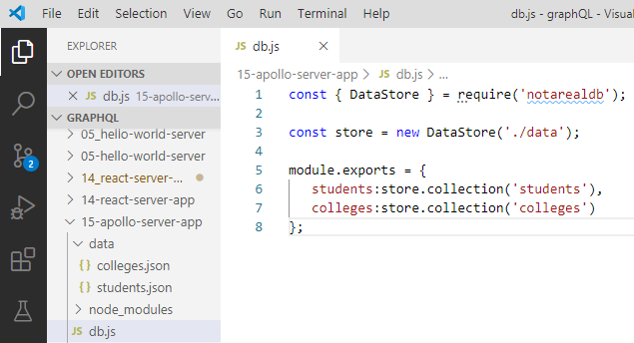
14 React Integration
https://www.tutorialspoint.com/graphql/graphql_react_integration.htm
Environment setup step 5 (Create Data Access Layer).
> db.js

Slide 6
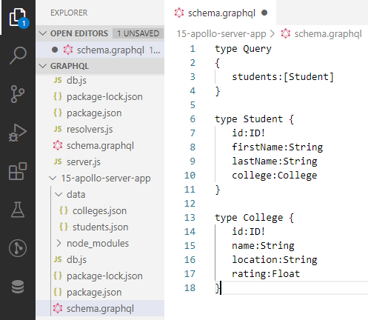
15 Apollo Server
https://www.tutorialspoint.com/graphql/graphql_apollo_client.htm
Setup Server
Step 2. Create a Schema:
Create scehma.graphql file in folder 15-apollo-server-app as follow:

Slide 7
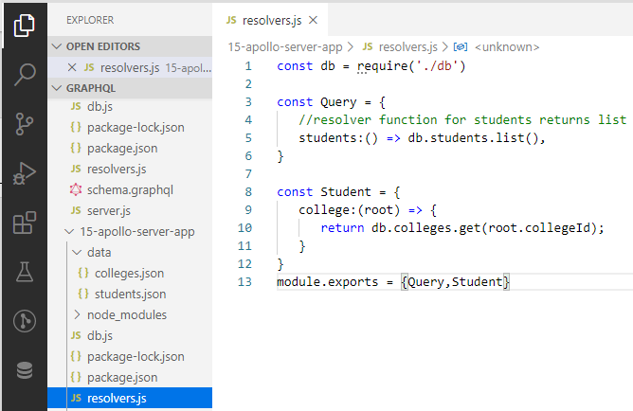
15 Apollo Server
https://www.tutorialspoint.com/graphql/graphql_apollo_client.htm
Setup Server
Step 3. Create a Resolver:
Create resolver.js file in folder 15-apollo-server-app as follow:

Slide 8
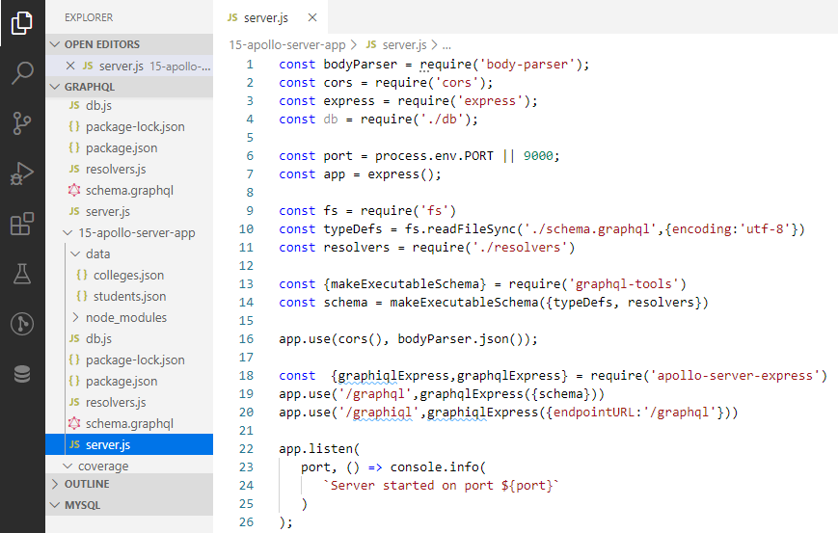
15 Apollo Server
https://www.tutorialspoint.com/graphql/graphql_apollo_client.htm
Setup Server
Step 4. Run Application
Create a server.js file. Refer Environment Setup (Step 8).

Slide 9
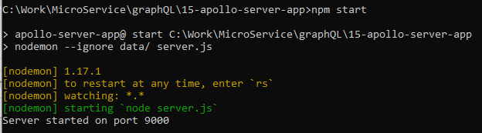
15 Apollo Server
https://www.tutorialspoint.com/graphql/graphql_apollo_client.htm
Setup Server
Step 4. Run Application
Open Command Prompt terminal.
> npm start
GraphQL run on port 9000.

Slide 10
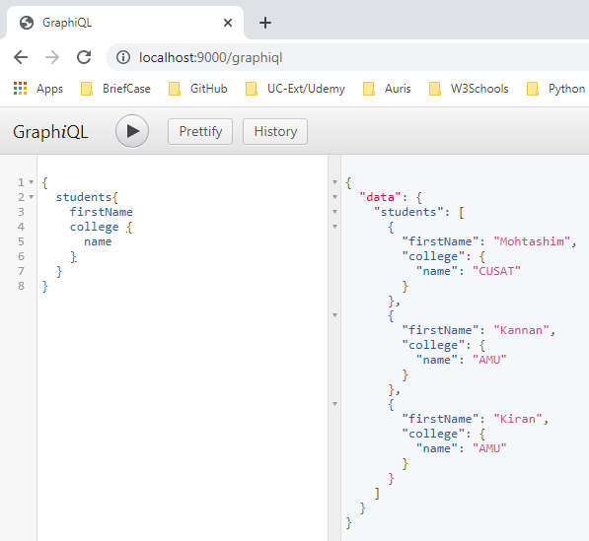
15 Apollo Server
https://www.tutorialspoint.com/graphql/graphql_apollo_client.htm
Setup Server
Step 4. Run Application
Open Chrome
> localhost:9000/graphiql
Enter
> {
> students {
> firstName
> college {
> name
> }
> }
> }
Click (>) Run

Slide 11
15.1 Setup Client

Slide 12
15.1 Setup Client
https://www.tutorialspoint.com/graphql/graphql_apollo_client.htm
The Apollo server terminal should be kept on running on port 9000 before executing the client application.
Open another new terminal.
React application will be running on port 3000.

Slide 13
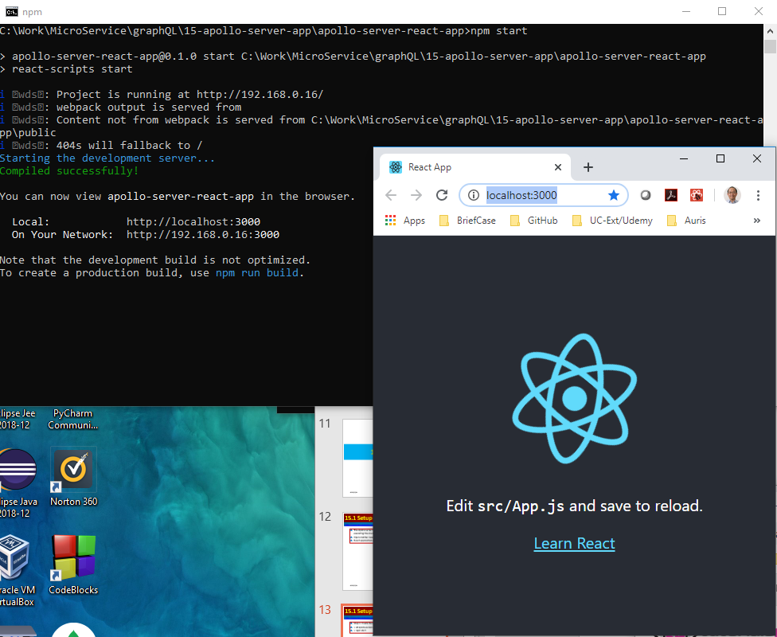
15.1 Setup Client
https://www.tutorialspoint.com/graphql/graphql_apollo_client.htm
Step 2. Start apollo-server-react-app
> cd apollo-server-react-app
> npm start

Slide 14
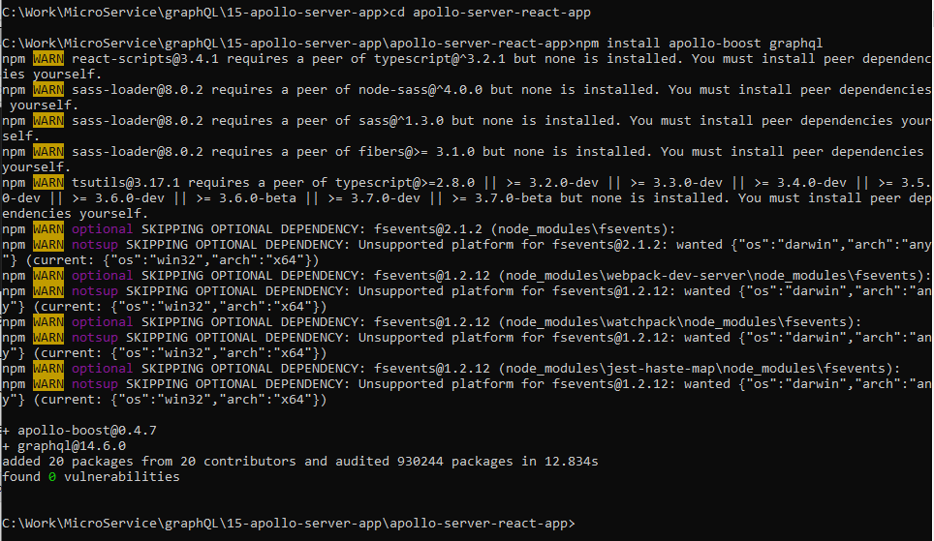
15.1 Setup Client
https://www.tutorialspoint.com/graphql/graphql_apollo_client.htm
Step 3. Install Apollo Client Libraries:
Open a new terminal
> cd apollo-server-react-app
> npm install apollo-boost graphql

Slide 15
15.1 Setup Client
https://www.tutorialspoint.com/graphql/graphql_apollo_client.htm
Step 4. Modify App Component in index.js File
With Apollo Client, we directly call server without use of fetch API.
The queries are mutation should be embedded in a string made with back tick notation.
The gql function directly parse the queries. A programmer can directly write queries in the same way when writing queries in GraphiQL tool. The gel is a tage function which parse the template string written in back tick notation to gra[hql query object.
The Apollo client query method returns a promise.

Slide 16
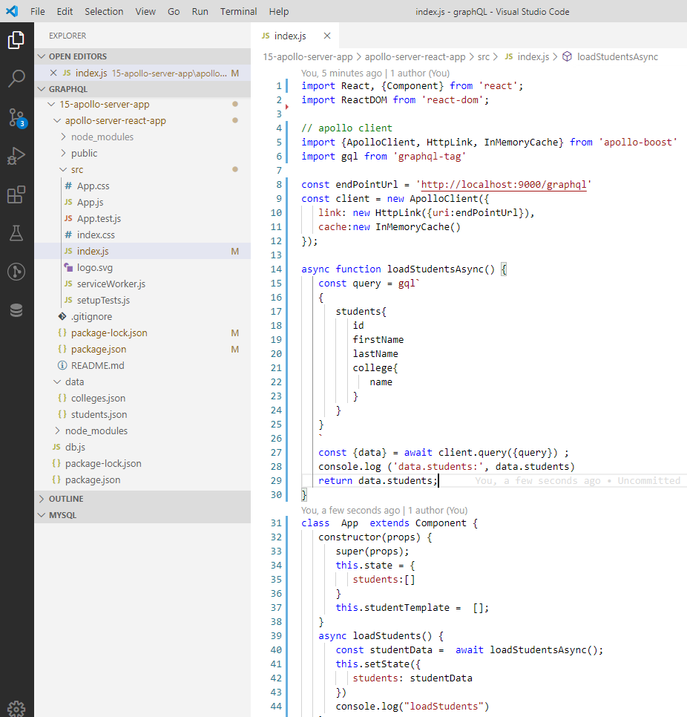
15.1 Setup Client
https://www.tutorialspoint.com/graphql/graphql_apollo_client.htm
Step 4. Modify App Component in index.js File
The index.js file is as follow.
Import Apollo Client
Use gql to fetch API for HTTP request.
1
2

Slide 17
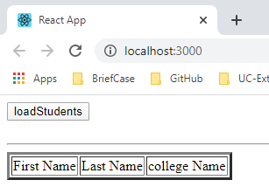
15.1 Setup Client
https://www.tutorialspoint.com/graphql/graphql_apollo_client.htm
Note: We do not use App.js.
The Component App in in the index.js.
Open terminal
> cd apollo-server-react-app
> npm start

Slide 18
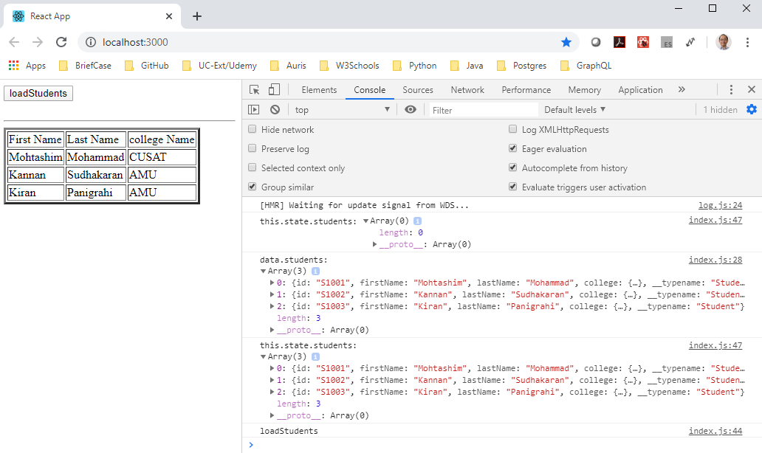
15.1 Setup Client
https://www.tutorialspoint.com/graphql/graphql_apollo_client.htm
Click button “loadStudents” to load the data from database.

Slide 19
End of Chapter

