Slide 1

11 Mutation: Part 1
Peter H. Chen

Slide 2

11 Mutation: Part 1
https://www.tutorialspoint.com/graphql/graphql_mutation.htm
Mutation: Part 1
We discuss mutation queries in GraphQL.
Mutation queries modify data in the data store and returns a value. It can be used to insert, update, or delete data.
Mutations are defined as a part of the schema.
The syntax of a mutation query is given below.
Illustration
Let us understand how to add new student record into the datastore using a mutation query.

Slide 3
11.1 Step 1

Slide 4
11.1 Step 1
https://www.tutorialspoint.com/graphql/graphql_mutation.htm
Step 1: Install Required Dependencies for the Project
Copy 10-query-app01 to 11-mutation-app (or Follow steps 3 to 5 explained in the Setup.pptx).

Slide 5
11.2 Step 2

Slide 6
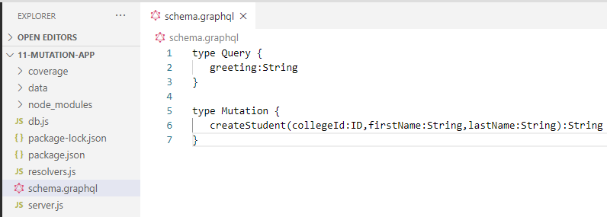
11.2 Step 2
https://www.tutorialspoint.com/graphql/graphql_mutation.htm
Step 2: Create a schema.graphql File
Add schema.graphql file in the project folder mutation-app and add the following code
Note:
The function createStudent returns a String type.
This is a unique identifier (ID) which is generated after creating a student

Slide 7
11.3 Step 3

Slide 8
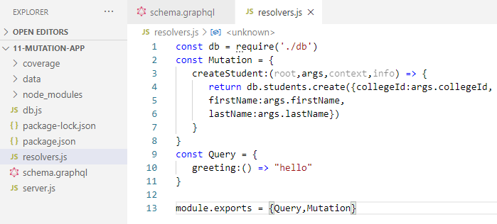
11.3 Step 3
https://www.tutorialspoint.com/graphql/graphql_mutation.htm
Step 3: Create a resolver.js File
Create a file resolvers.js in the project folder and add the following code.
The mutation function points to students collection in the datastore.
To add a new student, invoke the create method in students collection.
The args object will contain the parameters which are passed in the query.
The create method of students collection will return the id of a newly created student object.

Slide 9
11.3 Step 3

Slide 10
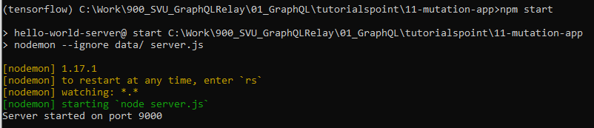
11.4 Step 4
https://www.tutorialspoint.com/graphql/graphql_mutation.htm
Step 4: Run Application
Create Servers.js as described in 03_Setup.pptx.
> npm start

Slide 11
11.4 Verify

Slide 12
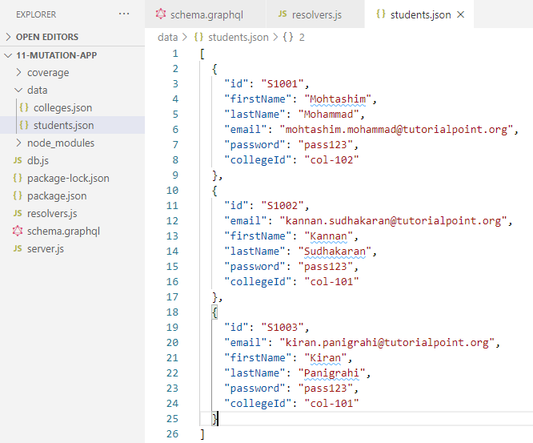
11.4 Verify
https://www.tutorialspoint.com/graphql/graphql_mutation.htm
Step 4: Verify
The original Students.json is as below.

Slide 13
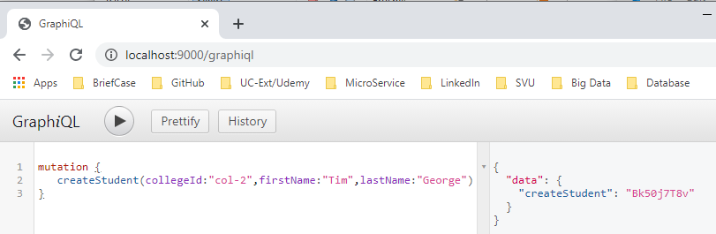
11.4 Verify
https://www.tutorialspoint.com/graphql/graphql_mutation.htm
Step 4: Verify
We run the GraphiQL editor with mutation { … }

Slide 14
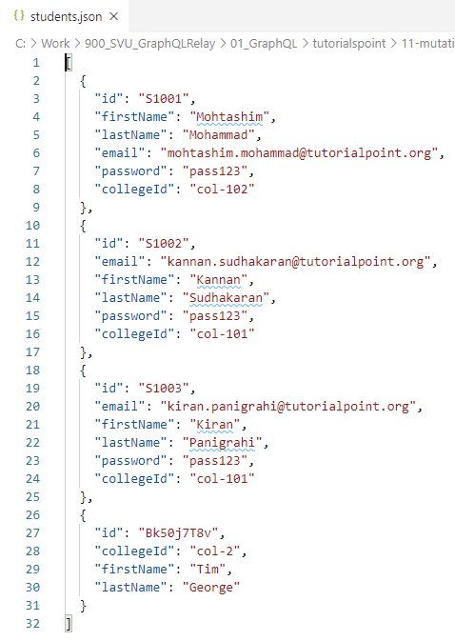
11.4 Verify
https://www.tutorialspoint.com/graphql/graphql_mutation.htm
Step 4: Verify
The collegeId: “col-2”, firstName: “Tim”, and lastName: “George” are added into students.json.

Slide 15
11.5 Summary

Slide 16
11.5 Summary
https://www.tutorialspoint.com/graphql/graphql_mutation.htm
Step 5: Summary
We discussed Mutation.
It is used to create the data for database.

Slide 17
End of Chapter

