Slide 1

11 Verify Mutation: Part 2
Peter H. Chen

Slide 2
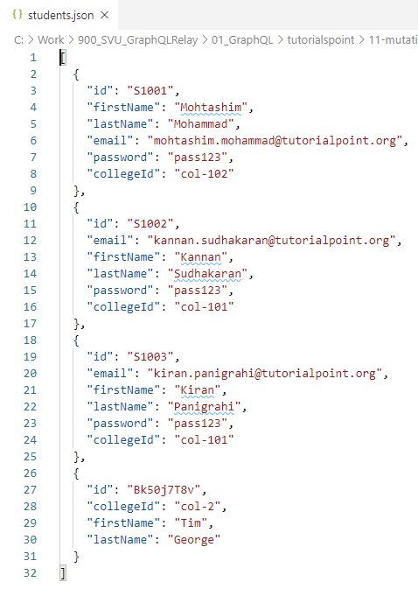
11 Verify Mutation: Part 2
https://www.tutorialspoint.com/graphql/graphql_mutation.htm
Verify Mutation: Part 2
To verify if the student object is created, we can use the studentById query.
You can also open the students.json file from data folder to verify the id.
The ID is “BK50j7T8v” for “Tim George”.

Slide 3
11.1 Step 1

Slide 4
11.1 Step 1
https://www.tutorialspoint.com/graphql/graphql_mutation.htm
Step 1: Install Required Dependencies for the Project
Copy 10-query-app01 to 11-mutation-app02 (or Follow steps 3 to 5 explained in the Setup.pptx).

Slide 5
11.2 Step 2

Slide 6
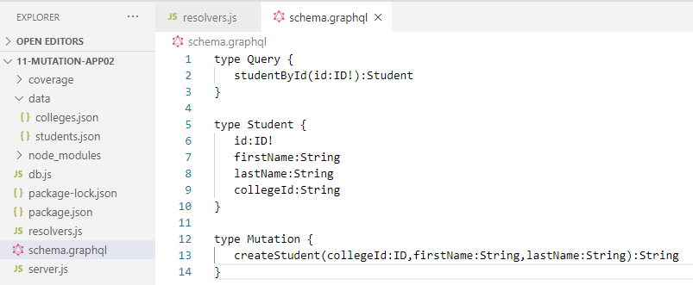
11.2 Step 2
https://www.tutorialspoint.com/graphql/graphql_mutation.htm
Step 2: Create schema.graphql
To use studentById query, edit the schema.graphql as given below

Slide 7
11.3 Step 3

Slide 8
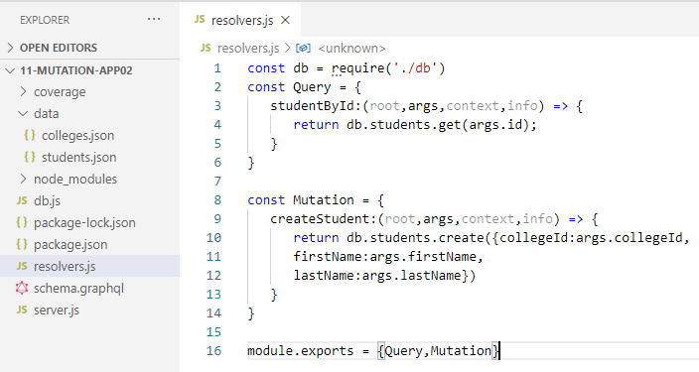
11.3 Step 3
https://www.tutorialspoint.com/graphql/graphql_mutation.htm
Step 3: Modify resolver.js file as given below

Slide 9
11.4 Run Application

Slide 10
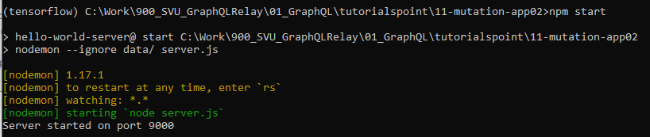
11.4 Run Application
https://www.tutorialspoint.com/graphql/graphql_mutation.htm
Step 4: Run Application

Slide 11
11.5 Verify

Slide 12
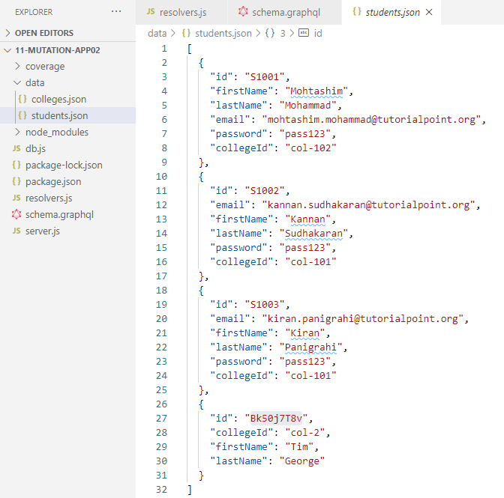
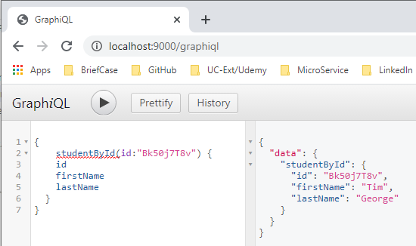
11.5 Verify
https://www.tutorialspoint.com/graphql/graphql_mutation.htm
Step 5: Verify

Slide 13
End of Chapter

