Slide 1

3 Environment Setup
Peter H. Chen

Slide 2
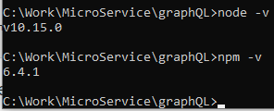
3 Environment Setup
https://www.tutorialspoint.com/graphql/graphql_environment_setup.htm
Build GraphQL on Windows:
1. Verify Node and npm Versions

Slide 3
3 Environment Setup
https://www.tutorialspoint.com/graphql/graphql_environment_setup.htm
2. Create a Project Folder and Open in VS Code
> mkdir test-app
> cd test-app
> code .

Slide 4
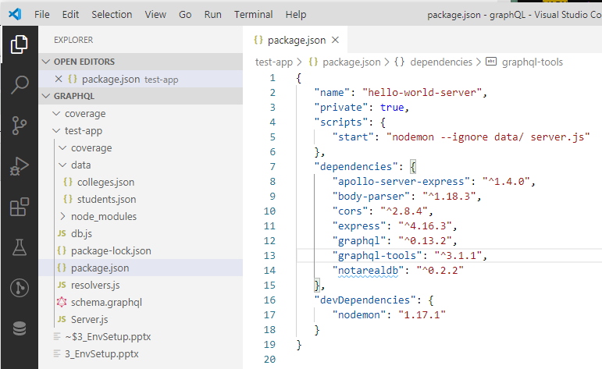
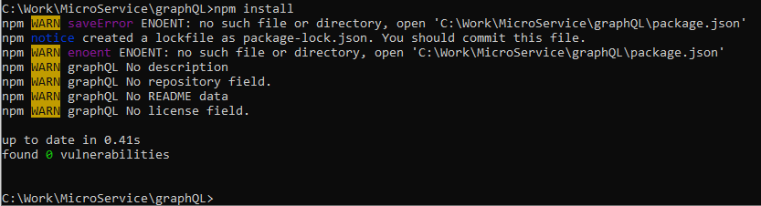
3 Environment Setup
https://www.tutorialspoint.com/graphql/graphql_environment_setup.htm
3. Create package.json as follow and install the dependencies:
> npm install

Slide 5
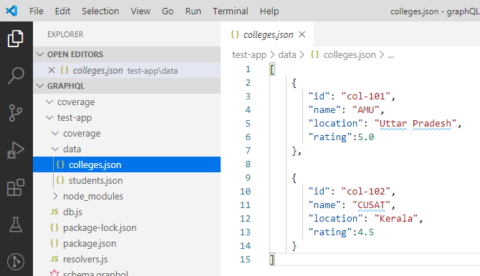
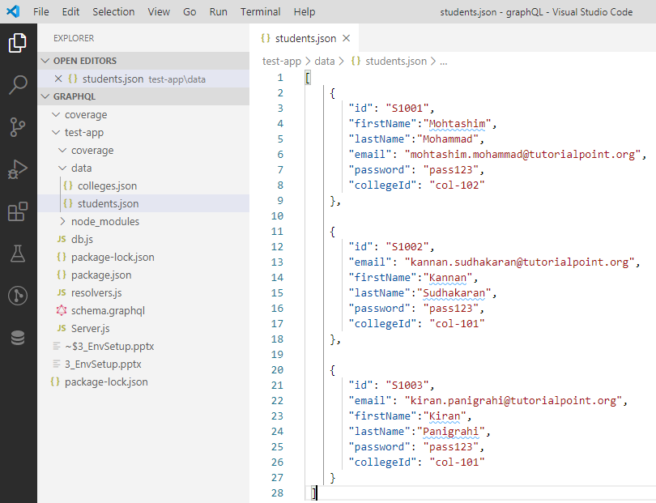
3 Environment Setup
https://www.tutorialspoint.com/graphql/graphql_environment_setup.htm
4. Create Flat File Database in Data Folder
Create a folder data and add two files students.json and colleges.json

Slide 6
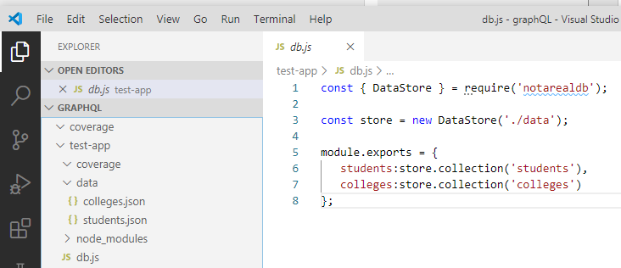
3 Environment Setup
https://www.tutorialspoint.com/graphql/graphql_environment_setup.htm
5. Create Data Access Layer
We create a datastore that loads the data folder contents. We need collection variables, students and colleges. Whenever the application needs data, it makes use of these collection variables.
> npm install notarealdb

Slide 7
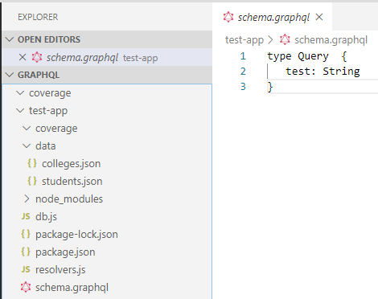
3 Environment Setup
https://www.tutorialspoint.com/graphql/graphql_environment_setup.htm
6. Create Schema File, schema.graphql
Create a schema file in the current project folder:

Slide 8
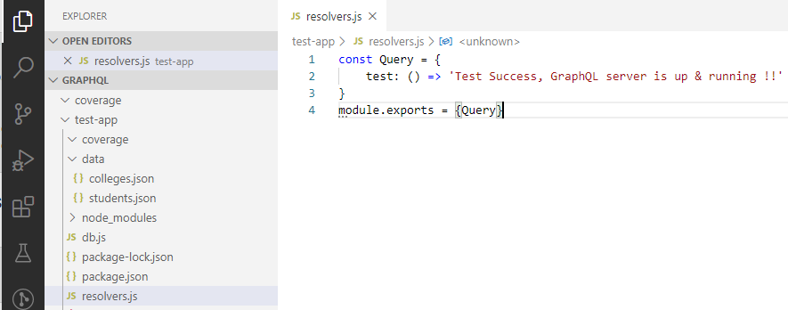
3 Environment Setup
https://www.tutorialspoint.com/graphql/graphql_environment_setup.htm
7. Create a resolver file: resolvers.js.

Slide 9
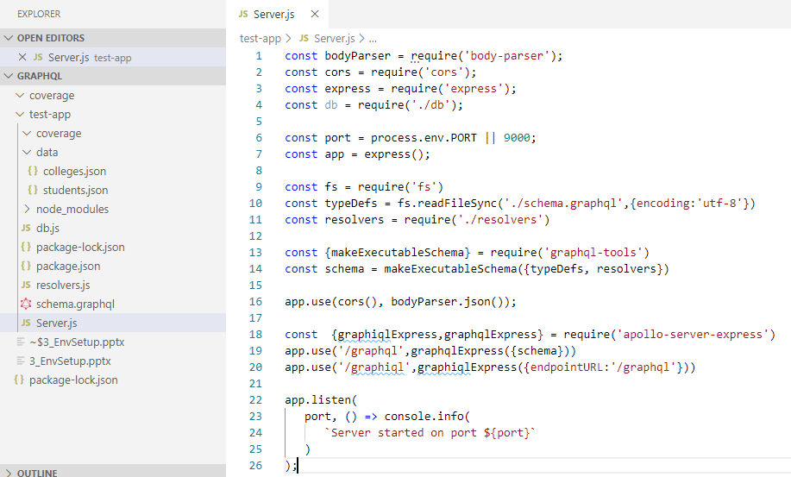
3 Environment Setup
https://www.tutorialspoint.com/graphql/graphql_environment_setup.htm
8. Create Server.js and Configure GraphQL.

Slide 10
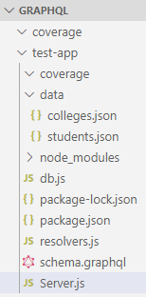
3 Environment Setup
https://www.tutorialspoint.com/graphql/graphql_environment_setup.htm
9. Verify folder and Run application
Folder structure:
> test-app
> data
students.json
colleges.json
db.js
resolvers.js
schema.graphql
Server.js

Slide 11
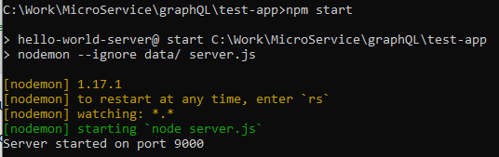
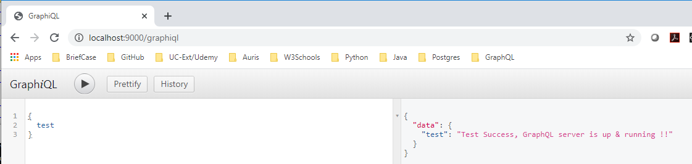
3 Environment Setup
https://www.tutorialspoint.com/graphql/graphql_environment_setup.htm
Run on the command line:
> npm start
Open chrome.
> localhost:9000/graphiql
Type “{ test}” and click “>” to run

Slide 12
End of Chapter

