Slide 1

4 Architecture
Peter H. Chen

Slide 2
4 Architecture
https://www.tutorialspoint.com/graphql/graphql_environment_setup.htm
GraphQL is a specification that describes the behavior of a GraphcQL server.
It is a set of guidelines on how requests and responses should handled like supported protocols.
The request is made by the client to graphQL server is called a Query.
Another important concept of GraphQL is its transport layer agnostics (unknown).
It can be used any available network protocol like TCP, websocket or any other transport layer protocol. It is neutral to databases. You can use it with relational or NoSQL database.
GraphQL Server can be deployed by using any of three methods:
GraphQL server with connected database
GraphQL Server that integrate existing systems
Hybrid approach

Slide 3
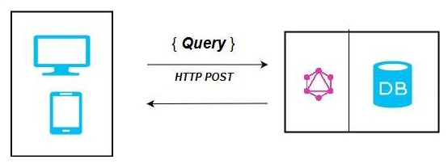
4 Architecture
https://www.tutorialspoint.com/graphql/graphql_environment_setup.htm
GraphQL Server with Connected Database

Slide 4
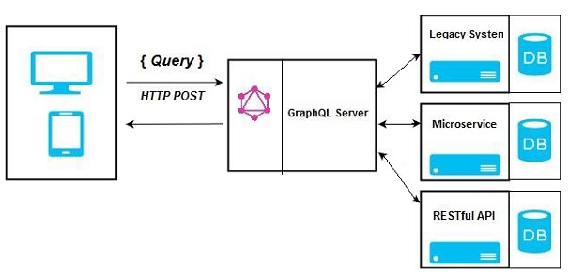
4 Architecture
https://www.tutorialspoint.com/graphql/graphql_environment_setup.htm
GraphQL Server Integrating with Existing Database

Slide 5
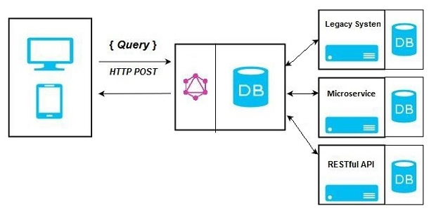
4 Architecture
https://www.tutorialspoint.com/graphql/graphql_environment_setup.htm
Hybrid Approach

Slide 6
End of Chapter

