Slide 1

5 Application Components
Peter H. Chen

Slide 2
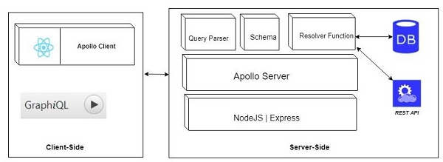
5 Application Components
https://www.tutorialspoint.com/graphql/graphql_environment_setup.htm
Application Components includes:
Server-Side Component: Schema, Query, Resolver
Client-Side Component: GraphiQL, ApploCLient

Slide 3
End of Chapter

